Slide 1
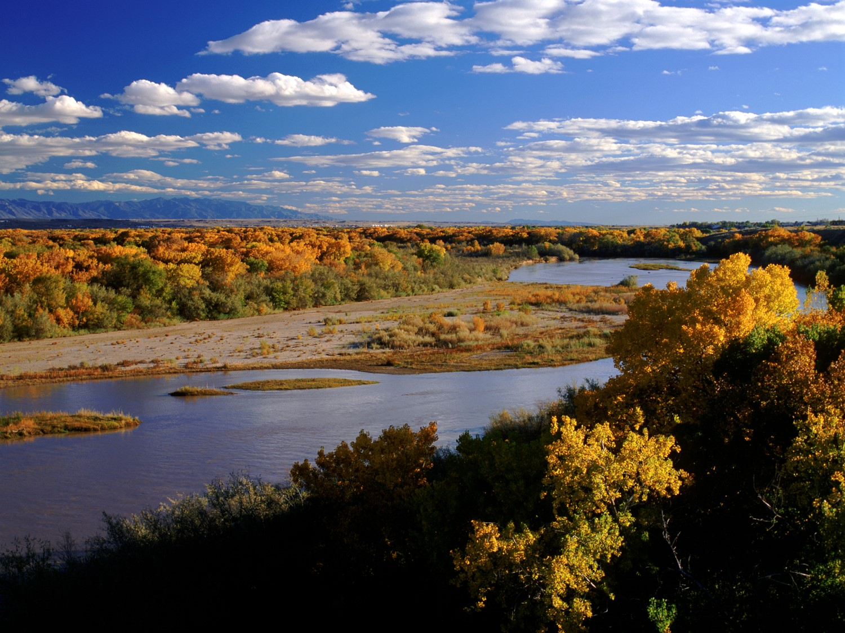

New Mexico’s 50-Year Water Security Plan
NMSU State of the Science Symposium
Tanya Trujillo, Deputy State Engineer
Jonas Armstrong, Water Protection Division Director
August 26, 2025

Slide 2
50-Year Water Security
Why does NM need this?
Vision for Water Security: Long-term goals and guiding principles for sustainable water management
Governor’s Strategic Framework Key strategies: conservation, innovation, equity, and resilience
Stakeholder Engagement & Collaboration Role of communities, tribes, agencies, and private sector partners
Implementation Timeline: over 5, 10, and 50 years

Slide 3
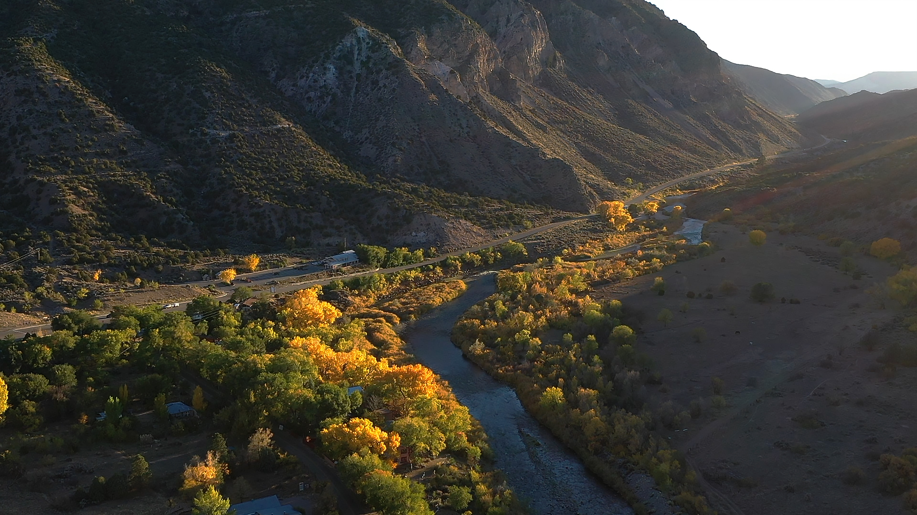
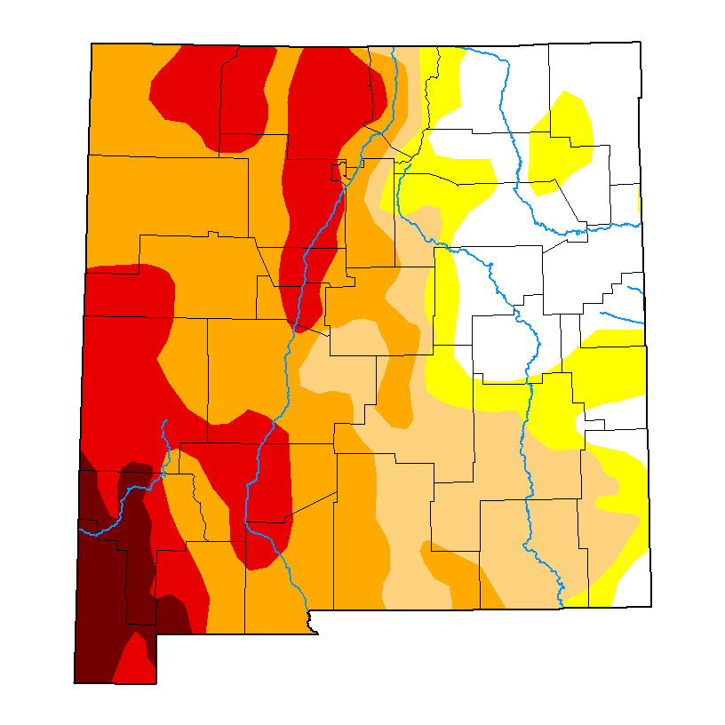
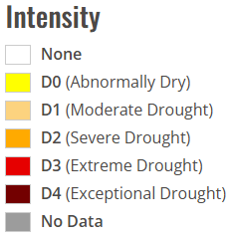
Drought Persists in New Mexico
  > 80% of New Mexico still in drought conditions
  Trending hotter, drier future – up to 25% water
  Emergency response collaborations with other agencies & local communities for fires, post-fire runoff/relief
US Drought Monitor
August 21, 2025
3

Slide 4
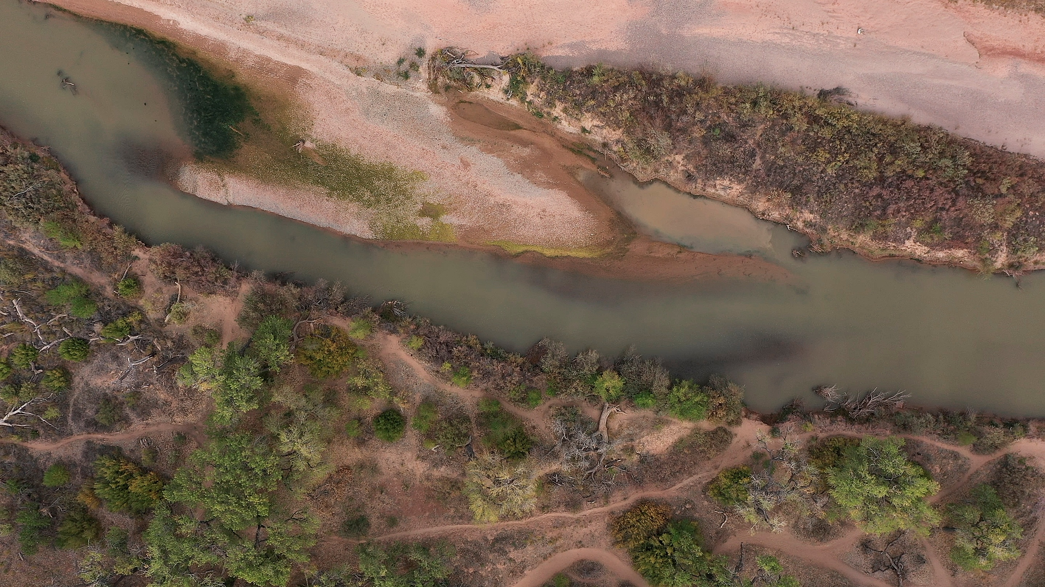
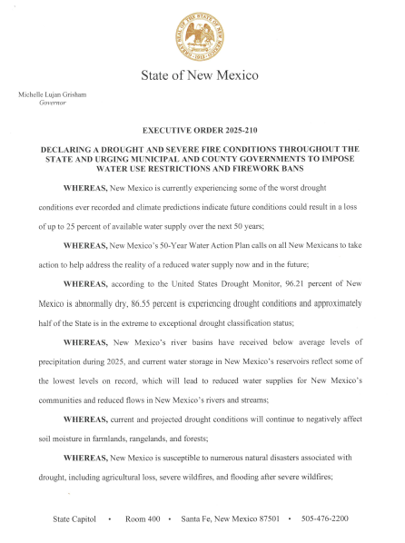
Governor’s Executive Order
  Executive Order 2025-210
    Issued May 22, 2025
    Confirmed drought & wildfire risks
  Drought Task Force
    Convened May 28, 2025
    Met June 27 & July 22 to review drought response resources
    Goal: comp. & supp. ongoing measures to manage water and address drought
    Preparing report for Gov. with recommendations
Notes:
Issued May 22, 2025
Confirmed drought & wildfire risks
Drought Task Force
Convened May 28, 2025
Met June 27 and July 22 to review available drought response resources
Goal to complement and support ongoing measures to manage water and address drought for our communities
Preparing report for Gov. with recommendations

Slide 5
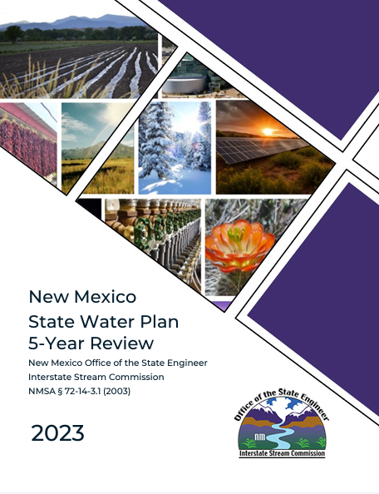
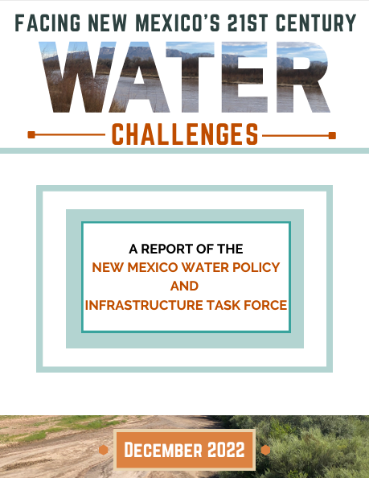
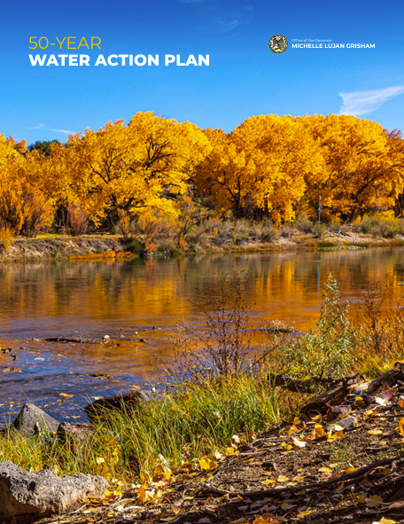
  2022 Water Policy & Infrastructure Task Force
  17 Recommendations
  106 strategies
  Multi-year phased implementation
  2023 State Water Plan Review
  Updates 2018 Plan
  Recommends investing in revitalized regional water planning
  2024 Governor’s 50-Year Water Action Plan
  Water conservation
  New water supplies
  Water & watershed protection
Notes:
Hannah

Slide 6
Water Conservation
• A1 Education program development
•A2 Incentivize agricultural water conservation
•A3 Reduce leaks in drinking water infrastructure/ increase municipal conservation
•A4 Improve water storage and delivery systems
New Water Supplies
•B1 Strategic Water Supply to develop treated brackish water (initial $40M appropriation)
•B2 Adopt policies to expand potable and non-potable water reuse
•B3 Improve groundwater mapping and monitoring
Water and Watershed Protection
•C1 Clean up contaminated groundwater sites
•C2 Develop a surface water discharge permitting program
•C3 Modernize wastewater treatment plants & stormwater infrastructure
•C4 Protect & restore watersheds
Notes:
Water Conservation
•A1 Develop a water education program
•A2 Incentivize agricultural water conservation
•A3 Reduce leaks in drinking water infrastructure/ increase municipal conservation
•A4 Improve water storage and delivery systems
New Water Supplies
•B1 Strategic Water Supply to develop treated brackish water (initial $40M appropriation)
•B2 Adopt policies to expand potable and non-potable water reuse
•B3 Improve groundwater mapping and monitoring
Water and Watershed Protection
•C1 Clean up contaminated groundwater sites
•C2 Develop a surface water discharge permitting program
•C3 Modernize wastewater treatment plants and stormwater infrastructure
•C4 Protect and restore watersheds

Slide 7
Forward Progress: Water Wins in 2025
Legislative Session (BUDGET - $393M)
Conservation & Infrastructure ($272M)
  $200M – water project fund
  $25M – Indian water rights settlements
  $15M – Rural Infrastructure Program Fund
  $6M – water planning and education
  $5M –ag water conservation projects
New Sources ($57.5M)
$40M strategic water supply
$8M brackish water tech, research & NMSU lab
$7.5M aquifer monitoring and mapping
$2M water data act
Protection & Restoration ($63.7M)
  $20M – clean up contaminated sites
  $20M – forest management and restoration
  $15M – natural resources damage assessments & restoration
  $5.7M – Superfund sites
  $3M –address PFAS contamination
Amounts on this slide are new nonrecurring appropriations in House Bill 2 (2025).
Not included: recurring agency funding, capital outlay bill, and Public Project Revolving Fund appropriations.

Slide 8
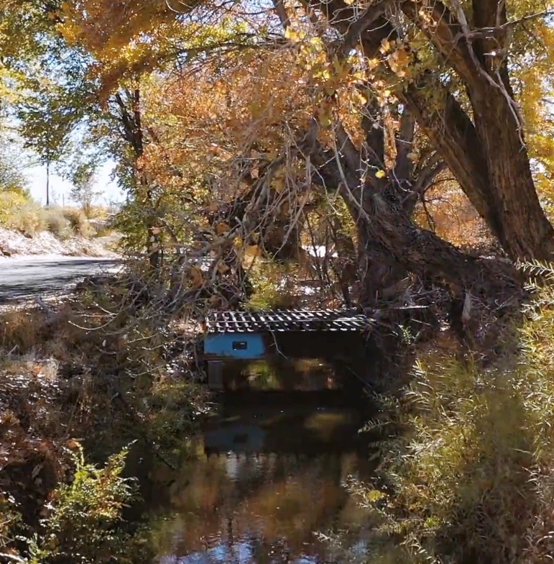
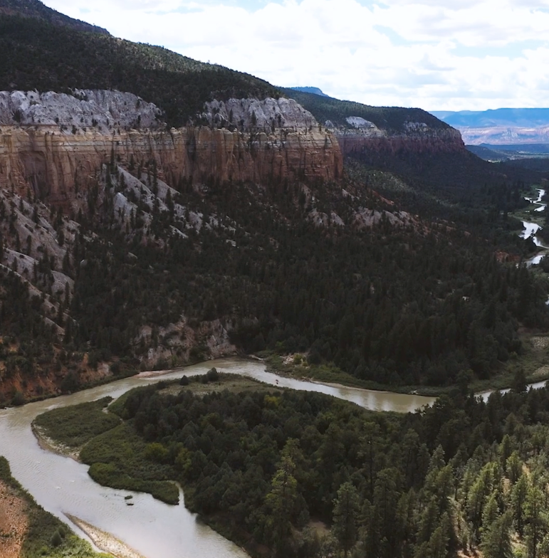
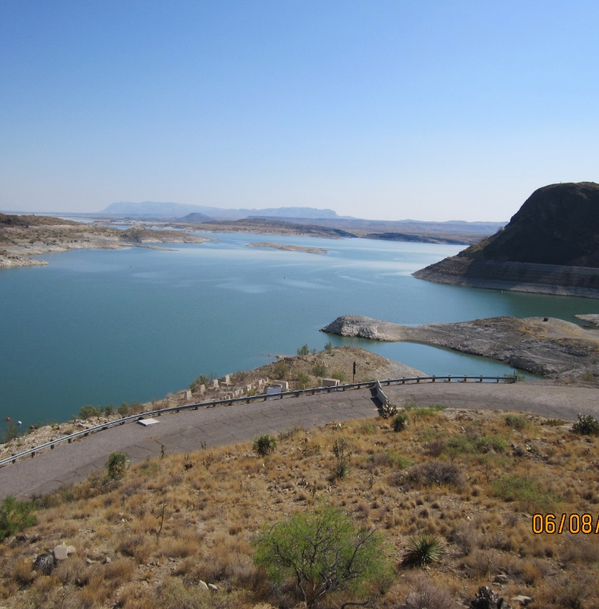
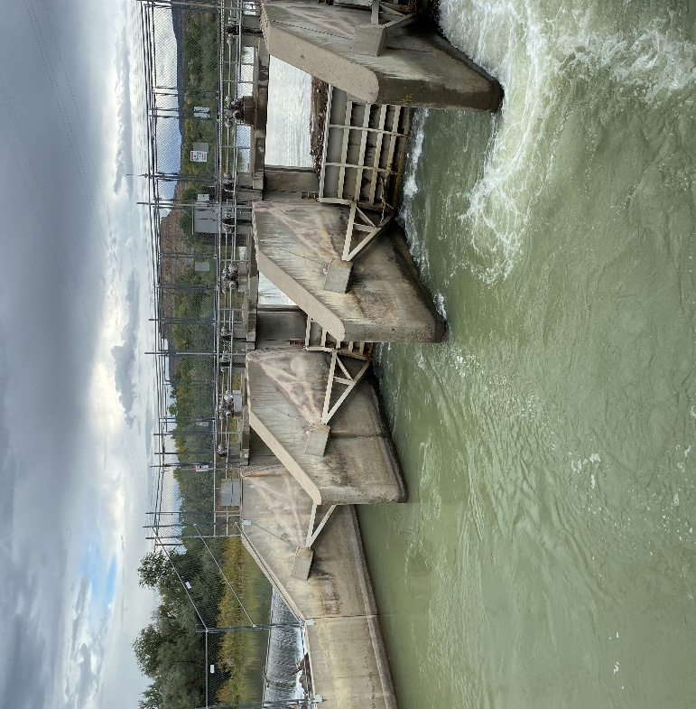
Water Security Planning Act
Implementation
Early 2023
2024
2025 - 2028
2029 - Beyond
Passage of the Water Security Planning Act
Public & Tribal Input
Create Water Security Tribal Advisory Council (WSTAC)
Finalize Rules and Guidelines Based on Input & Initiate Regional Planning
WSTAC Ongoing
Iterative, Staggered Regional Water Planning
WSTAC Ongoing
8
Notes:
Actions happening in the next year:
NMISC Rule Promulgation and Guideline Adoption
Proposed rule introduced to commission July 17
Public comment period through September 27
Public hearing October 17
Following the hearing, the commission will deliberate and adopt, amend, or reject the proposed rule
Water Security Planning Tribal Advisory Council Support
Initial Planning Period for Regional Councils
Developing Tools and Templates for Planning
Supporting the Accuracy and Accessibility of Best Available Science

Slide 9

50 Year Water Action Plan
NMED lead agency on 6 of 11 Action Plan priorities
50 Year Water Action Plan
Reduce
Leaks
(A3)
Strategic Water Supply (B1)
Water Reuse Rules
(B2)
Cleanup Groundwater (C1)
Surface Water Permitting (C2)
Aging Water Infrastructure
(C3)
9
Notes:
A3 = Asterra
B1 = SWS; grant application form and RFP going out on 8/25
B2 = WATR Alliance petition to WQCC is pending
C1 = SB21 and neglected contaminated sites fund/funding; 25+ sites set for cleanup
C2 = SB21 and draft rules going out late August or early September for a petition to WQCC in December
C3 = NMED funding programs; just executed $150M loan with City of Santa Fe to address Clean Water Act violations; in FY25, invested $70M in water infrastructure and initiated 148 new projects

Slide 10
50 Year Water Action Plan
50 Year Water Action Plan
Reduce
Leaks
(A3)
Strategic Water Supply (B1)
Water Reuse Rules
(B2)
Cleanup Groundwater (C1)
Surface Water Permitting (C2)
Aging Water Infrastructure
(C3)
Spotlight: Reduce Leaks
In 2025, used ASTERRA satellite technology to locate underground leaks in FIVE communities
Water savings from these communities:
  241.8 gals per minute
  348,200 gals per day
  127.8 M gals per year
Cost: $283,317
Equals water in about 200 Olympic-sized swimming pools
10
Notes:
A3 = Asterra
B1 = SWS; grant application form and RFP going out on 8/25
B2 = WATR Alliance petition to WQCC is pending
C1 = SB21 and neglected contaminated sites fund/funding; 25+ sites set for cleanup
C2 = SB21 and draft rules going out late August or early September for a petition to WQCC in December
C3 = NMED funding programs; just executed $150M loan with City of Santa Fe to address Clean Water Act violations; in FY25, invested $70M in water infrastructure and initiated 148 new projects
Equals THE AMOUNT OF WATER water in about 200 Olympic-sized swimming pools

Slide 11
50 Year Water Action Plan
50 Year Water Action Plan
Reduce
Leaks
(A3)
Strategic Water Supply (B1)
Water Reuse Rules
(B2)
Cleanup Groundwater (C1)
Surface Water Permitting (C2)
Aging Water Infrastructure
(C3)
Spotlight: Strategic Water Supply
Treat brackish water to provide new water supplies
Provide new water for community uses
Protect and preserve freshwater resources
Promote robust local economies
$40 million appropriated for grants and contracts
Launched on August 25 - https://www.env.nm.gov/strategic-water-supply/
11
Notes:
A3 = Asterra
B1 = SWS; grant application form and RFP going out on 8/25
B2 = WATR Alliance petition to WQCC is pending
C1 = SB21 and neglected contaminated sites fund/funding; 25+ sites set for cleanup
C2 = SB21 and draft rules going out late August or early September for a petition to WQCC in December
C3 = NMED funding programs; just executed $150M loan with City of Santa Fe to address Clean Water Act violations; in FY25, invested $70M in water infrastructure and initiated 148 new projects

Slide 12



  Advances the exploration, production, and treatment of brackish water to protect New Mexico’s freshwater resources.
  Provides grants and contracts to eligible entities for projects to utilize brackish water.
  Brackish water is groundwater that has higher salinity than freshwater (greater than one thousand parts per million of dissolved solids).
Committed to Supporting:
  Vital Treatment Plant Construction Projects
  Innovative Research and Demonstration Projects, including Pioneering Design Pilots
  Comprehensive Feasibility Studies or Environmental Documentation Projects
  New Funding Opportunities Now Available
More Info?
Funding Available
Program Goals
Provide new water for community uses
Protect and preserve freshwater resources
Promote robust local economies
Create jobs
Support New Mexico’s clean energy transition
$40 Million appropriated to the Strategic Water Supply to allocate to grants and contracts
Eligible Entities: Grants
Eligible Entities: Contracts
Counties 🌢 Municipalities 🌢 State agencies
Political subdivisions of New Mexico
State institutions of higher education Federally recognized Indian nations, tribes, or pueblos in New Mexico
For-profit businesses 🌢 Non-profits
🌢 Counties 🌢 Municipalities
Other political subdivisions 🌢 State agencies
🌢 State institutions of higher education
🌢 Federally recognized Indian nations, tribes, or pueblos in New Mexico
12

Slide 13
50 Year Water Action Plan
50 Year Water Action Plan
Reduce
Leaks
(A3)
Strategic Water Supply (B1)
Water Reuse Rules
(B2)
Cleanup Groundwater (C1)
Surface Water Permitting (C2)
Aging Water Infrastructure
(C3)
Spotlight: Water Reuse Rules
Develop and implement comprehensive water reuse rules for potable and non-potable reuse of treated wastewater, including produced water
Develop rigorous science-based standards and permitting requirements to protect the environment and public health
Ensure the necessary regulatory frameworks are in place by 2026 to maximize new water supplies
13
Notes:
A3 = Asterra
B1 = SWS; grant application form and RFP going out on 8/25
B2 = WATR Alliance petition to WQCC is pending
C1 = SB21 and neglected contaminated sites fund/funding; 25+ sites set for cleanup
C2 = SB21 and draft rules going out late August or early September for a petition to WQCC in December
C3 = NMED funding programs; just executed $150M loan with City of Santa Fe to address Clean Water Act violations; in FY25, invested $70M in water infrastructure and initiated 148 new projects

Slide 14
50 Year Water Action Plan
50 Year Water Action Plan
Reduce
Leaks
(A3)
Strategic Water Supply (B1)
Water Reuse Rules
(B2)
Cleanup Groundwater (C1)
Surface Water Permitting (C2)
Aging Water Infrastructure
(C3)
Spotlight: Cleanup Groundwater
Senate Bill 21 (2025) created a dedicated fund and clarified NMED authority to hold polluters responsible for groundwater contamination
$20M appropriation in 2025 to clean up neglected contaminated sites
Sites identified and contracts in place
  Petroleum products and heavy metals at a Tucumcari truck stop
  Oil and gas refinery contamination in Bloomfield
  Multiple former uranium mine sites in the Grants Mining District
14
Notes:
A3 = Asterra
B1 = SWS; grant application form and RFP going out on 8/25
B2 = WATR Alliance petition to WQCC is pending
C1 = SB21 and neglected contaminated sites fund/funding; 25+ sites set for cleanup
C2 = SB21 and draft rules going out late August or early September for a petition to WQCC in December
C3 = NMED funding programs; just executed $150M loan with City of Santa Fe to address Clean Water Act violations; in FY25, invested $70M in water infrastructure and initiated 148 new projects

Slide 15
50 Year Water Action Plan
50 Year Water Action Plan
Reduce
Leaks
(A3)
Strategic Water Supply (B1)
Water Reuse Rules
(B2)
Cleanup Groundwater (C1)
Surface Water Permitting (C2)
Aging Water Infrastructure
(C3)
Spotlight: Surface Water Permitting
August 2025: Draft rules for public comment
Spring 2026: Water Quality Control Commission hearing
Combined $8.3 million appropriation in 2023-2024
15
Notes:
A3 = Asterra
B1 = SWS; grant application form and RFP going out on 8/25
B2 = WATR Alliance petition to WQCC is pending
C1 = SB21 and neglected contaminated sites fund/funding; 25+ sites set for cleanup
C2 = SB21 and draft rules going out late August or early September for a petition to WQCC in December
C3 = NMED funding programs; just executed $150M loan with City of Santa Fe to address Clean Water Act violations; in FY25, invested $70M in water infrastructure and initiated 148 new projects

Slide 16
50 Year Water Action Plan
Spotlight: Aging Water Infrastructure
Since January 1, 2019:
  6,339 water, wastewater and solid waste projects completed/in-progress
  $550.51 million disbursed
New Mexico faces infrastructure challenges. We need an estimated:
  $3.3 billion for drinking water improvements
  $2.3 billion for wastewater improvements
Delaying investments increases costs and risks of aging infrastructure, placing an unsustainable burden on the state
50 Year Water Action Plan
Reduce
Leaks
(A3)
Strategic Water Supply (B1)
Water Reuse Rules
(B2)
Cleanup Groundwater (C1)
Surface Water Permitting (C2)
Aging Water Infrastructure
(C3)
16
Notes:
Slide 10 Notes:
During Governor Michelle Lujan Grisham's Administration, (January 1, 2019 through August 15, 2025), 6,339 water, wastewater and solid waste projects were completed or are currently in progress. A total of $550.51 million was disbursed to these projects during this time frame.
Drinking water needs in New Mexico are an estimated $3.3 billion.
Wastewater needs in New Mexico are an estimated $2.3 billion.

Slide 17
50 Year Water Action Plan

