Slide 1




Irrigating with Treated Produced Water: Plant Growth, Ion Dynamics & Microbial Communities
Punhasa Senanayake, Adrianne Lopez, Yanyan Zhang, Thiloka Edirisooriya, Danielle Smith, Pei Xu, Huiyao Wang
Department of Civil Engineering, New Mexico State University
Texas Pacific Water Resources
Disclaimer: The New Mexico Produced Water Research Consortium at New Mexico State University is conducting independent, science-based research to evaluate potential environmental and health effects related to the reuse of treated produced water for fit-for-purpose applications. This work is designed to generate objective data under controlled conditions, without promoting or opposing any specific reuse practices. Our goal is to provide clear, reliable information that supports informed decision-making around the safe and responsible use of produced water in New Mexico and beyond.
This presentation includes preliminary research data from the New Mexico Produced Water Research Consortium at New Mexico State University. The information presented is subject to change and has not yet undergone formal quality assurance or quality control (QA/QC) review. Distribution or sharing of this material without prior authorization from New Mexico State University is not permitted.

Slide 2
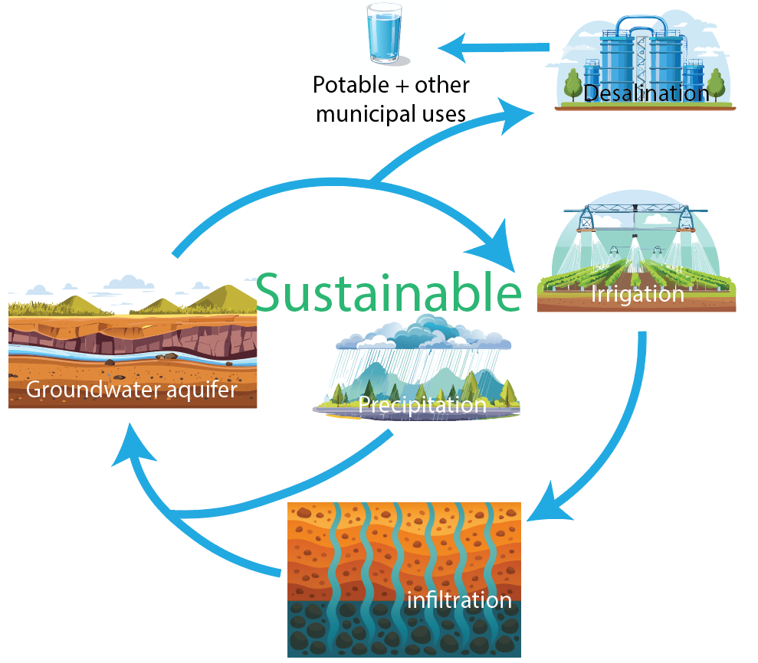
Sustainable Water Use in Arid and Semiarid Regions
~70% of the groundwater was utilized for irrigation.
Economic development and population growth have increased water demand for drinking, agriculture, and industrial uses.
State (2020) | Main sources (% of total supply)
Arizona | ~41% groundwater, ~54% surface water, ~5% reuse
New Mexico | ~50% groundwater, ~49% surface water, <2% reuse
Texas | ~55% groundwater, ~42% surface water, <3% reuse

Slide 3
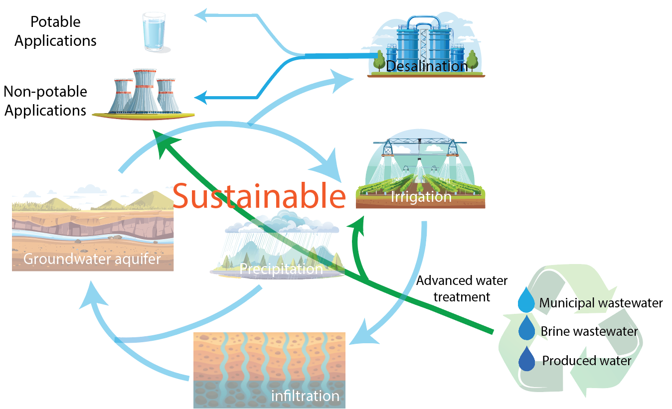
Sustainable Water Use in Arid and Semiarid Regions
Various treated alternative water sources, such as reclaimed municipal wastewater, desalinated brackish water and seawater, have been proposed and are currently utilized for agricultural irrigation and potable water use.
The chemical composition of treated produced water strongly depends on the geological formations from which it is extracted, the fracturing additives used during hydrocarbon recovery, and the desalination treatment process.

Slide 4
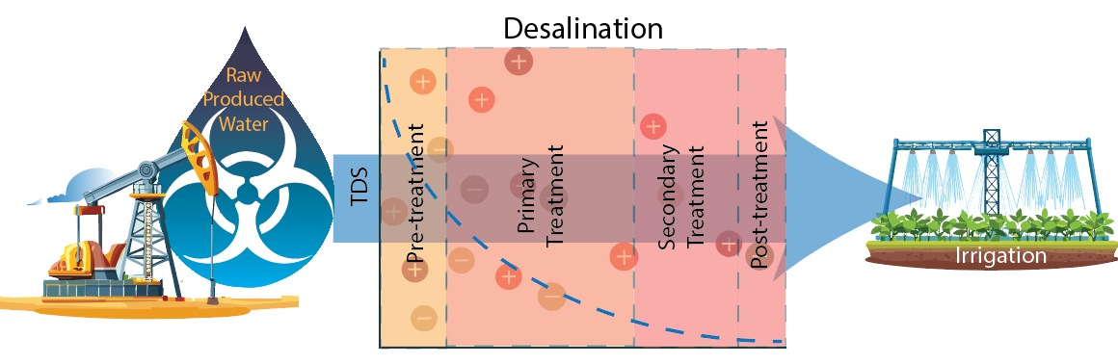
Raw Produced Water & Treated Produced Water (tPW) Use in Irrigation
High-TDS tPW (>1000 mg/L) alters soil structure and nutrient availability by increasing salinity and shifting cation-exchange behavior.
PW irrigation imposes osmotic stress on plants, reducing water uptake and growth.
low-TDS tPW (≤1000 mg/L) tends to maintain soil organic carbon and Ca²⁺/Mg²⁺, whereas high-TDS (≥1500 mg/L) drives surface accumulation of Cl⁻ and SO₄²⁻, disrupts microbes, and enhances nutrient leaching.
Sodium and chloride, commonly elevated in PW, increase salinity/sodicity, suppressing plant performance and microbial diversity, whereas calcium and magnesium counter sodicity, improving permeability and aeration.
Sedlacko et al., 2019; Ganjegunte et al., 2008; McAdams et al., 2019 Oetjen et al., 2018; Suvendran et al., 2024

Slide 5
Motivation & Objectives
The project was designed to study the influence of tPW (500, 1000, 1500 mg/L TDS) vs. control (12 mg/L TDS) on:
Soil health (SQI: chemical & physical)
Ion transport & organics in soil profile
Microbial communities (bacteria/fungi)
Alfalfa forage quality (CP, fiber, digestibility)
Ion Dynamics
Plant Growth
Soil Health
Soil: Soil was collected from 2 different counties, Reeves & Loving, both facing disposal constraints
Water: With the aim of validating the treatment train, TPWR chose 3 water qualities, produced by blending <1% RO concentrate + permeate
Plants: Native plants from Reeves & Loving county were purchased/collected based on env. survey. Alfalfa was chosen based on water uptake and climate tolerance
Microbial Communities

Slide 6
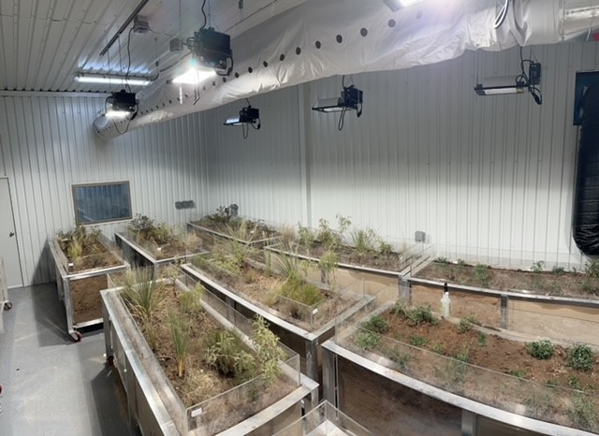
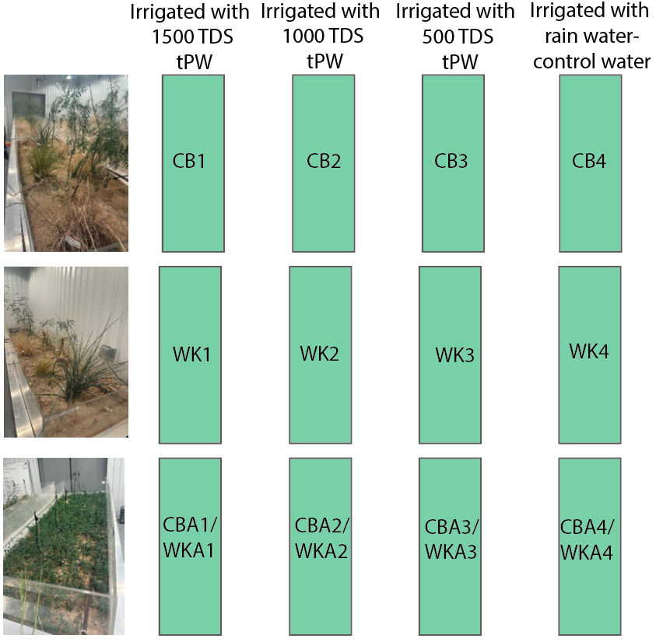
Materials and Methods
The greenhouse experiments were conducted from July 11, 2023, to April 22, 2024, in Midland, Texas.
The two soil types, Reeves (CB) and Whiskers (WK), were collected from Loving County and N. Reeves County, Texas, respectively.
The irrigation was conducted using tPW with TDS concentrations of 1500 mg/L (i=1), 1000 mg/L (i=2), and 500 mg/L (i=3), and the control water (CW) system maintained the TDS at ~15 mg/L (i=4).
Native plants were irrigated with ~15 gpd, Alfalfa was irrigated with ~50 gpd
Soil samples were collected at depths of 1, 2, and 3 ft. (30, 60, 90 cm) within the irrigation bed profile to assess changes in soil composition over time.
A comprehensive forage analysis was conducted to assess the influence of soil health on plant nutrient composition and overall growth.
To evaluate the impact of tPW on soil microbial community composition, topsoil samples (0-15 cm) and subsurface soil samples (15-30 cm) from the soil bed where alfalfa was planted.

Slide 7
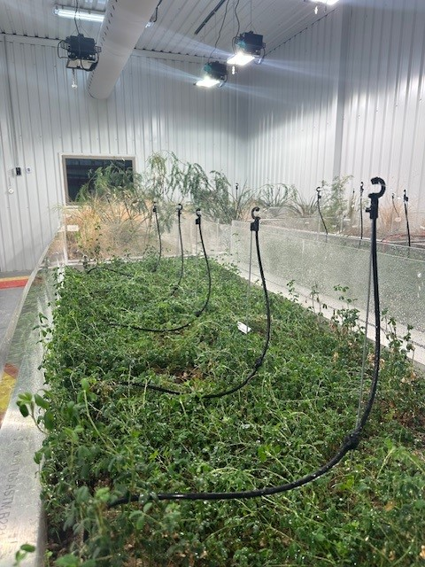
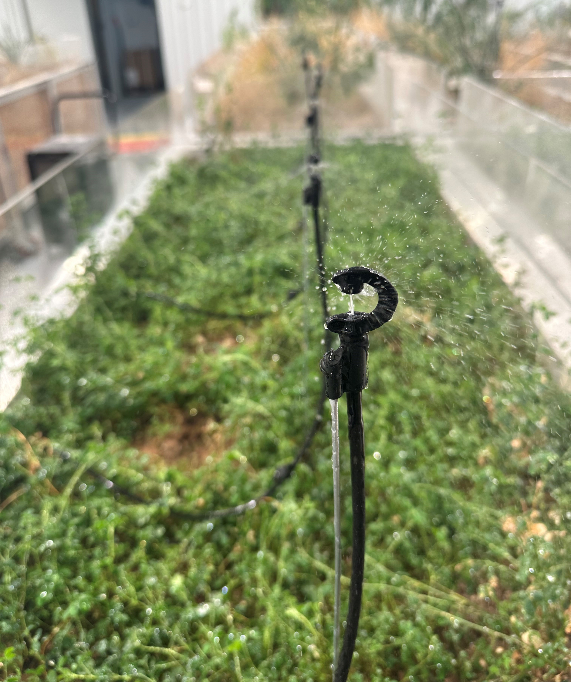
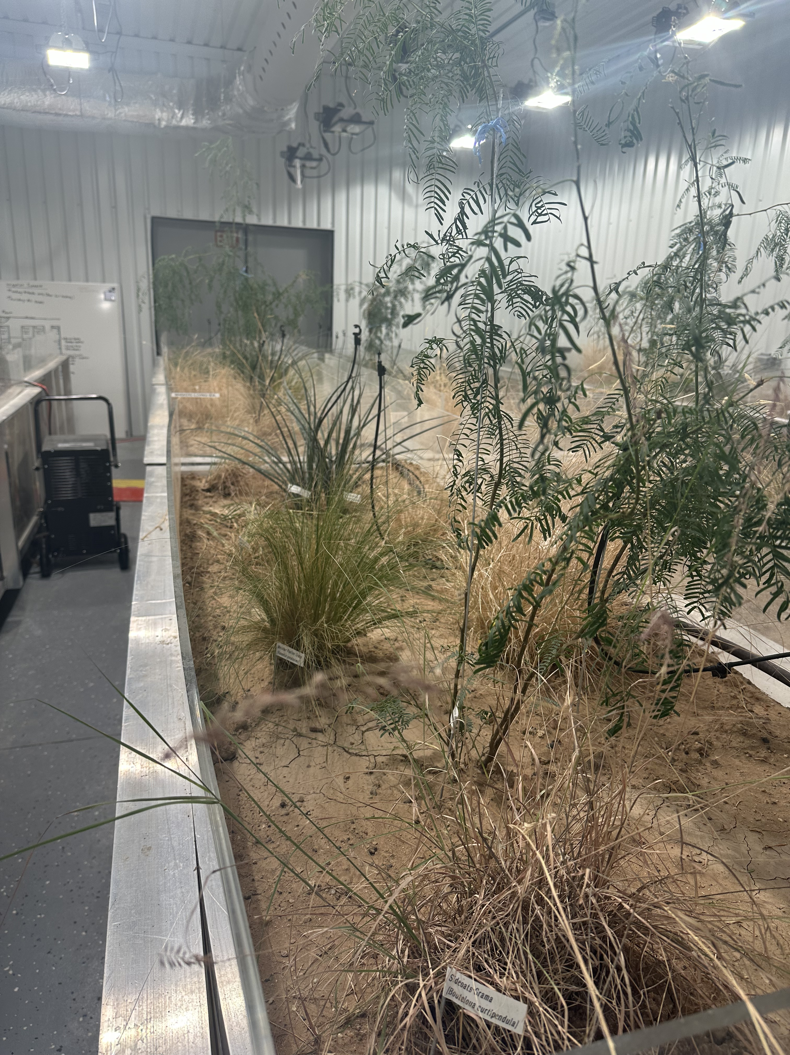
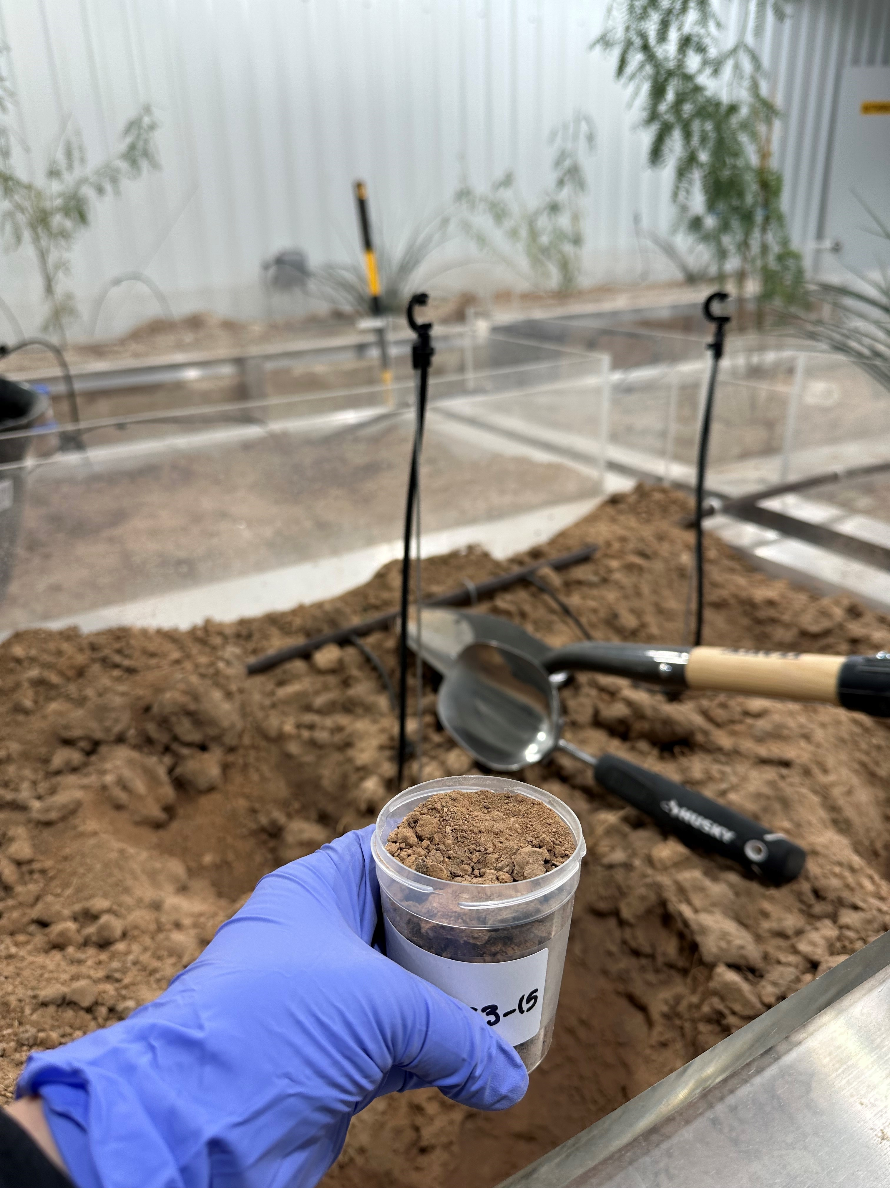
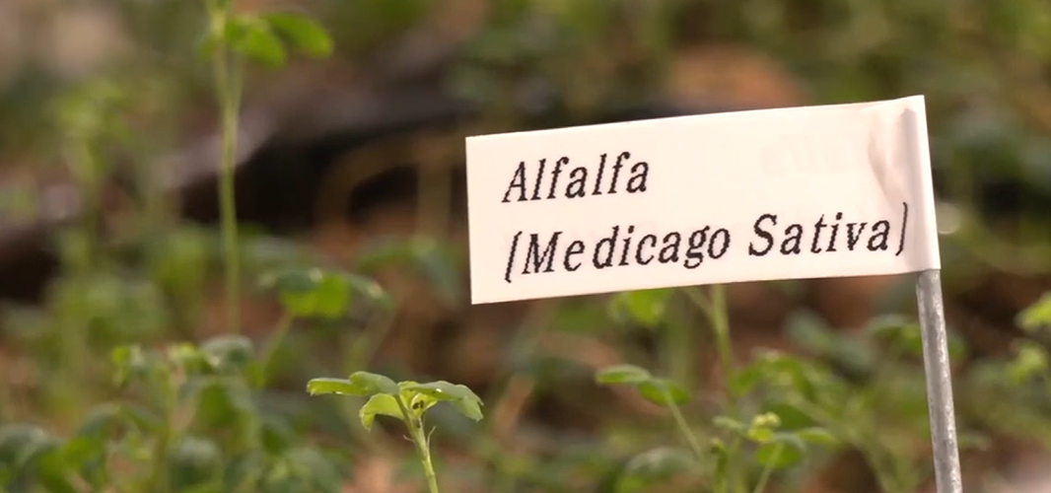
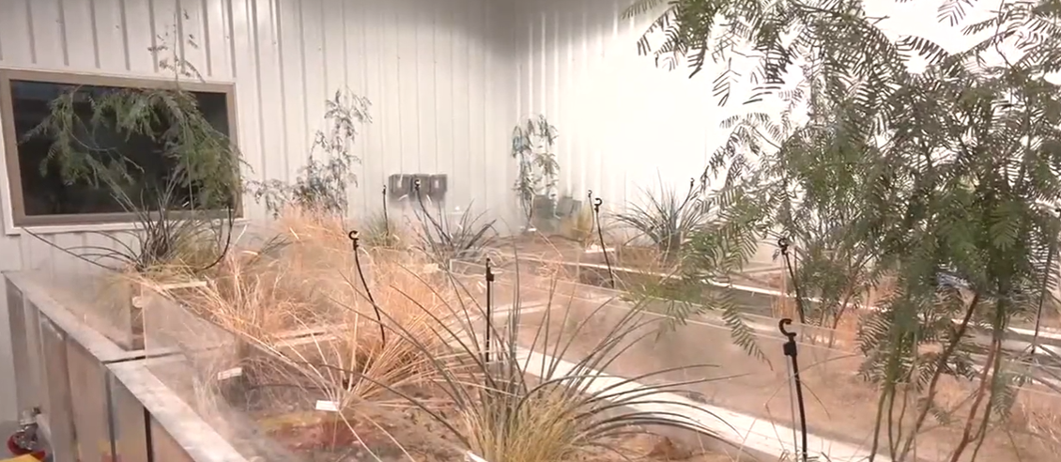
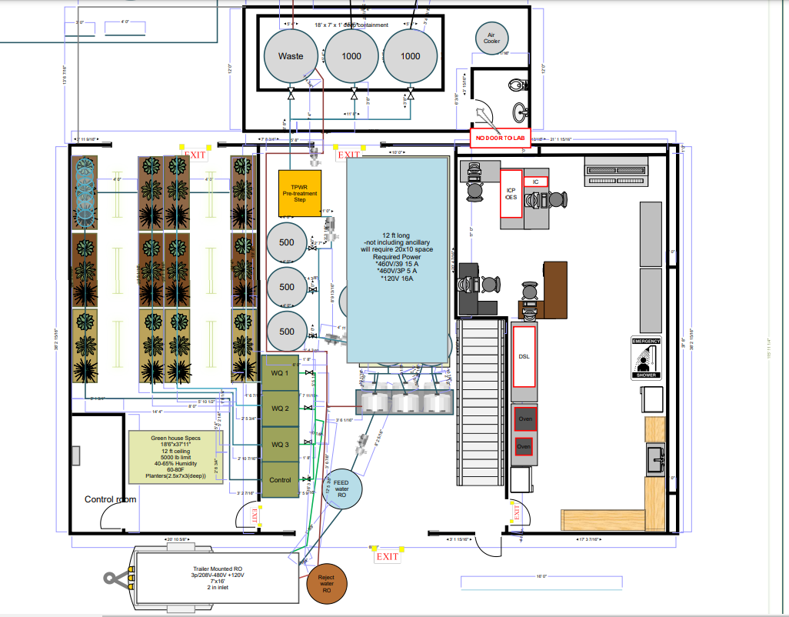
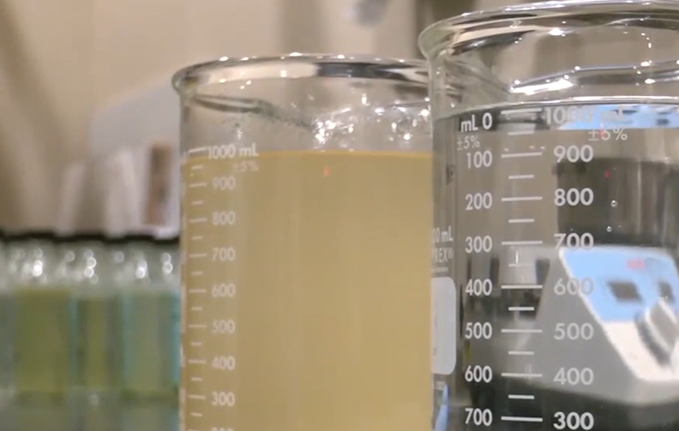
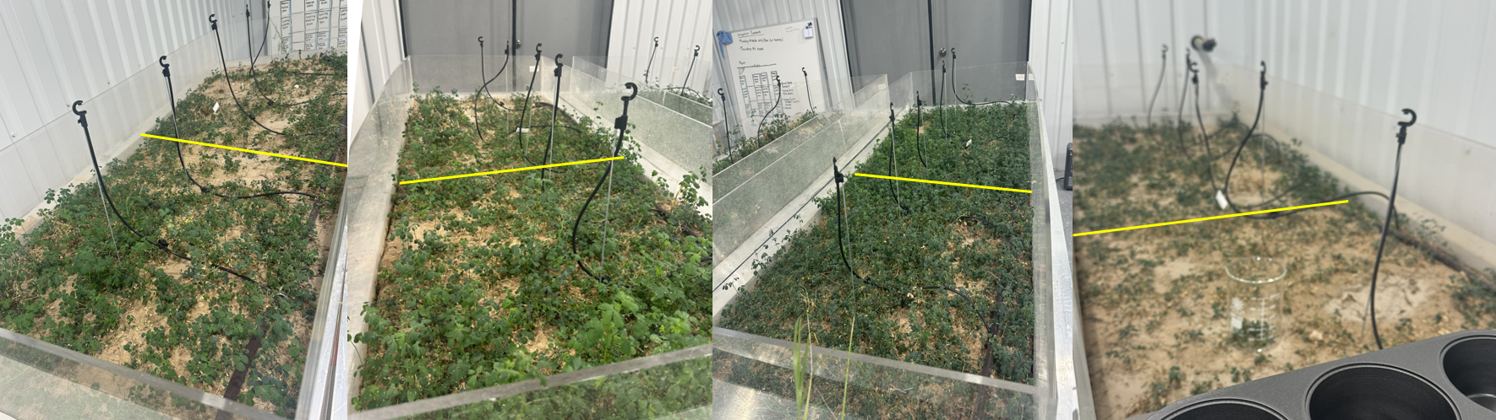
Materials and Methods

Slide 8
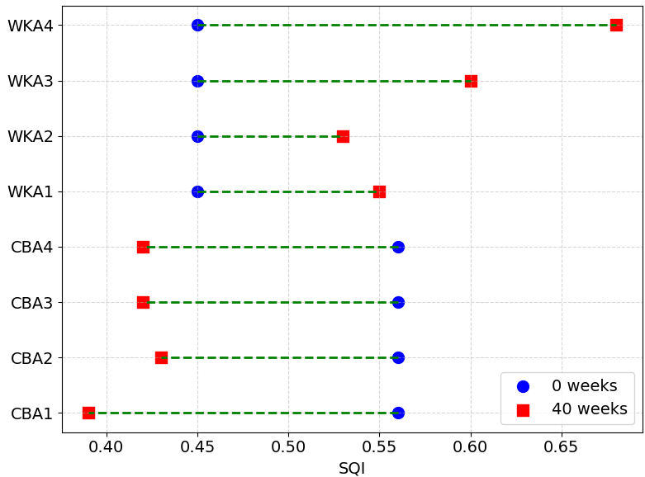
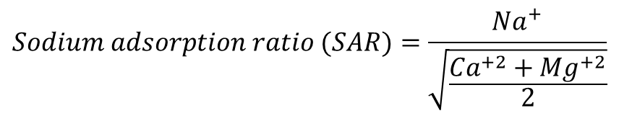

Macroscopic Overviews of Soil Health Utilizing Soil Quality Index (SQI)
$$SQI=0.6×{SQI}_{chem}+{0.4×SQI}_{phy}$$
$${SQI}_{chem}=f\left(pH,EC\right) ;electrical conductivity (EC)$$
$${SQI}_{phy}=f\left(Total Solids,SAR\right)$$
$$Sodium adsorption ratio (SAR)=\frac{{Na}^{+}}{\sqrt{\frac{{Ca}^{+2}+{Mg}^{+2}}{2}}}$$
CB-alfalfa (CBA):
tPW‑1000 outperformed control
tPW‑1500 showed the greatest decline in soil health
CW and tPW‑500 behave similarly
WK-alfalfa (WKA):
net increase in total SQI across treatments
chemical gains offset minor physical losses
Depth analysis indicates that chemical SQI improves with depth. A greater changer for both soil types was observed at 1ft.

Slide 9
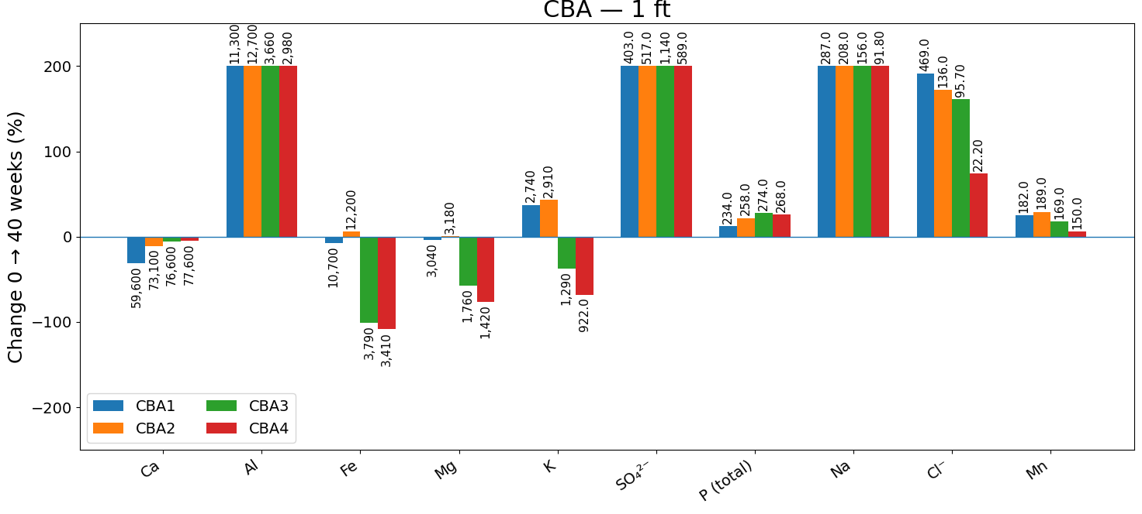
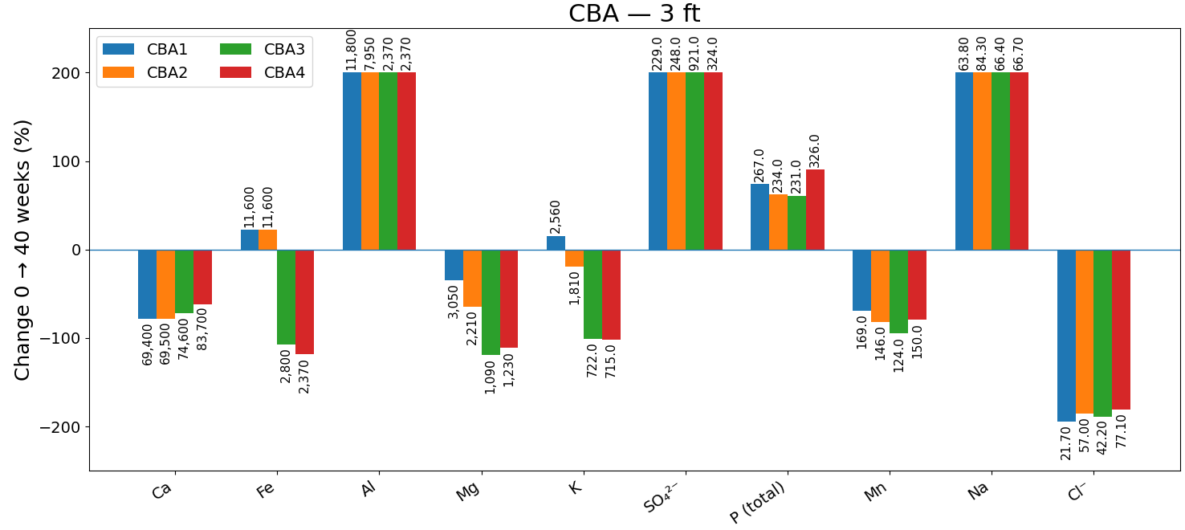
Ion Dynamics (CBA)
Strong salt accumulation (Na, Cl⁻, SO₄²⁻) and retention of K at 1 ft. matching evaporation and sprinkler inputs.
Depletion of divalent cations (Ca, Mg), and a greater enrichment of P was observed at 3 ft. and some trace elements (e.g., Zn), pointing to downward leaching/redistribution and ongoing exchange at depth.
These patterns line up with the CBA needing Ca/Mg remineralization to offset deep drawdown, while surface layers accumulate the more mobile salts

Slide 10
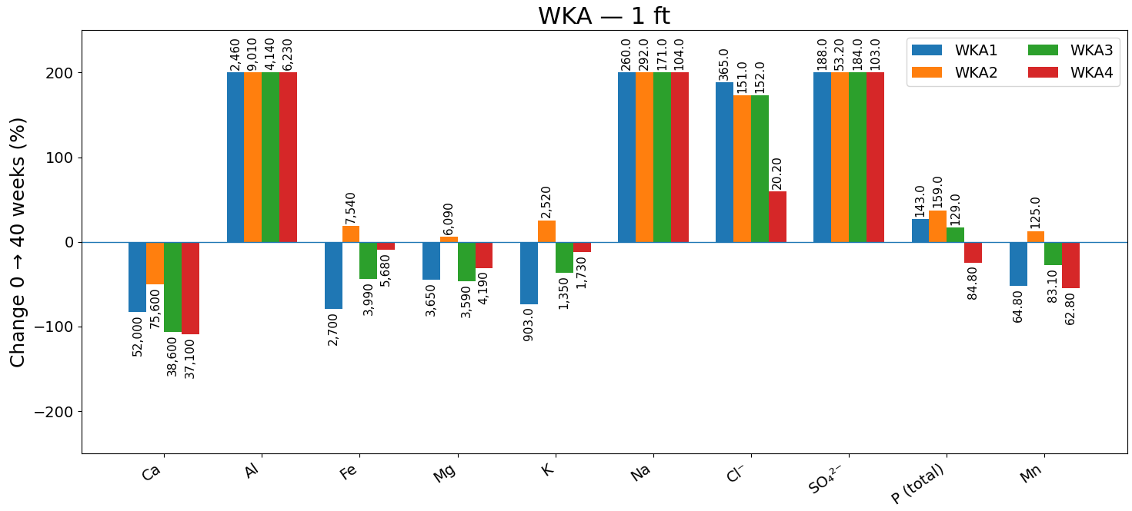
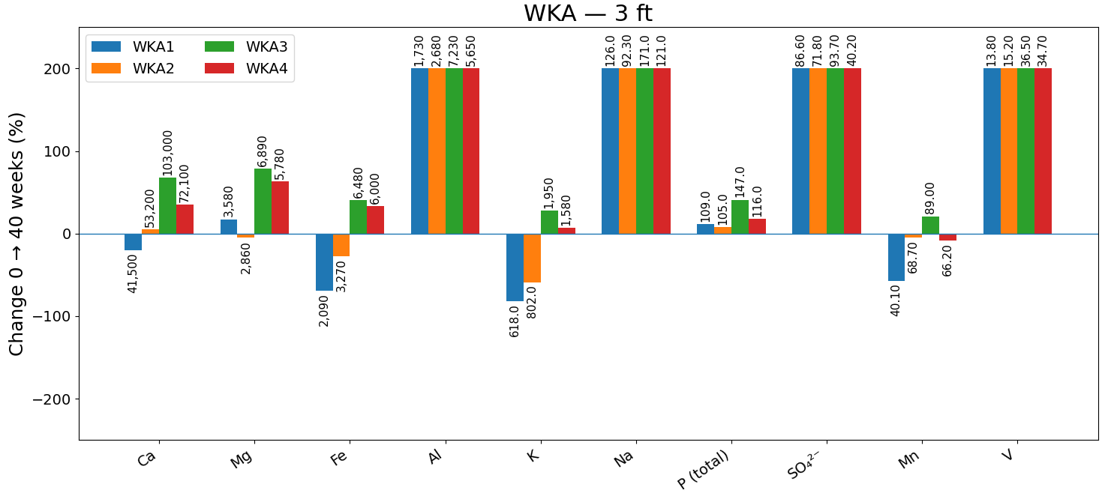
Ion Dynamics (WKA)
WKA soils show muted surface build-up and greater accumulation of mobile salts at 3 ft., indicating efficient leaching through a more permeable/sandy profile.
K is preferentially retained near the surface while Mn is depleted at depth.
Ca remains dominant with minor decline, helping maintain a favorable structure
overall smaller magnitude changes than CBA, however, with a clear depthward migration of Na⁺/Cl⁻/SO₄²⁻ and P.

Slide 11
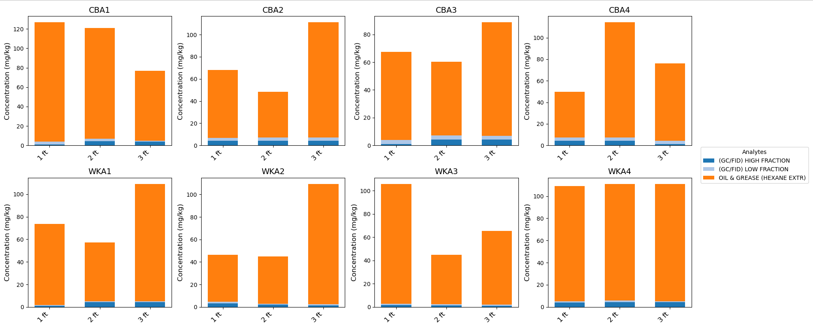
Organic Compounds
Hexane-extractable oil & grease is the major organic pool at 40 weeks at all depths in both soils (~50–130 mg/kg).
High- and low-fraction TPH remain small (≤ 8 and ≤ 3 mg/kg, respectively) and show weak, depth-invariant response; likely limited by sorption and biological attenuation.
Soils irrigated with tPW behaved similarly to CW with respect to organics, indicating the trace amount of TPH in tPW does not influence the soil composition.

Slide 12
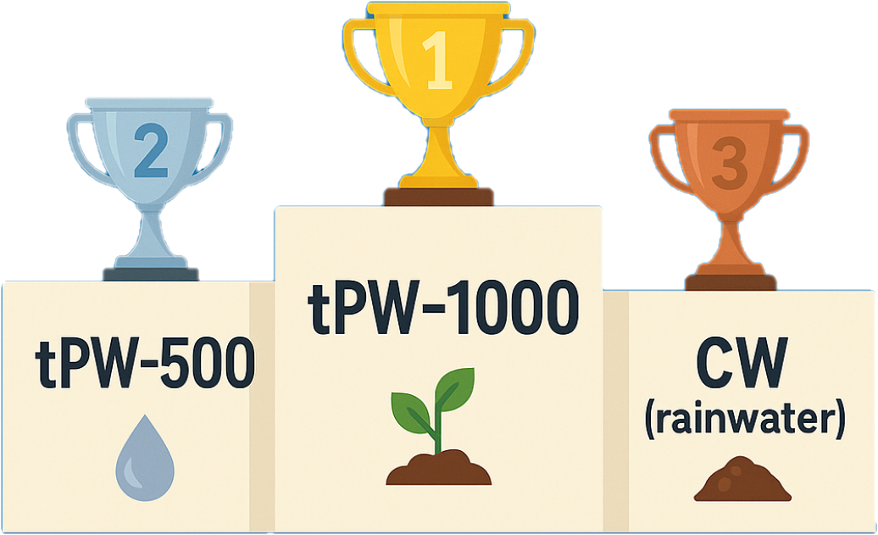
Influence of Inorganic and Organic Compounds on Soil Health and Plant Growth
Across soils, Ca fell 10–25% and Mg fell 14–40%, while K increased 20–40%. Na increased under tPW-1500, elevating SAR and risking clay dispersion. B increased, nevertheless, remained within the 0.1–5.0 mg/kg guideline.
In clayey CBA, Cl⁻ and SO₄²⁻ concentration increases by >15% in the 1 and 2 ft, while sandy WKA leached ~60 ± 10% of added Cl⁻ below 2 ft. PO₄³⁻ was retained near-surface in CBA, while 0.8 ± 0.2 mg/kg leached to 3 ft. in WKA.
The organics in the tPW do not influence the soil organic position, likely due to microbial activities.
tPW ≤ 1000 mg/L TDS produced ion/organic profiles comparable to CW and is more compatible with soil health; tPW-1500 drove salt accumulation (Na, Cl⁻, SO₄²⁻) and deeper salinity in WKA, requiring soil-specific management and depth-aware monitoring

Slide 13
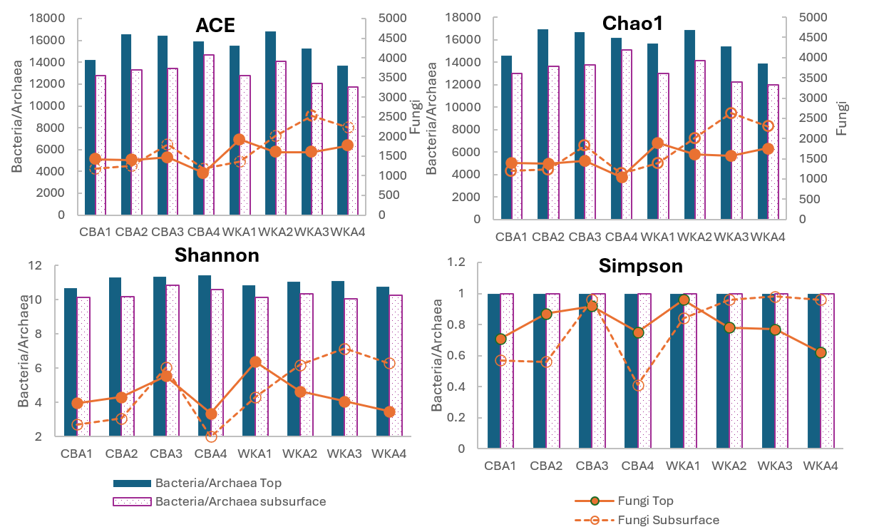
Soil Microbial Community Profiles
≤1000 mg/L tPW waters illustrate minimal impact on bacterial/fungal richness & diversity
1500 mg/L tPW reduced fungal richness in WKA subsurface and the top soils shown to be less affected
Bacterial diversity illuminate stability, while fungal response is more sensitive to salinity of the water.

Slide 14
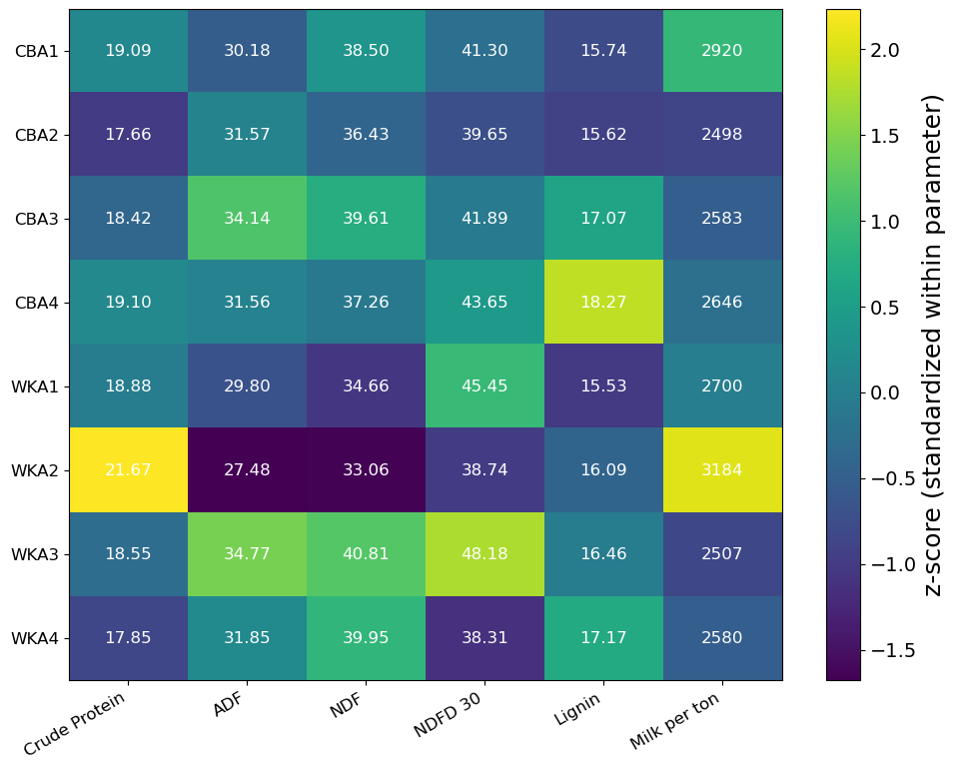
Key Cultivation Parameters for Alfalfa in CBA and WKA
Alfalfa planted in tPW‑1000 show balanced CP & lower ADF/NDF and high RFQ (esp. WK‑1000)
tPW‑500 illustrates the highest NDFD (better digestibility) with slightly lower CP
Alfalfa planted in the control (12 mg/L) system show higher lignin & fiber thereby lower nutritive value
Even though CP is acceptable for the plant irrigated with tPW-1500, it nevertheless shows less optimal balance compared to tPW with 1000 mg/L TDS.

Slide 15
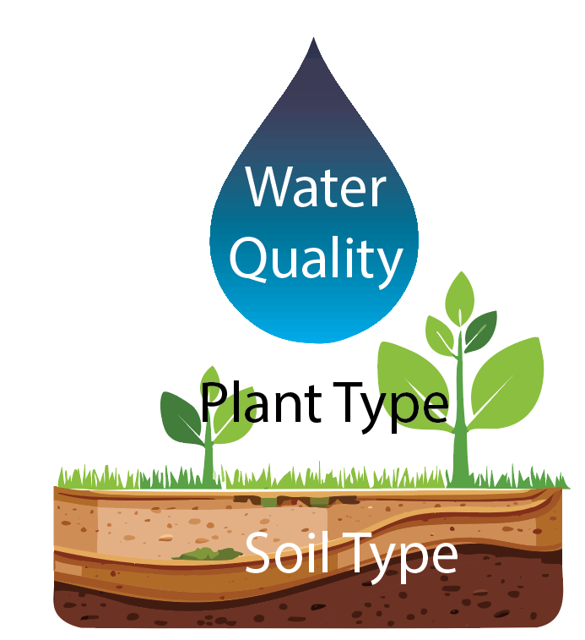
Conclusion and Recommendations
Treated produced water with TDS ≤ 1000 mg/L is a viable irrigation source that matches or exceeds CW for soil health and forage quality.
Avoid high-salinity tPW (>1000 mg/L TDS), which drives salinization, nutrient imbalance, and osmotic stress, especially near the surface, and reduces fungal richness, especially in loamy soils.
CBA (clay soil) best irrigated with ≤ 1000 mg/L, benefitting from ion retention. However, remineralization with Ca/Mg (Ca, Mg, Fe tend to decline; K rises).
WKA (sandy/loamy) favors ≤ 500 mg/L (or CW) to limit deep leaching and maintain microbial balance.
When evaluating the plant profile, tPW-1000 delivers the most balanced feed (higher CP, lower fiber, better digestibility). tPW-500 boosts NDFD with a slight decrease in CP. tPW-1500 sits mid-pack and does not show balance nutrients.
Track EC, SAR, Ca/Mg/Na/K/Cl/ SO₄²⁻/P by depth, plus microbial community metrics. Use action thresholds (e.g., EC < 4 dS/m, monitor SAR) to adjust TDS targets and amendment rates.

Slide 16
Contact Information
New Mexico State University
New Mexico Produced Water Research Consortium (NMPWRC)
College of Engineering Outreach | (575) 646-4033 | nmpwrc@nmsu.edu
Dr. Pei Xu
Chief Technology Officer and Research Director
Professor, Civil and Environmental Engineering
pxu@nmsu.edu
Dr. Huiyao Wang
Professor, Civil and Environmental Engineering
huiyao@nmsu.edu
Dr. Yanyan Zhang
Assc. Professor, Civil and Environmental
zhangy@nmsu.edu
Dr. Punhasa Senanayake
Post Doctoral, Civil and Environmental Engineering
punhasa@nmsu.edu
Dr. Thiloka Edirisooriya
Post Doctoral, Civil and Environmental Engineering
thiloka@nmsu.edu
Adrianne Lopez
Technical Research & Development Manager
Texas Pacific Water Resources
alopez@tpwresources.com
Danielle Smith
Biologist, Water Chemist Technician
Texas Pacific Water Resources
dsmith@tpwresources.com

