Slide 1
Green H₂ production using alternative water and waste plastics
Huiyao Wang, Pei Xu, E.M.N. Thiloka Edirisooriya, Tarek Ahasan, Punhasa S. Senanayake
College of Engineering
Department of Civil Engineering
Disclaimer: The New Mexico Produced Water Research Consortium at New Mexico State University is conducting independent, science-based research to evaluate potential environmental and health effects related to the reuse of treated produced water for fit-for-purpose applications. This work is designed to generate objective data under controlled conditions, without promoting or opposing any specific reuse practices. Our goal is to provide clear, reliable information that supports informed decision-making around the safe and responsible use of produced water in New Mexico and beyond.
This presentation includes preliminary research data from the New Mexico Produced Water Research Consortium at New Mexico State University. The information presented is subject to change and has not yet undergone formal quality assurance or quality control (QA/QC) review. Distribution or sharing of this material without prior authorization from New Mexico State University is not permitted.

Slide 2
Team
Dr. Huiyao Wang, professor of materials sciences and environmental engineering
Over 30 years of in-depth experience in fabrication, processing, design, and characterization of nanomaterial, photocatalysts, semiconductor and metal coatings and thin films, fuel cells, solar cells.
Primary inventor and PI of multiple photocatalysis research projects for water treatment, energy production, and resource recovery funded by federal agencies and industry
Dr. Pei Xu, professor of environmental engineering
Over 30 years of experience in basic and applied research on environmental remediation, contaminants removal, and resource recovery.
Lead multi-million $ R&D projects, technology transfer, and commercialization through public-private partnerships with state, federal, and industry on sustainable water-energy-environment systems.
Dr. E.M.N. Thiloka Edirisooriya, postdoc.
Conduct experimental research on photo-reforming plastic for H₂ production.
Tarek Ahasan, PhD student under Dr. Wang.
Focuse on photocatalytic hydrogen production from alternative waters. Will continue postdoctoral research.
Dr. Punhasa S. Senanayake, postdoc.
Conduct modeling research on photocatalysts for H₂ production.
1
Notes:
Our team includes two professors., Pei and me. Dr. Thiloka used to be my PhD student, now she is postdoc. Tarak is my PhD student; he will continue his postdoctoral work. Dr. Punhasa conducts modeling work on photocatalysts.
The research team has extensive experiences in materials, photocatalysis, and clean energy production. Pei and I are over 30 years collaborations on applying nanomaterials and technologies in environmental

Slide 3
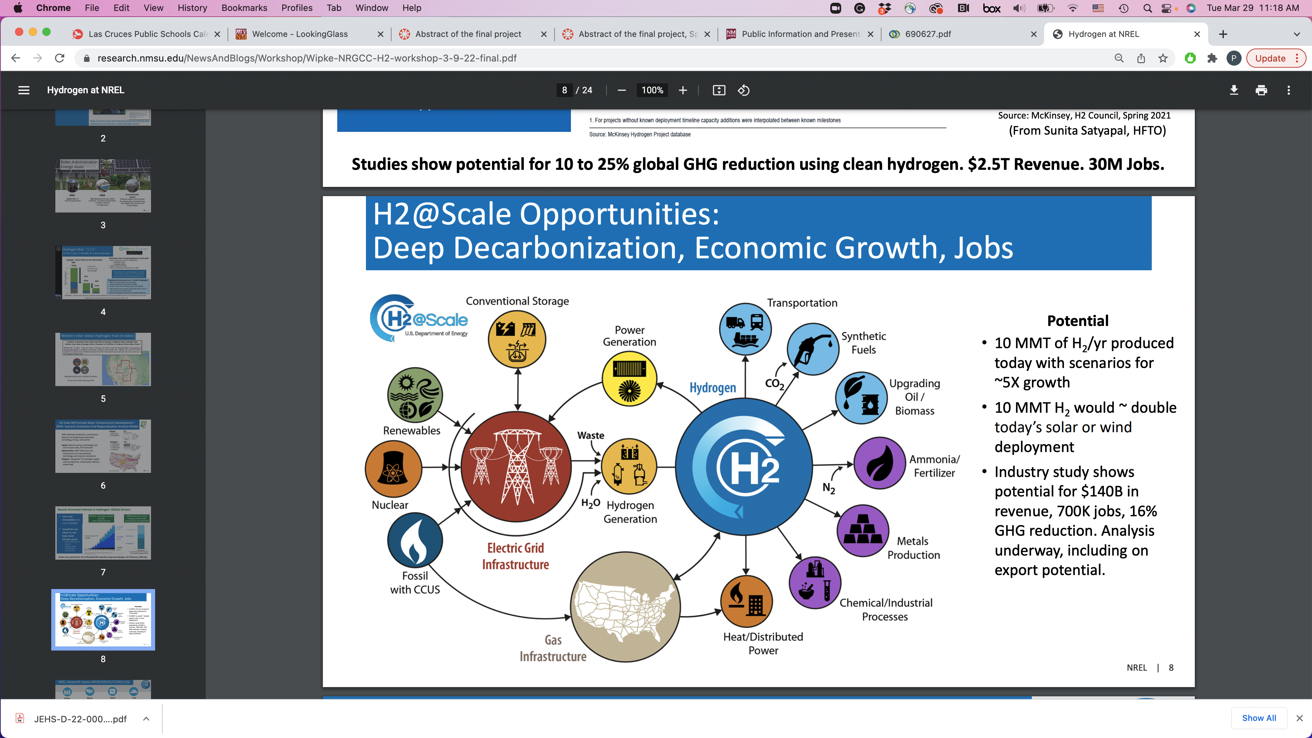
H₂ as a clean energy source to promote economic growth
Source: U.S. Department of Energy
1
2
Notes:
Hydrogen has a wide range of applications across various industries due to its unique properties as a clean, lightweight, and highly reactive element. Here are the main applications of hydrogen:
🔋 1. Energy and Fuel
Hydrogen Fuel Cells: Used to generate electricity in fuel cell vehicles (cars, buses, trucks, trains, even ships and airplanes), emitting only water vapor.
Hydrogen as a Fuel: Can be burned directly for heat or power generation in turbines and engines.
Energy Storage: Acts as an energy carrier; excess renewable energy (solar/wind) can be stored as hydrogen via electrolysis and used later.
🏭 2. Industrial Applications
Ammonia Production: Hydrogen is a key ingredient in producing ammonia (NH₃) through the Haber-Bosch process, widely used in fertilizers.
Petroleum Refining: Used to remove sulfur from fuels (hydrodesulfurization) and improve fuel quality.
Methanol Production: Hydrogen is used in synthesizing methanol, which is a precursor to many chemicals and fuels.
Hydrogenation Processes: Used to convert unsaturated fats to saturated fats in food processing, and to produce chemicals like margarine.
🌿 3. Environmental Applications
Clean Energy Transition: Hydrogen supports decarbonization in hard-to-abate sectors (like steel, cement, and shipping).
Emission Reduction: When produced from renewable energy (green hydrogen), it helps reduce greenhouse gas emissions.
🚗 4. Transportation
Fuel Cell Electric Vehicles (FCEVs): Including cars, buses, trucks, and trains, offering fast refueling and long range.
Aviation and Maritime: Research is ongoing to use hydrogen as a fuel in aircraft and ships.
🧪 5. Scientific and Space Applications
Rocket Propulsion: Liquid hydrogen is used as rocket fuel in combination with liquid oxygen.
Cooling Systems: Liquid hydrogen is used as a cryogenic coolant in scientific equipment and particle accelerators.
🏘️ 6. Residential and Commercial Heating (Emerging)
Hydrogen Blending in Gas Grids: In some regions, hydrogen is being blended with natural gas for heating and cooking.
Hydrogen Boilers and Heat Pumps: Under development for hydrogen-based home heating.

Slide 4
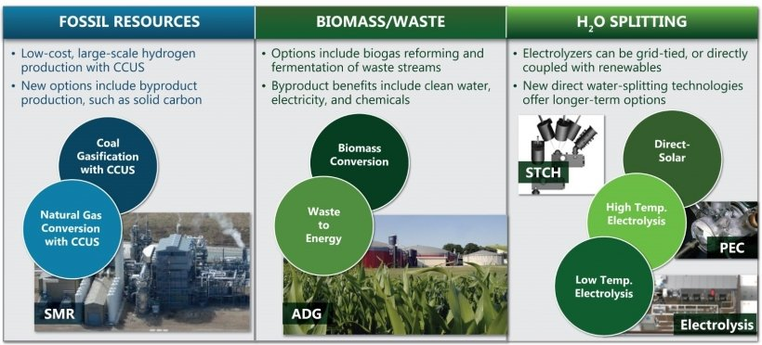
H₂ production technologies
Source: U.S. Department of Energy
CCUS: carbon capture, utilization and storage
STCH: Solar thermochemical hydrogen
2
3
Notes:
How is Hydrogen Produced?
The first method is through fossil fuel conversion these are thermal processes using fossil fuels with steam to generate hydrogen gas which is energy intensive and generates waste biproducts such as CO2 which needs carbon capture.
The second method is water splitting which requires an electric current to be run through water to generate hydrogen and oxygen gas though this process extremely energy intensive.
The last and method is biomass conversion which uses the same gasification process as fossil fuel and has the same issues such as high energy intensity and CO2 emission.
This project is about the waste to energy approach

Slide 5
Challenges in hydrogen production
Thermocatalysis uses fossil fuels and emits ~10 kg CO₂/kg H₂
Current Green H₂ Price: ~$5/kg H₂
DOE Goal: $2/kg by 2026 and $1/kg H₂ by 2031
Electrolysis Challenges
1. Cost of Materials
Requires expensive noble metals like Platinum (Pt), Ruthenium (Ru), and Iridium (Ir) as catalysts.
2. High Energy Consumption
Consumes ~50–55 kWh of electricity to produce 1 kg of hydrogen.
3. Water Demand
~ 10 – 15 liters of water per kilogram of H₂ produced, including:
9 liters of ultra-pure water for the electrolysis.
Additional water for cooling, purification, and system losses, depending on the
process.
To support a 1 MW water electrolysis plant, water demand is estimated at
1900 – 2800 gallons per day。
4
Notes:
thermocatalysis (Conventional Method)
Relies on fossil fuels.
Emits approximately 10 kg of CO₂ per kg of H₂ produced.
💰 Green Hydrogen Costs
Current price: ~$5/kg H₂
DOE Targets:
$2/kg by 2026
$1/kg by 2031
⚙️ Electrolysis Challenges
1. Cost of Materials
Requires expensive noble metals like Platinum (Pt), Ruthenium (Ru), and Iridium (Ir) as catalysts.
2. High Energy Consumption
A 1 MW electrolyzer consumes ~50–55 kWh of electricity to produce 1 kg of hydrogen.
3. Water Demand
Approximately 10–15 liters of water are needed per 1 kg of hydrogen, including:
~9 liters of ultra-pure water for the electrolysis reaction.
Additional water for cooling, purification, and system losses.
A 1 MW electrolyzer plant requires 1,900–2,800 gallons of water per day.

Slide 6
1. Photocatalytic water splitting for H₂ Production
Proposed solution:
Technical Summary:
Utilize photocatalysts that are simple to synthesize
Produce hydrogen from alternative water sources.
Simultaneous waster and wastewater treatment.
Technical Merits:
Operate under free sunlight and ambient conditions.
Active in complex water matrices.
No extensive pretreatment requirement for alternative water sources.
5
Notes:
Technical Summary: Photocatalytic Water Splitting for Hydrogen Production
Utilizes photocatalysts that are simple and cost-effective to synthesize.
Enables hydrogen generation from alternative water sources, including wastewater.
Supports simultaneous water and wastewater treatment, contributing to environmental remediation.
Technical Merits
Operates under natural sunlight and ambient environmental conditions, minimizing energy input.
Effective in complex water matrices, demonstrating robustness in real-world applications.
No extensive pretreatment required for non-traditional water sources, reducing operational complexity and cost.

Slide 7
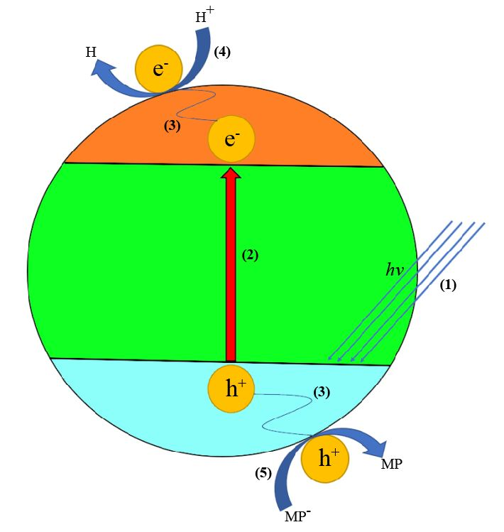
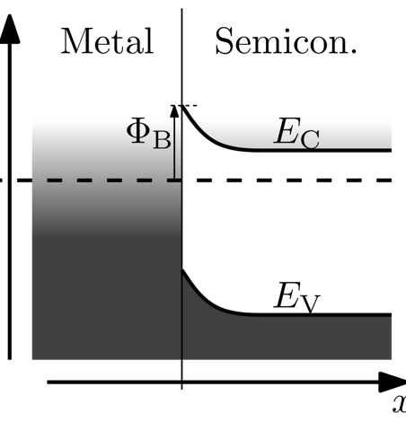
Photocatalyst
Advantages of metal-semiconductor nanocomposite photocatalysts (Au/TiO₂, Pt/TiO₂):
Plasmonic metal nanostructures have a greatly strong ability to harvest photon energy by free electrons collective oscillation under light excitation, which is known as localized surface plasmonic resonance.
When metal is in contact with a semiconductor, their different work functions induce a space-charge region with an internal electric field, bending semiconductor bands, and give rise to a Schottky barrier on metal–semiconductor interface.
The Schottky barrier significantly hinders the recombination of excited electrons and holes by photons and facilitates electron-hole separation.
Single metal atoms on nano-semiconductor can enhance the efficiency of the novel nanocomposite photocatalysts
Figure 1: Mechanism of photocatalytic hydrogen production. Band diagram for n-type semiconductor-metal Schottky barrier without bias. (copied from the Wikipedia)
6
Notes:
The core of the photocatalysis process is photocatalyst. When the photocatalysts inside water are irradiated by sun light, if the energy of photon is larger than the band gap of the catalysts, excited electron and hole pairs are produced, and cause a series of chemical reactions to split water and produce H2. Now, we talk about the advantages of metal-semiconductor nanocomposite photocatalyst. Plasmonic metal nanostructures have greatly strong ability to harvest photon energy, doping metal can also decrease the band gap of the semiconductor particle and increase the absorption of the visible light.
When metal is in contact with semiconductor, their different work functions induce bending semiconductor bands, and cause Schottky barrier.
The Schottky barrier significantly hinders the recombination of excited electron and hole by photon.
We prepared single atom Pt on TiO2 semiconductor particles, this single atom nanocomposite photocatalyst can enhance the efficiency of the novel photocatalyst.

Slide 8
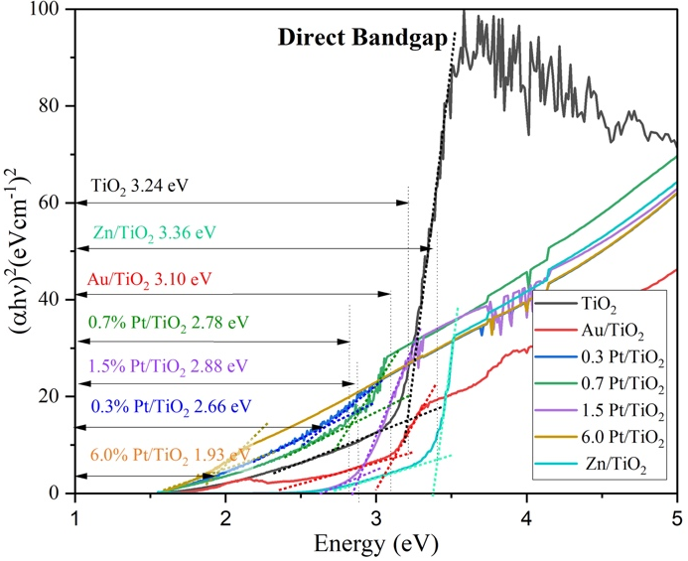
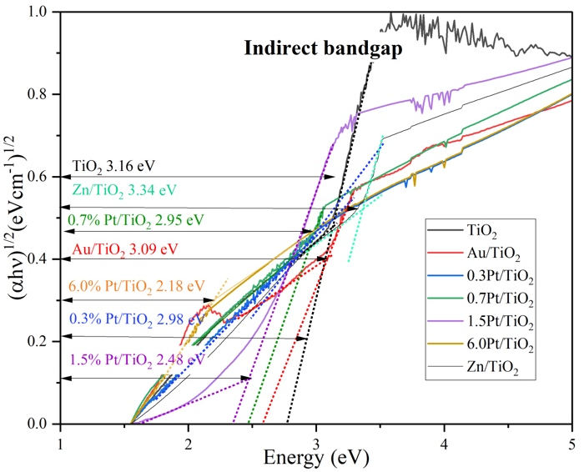
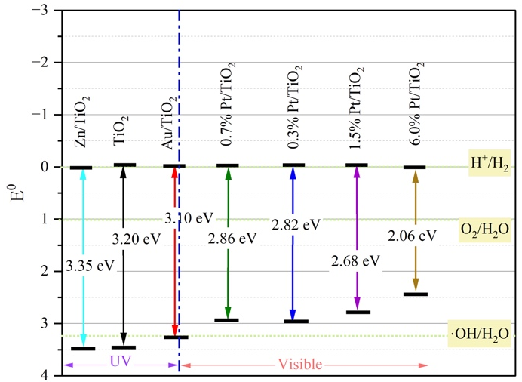
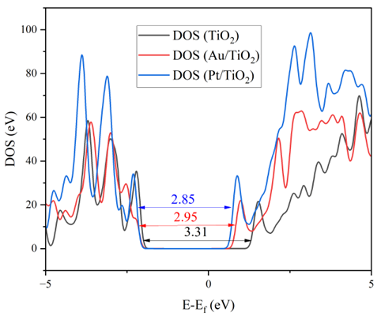
Bandgaps of atom-nano composite photocatalysts
A
B
C
D
Figure 2: Bandgap energy analysis of Pt/TiO_{2,} Au/TiO₂, and Zn/TiO₂ considering (A) direct electron transition, (B) indirect electron transition, and (C) Summary calculated bandgaps different catalysts with (D) computation simulation of density of state (DOS) plot.
7
Notes:
The bandgap energy is an essential parameter for determining the suitable wavelength range of the light source to power the photo-reforming process. nanoTiO2 particles are very popular photocatalysts, have a 3.2 eV bandgap. The bandgap is big, is related to UV, only 6% of the total solar radiation falling on the earth is ultraviolet. 42% is visible light.
Using the normalized UV-Vis spectrum of the catalysts dispersed in DI water, the bandgap energy was calculated following the Tauc plot method.
Doping Pt and Au to the TiO₂ resulted in a significant shrink in the bandgap. but Zn doped TiO₂ shows a bandgap increase of 0.15 eV compared to pure TiO_{2,} The wide bandgap is not good for photoreforming.

Slide 9
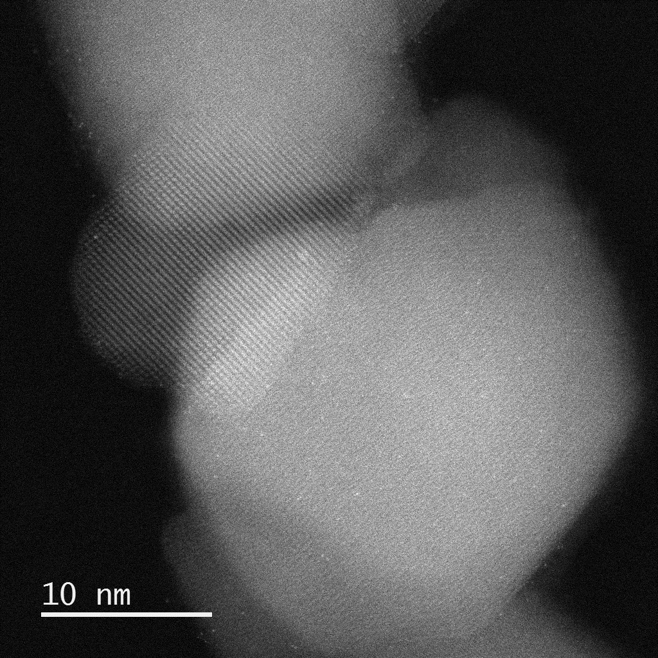
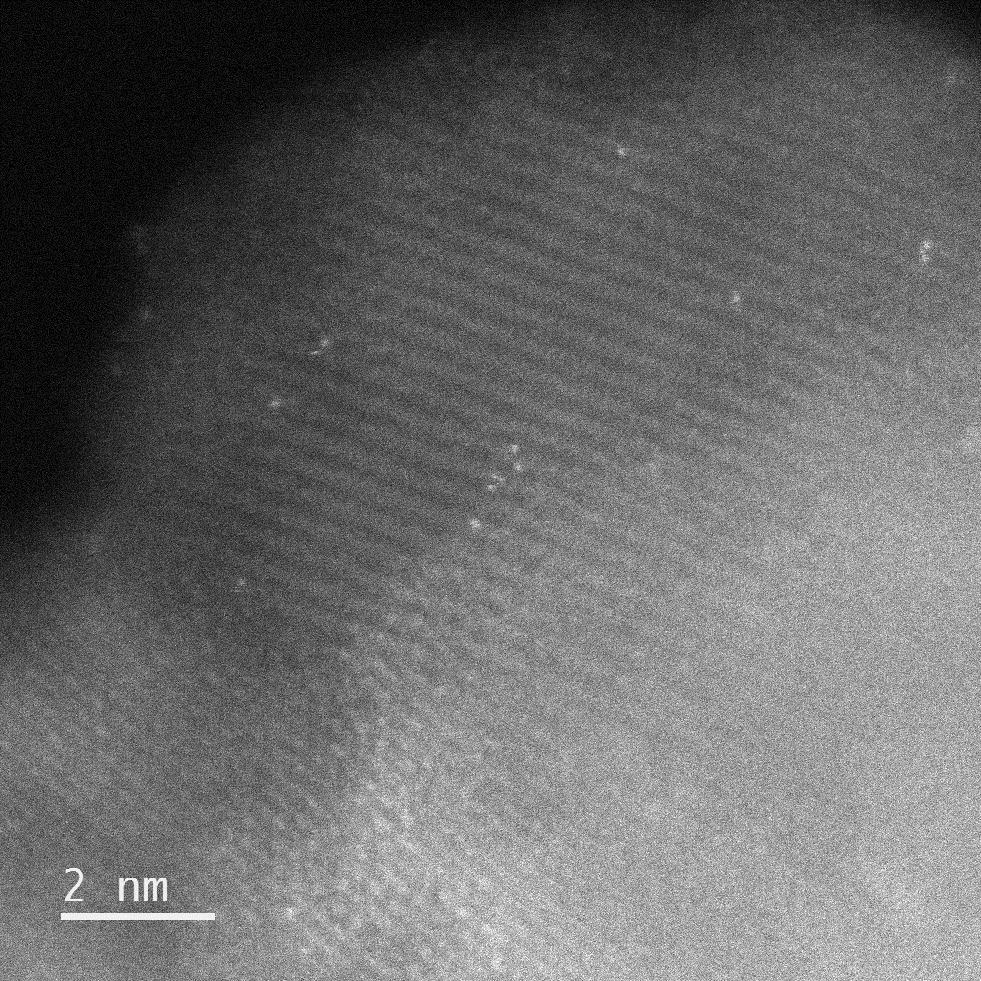
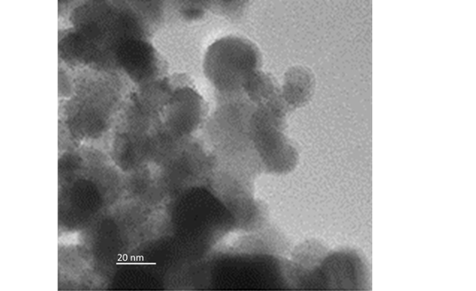
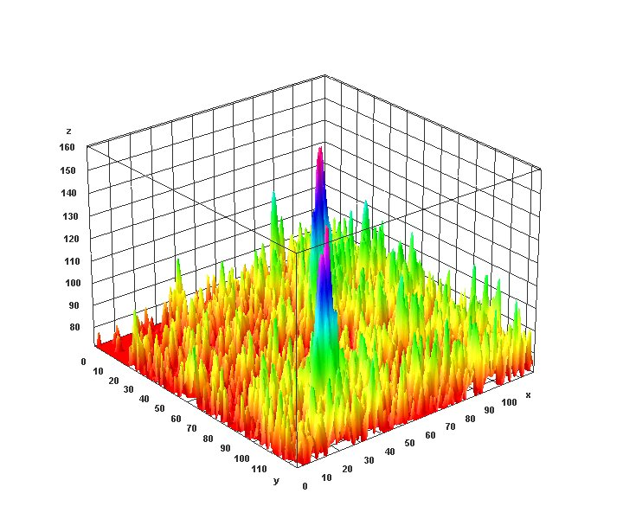
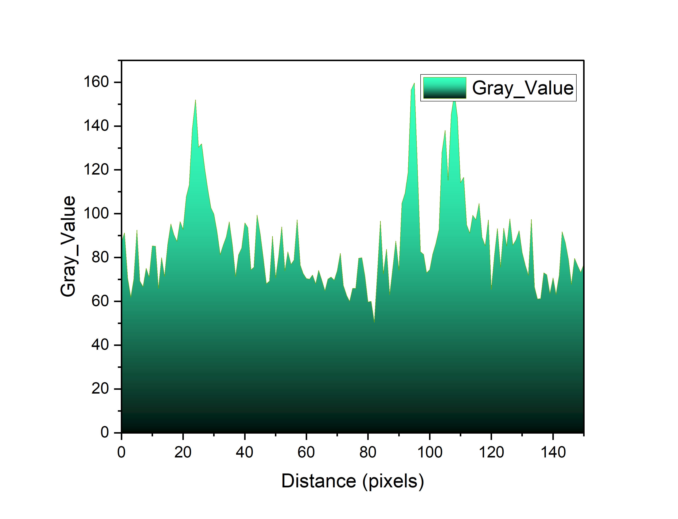
Photocatalysts Pt/TiO₂ and Au/TiO₂
Transmission electron microscopy analysis of catalysts
A
B
C
D
E
b
a
Figure 3: The TEM images of (A) 0.7% Pt/TiO₂, (B) zoomed image of single Pt atoms on the surface of TiO₂, (C)Au/TiO₂, (D) surface plot around line ab, and (E) surface profile of line ab
The average size of metal composite TiO₂ particle remains the same at 20 nm indicating that the surface modification does not affect the particle size significantly.
Random distribution of Pt single atoms on the TiO₂ surface is observed
The average Au particle deposited on the TiO₂ surface is 2.1 nm
8
Notes:
nanoTiO2 particles is very popular photocatalysts, have a 3.2 eV bandgap. Two kinds of novel Photocatalysts were characterized by TEM. Single Pt atoms deposited on the surface of nanoTiO2 particles formed high efficiency atom-nanocomposite catalyst, and catalytic cost can decrease by about ten times. Nano-Au particles deposited on the surface of nano-TiO2 formed nanocomposite catalyst.
Scanning transmission electron microscopy (STEM) was used to image and compare the particle size distribution and morphology of the pristine TiO₂ with the metal-doped TiO₂.

Slide 10

Ag/G/TiO₂ atom-nanocomposite photocatalyst
Develop atom-nanocomposite photocatalysts (metal atoms or clusters- graphene nanosheets- semiconductor nanoparticles)
One example: Ag/G/TiO₂
Synthesized by the hydrothermal and microwave-assisted method.
Simple to synthesize.
Active under both UV and visible light spectrum.
Have a high surface area due to graphene.
Produce H₂ from alternative water sources.
Use a slurry-based system for effective
contact and scalability.
Solar Concentrator
H₂ Storage Tank
Reactor
Outlet
Inlet
Figure 4: On-site green hydrogen production from produced water using solar-powered continuous flow reactors in oilfield.
9
Notes:
Development of Atom-Nanocomposite Photocatalysts for Hydrogen Production
Design and synthesize atom-nanocomposite photocatalysts composed of metal atoms or clusters, graphene oxide (GO) nanosheets, and semiconductor nanoparticles.
Example system: Ag/GO/TiO₂ nanocomposite.
Synthesized using hydrothermal and microwave-assisted methods, which are straightforward and scalable.
Photocatalytic activity under both UV and visible light, including natural sunlight.
High surface area provided by graphene oxide enhances active site availability and reaction efficiency.
Capable of producing hydrogen from alternative water sources, supporting sustainable energy and water treatment.
Utilizes a slurry-based system, enabling effective catalyst-water interaction and offering scalability for practical applications.

Slide 11
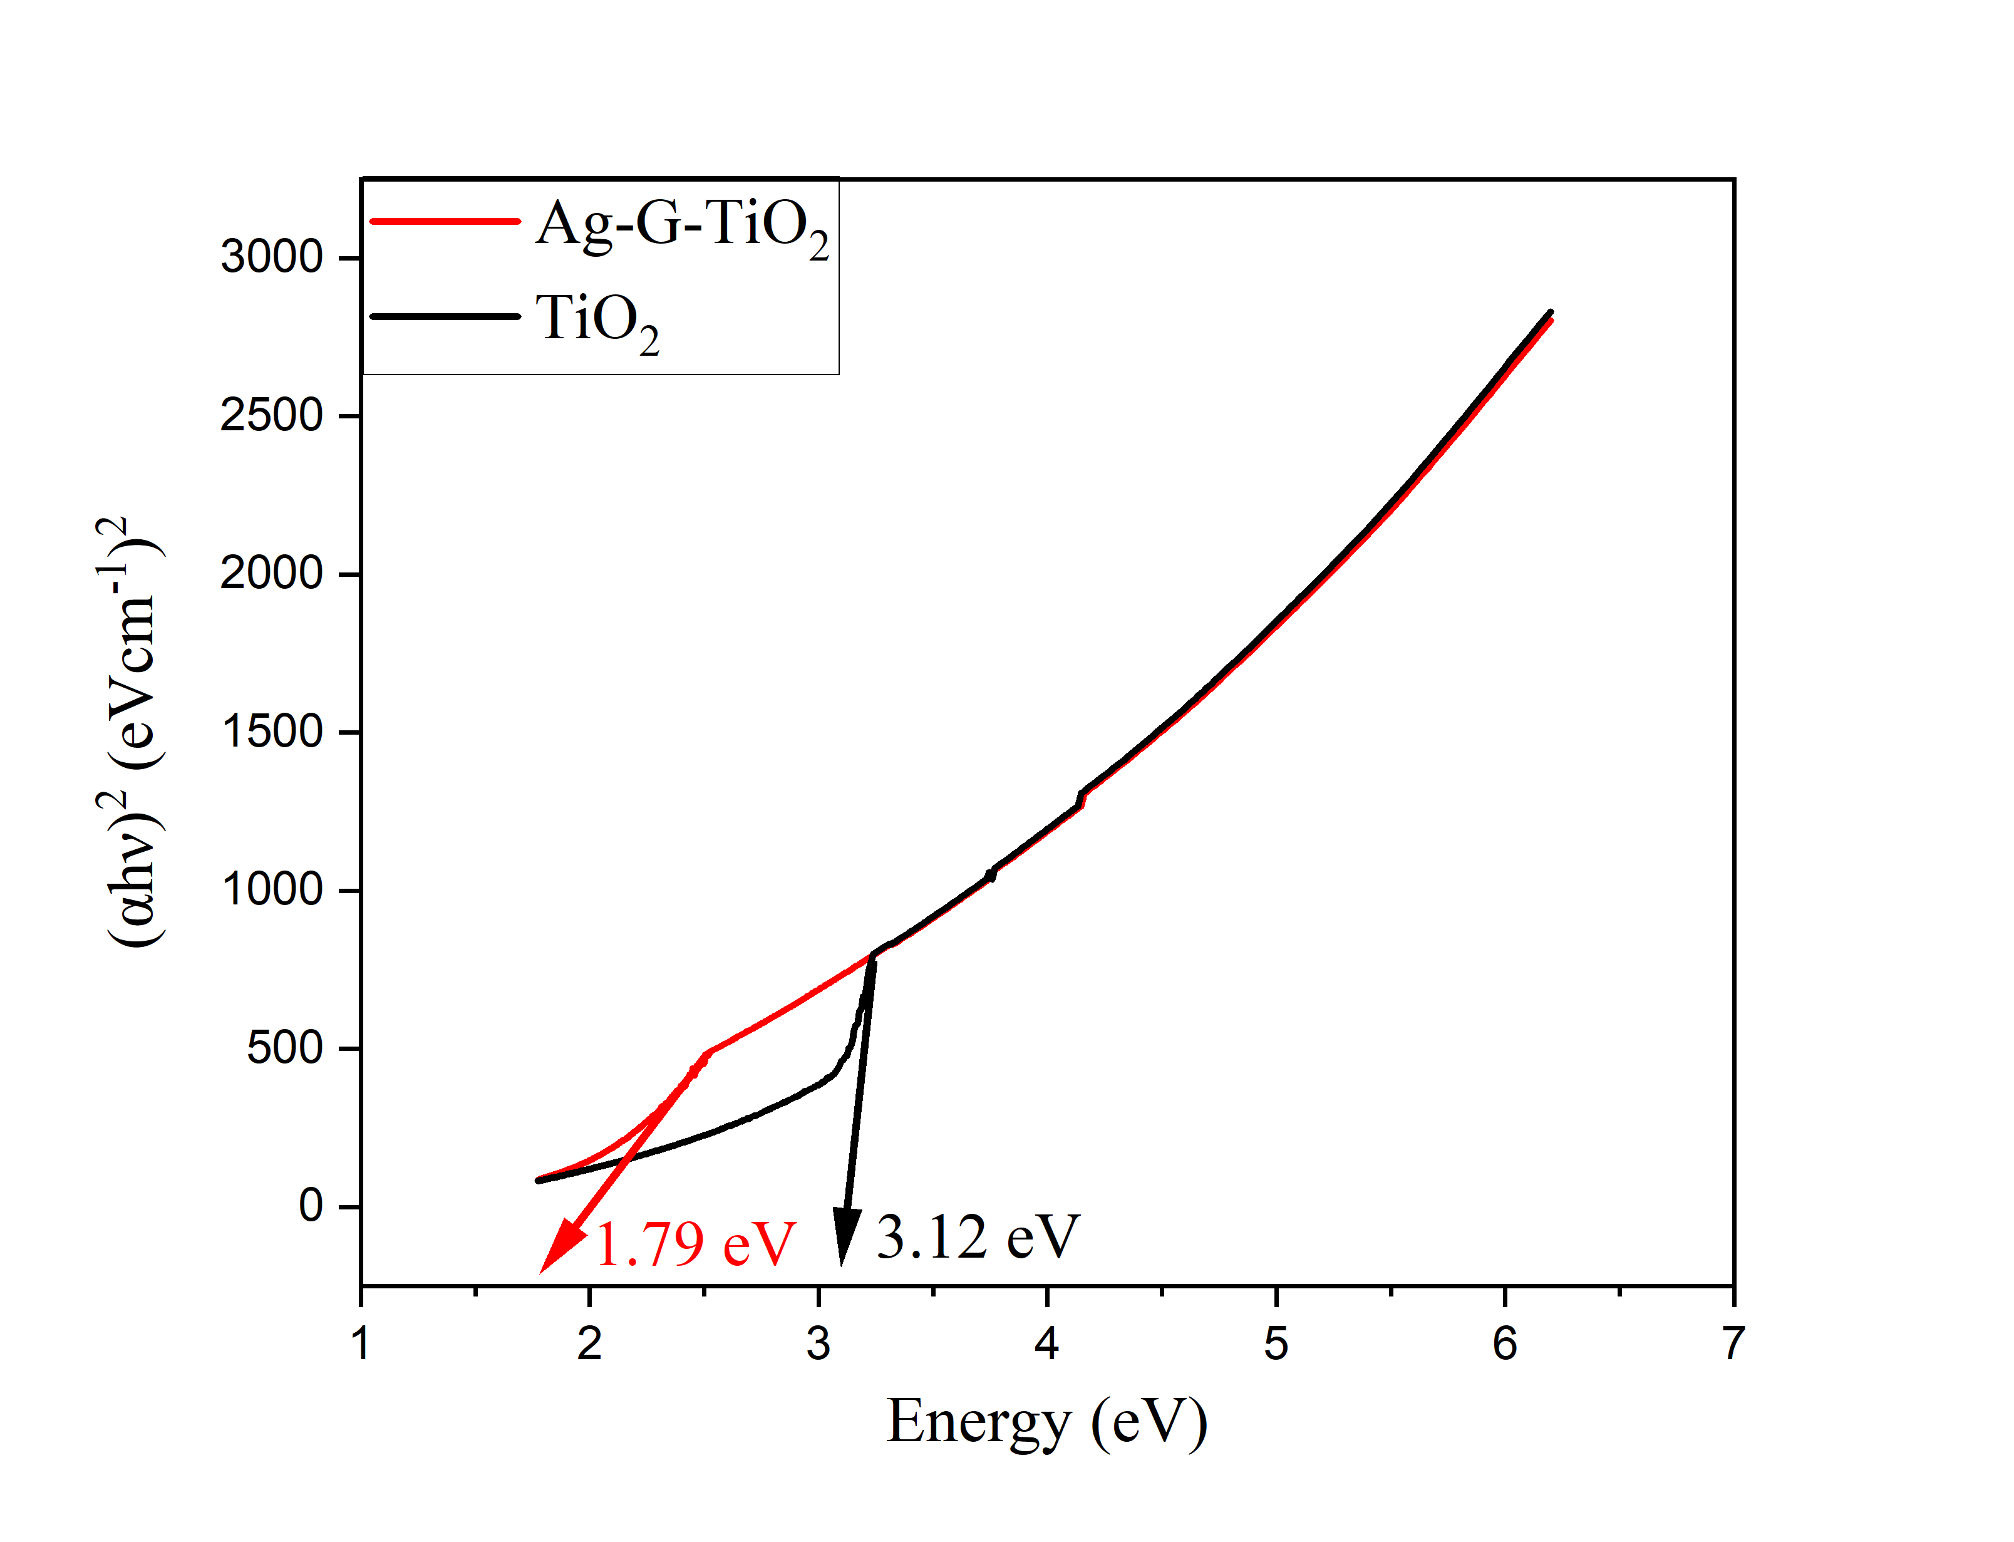
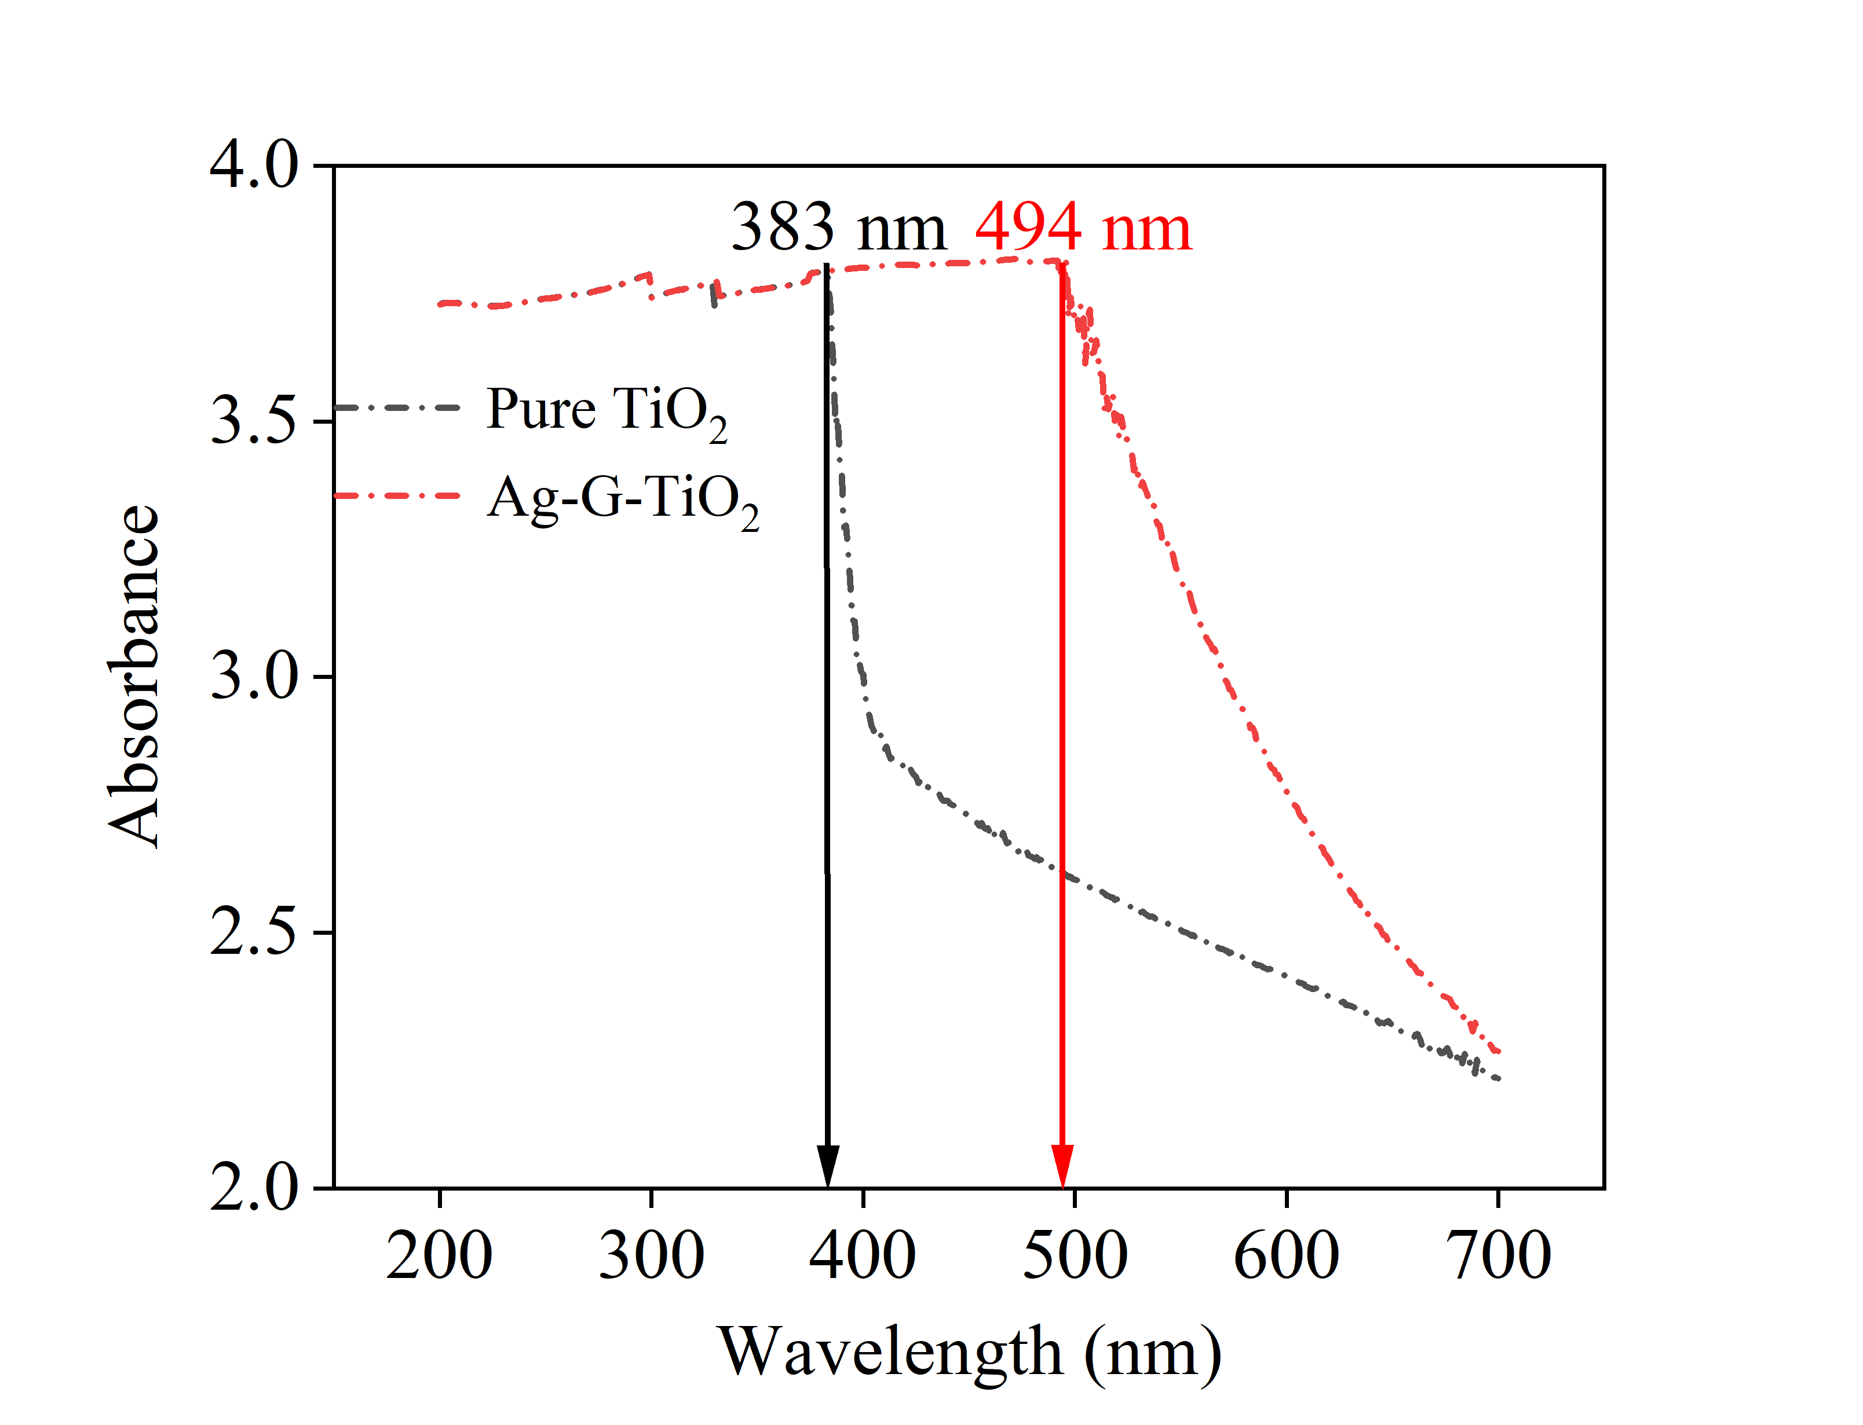
Bandgap and TEM image of photocatalyst Ag/G/TiO₂
Figure 5: Bandgap characteristics and optical absorption behavior of pure TiO₂ and Ag/G/TiO₂. TEM image of the catalysts and Ag particles: Ag/G/TiO₂.
10
Notes:
(a) Bandgap characteristics and (b) optical absorption behavior of pure TiO₂ and the Ag/G/TiO₂ nanocomposite, highlighting enhanced visible light absorption due to Ag and G incorporation. (c) TEM image and corresponding particle size distribution of the Ag/G/TiO₂ catalyst, illustrating the morphology of the composite and the dispersion of Ag nanoparticles.

Slide 12
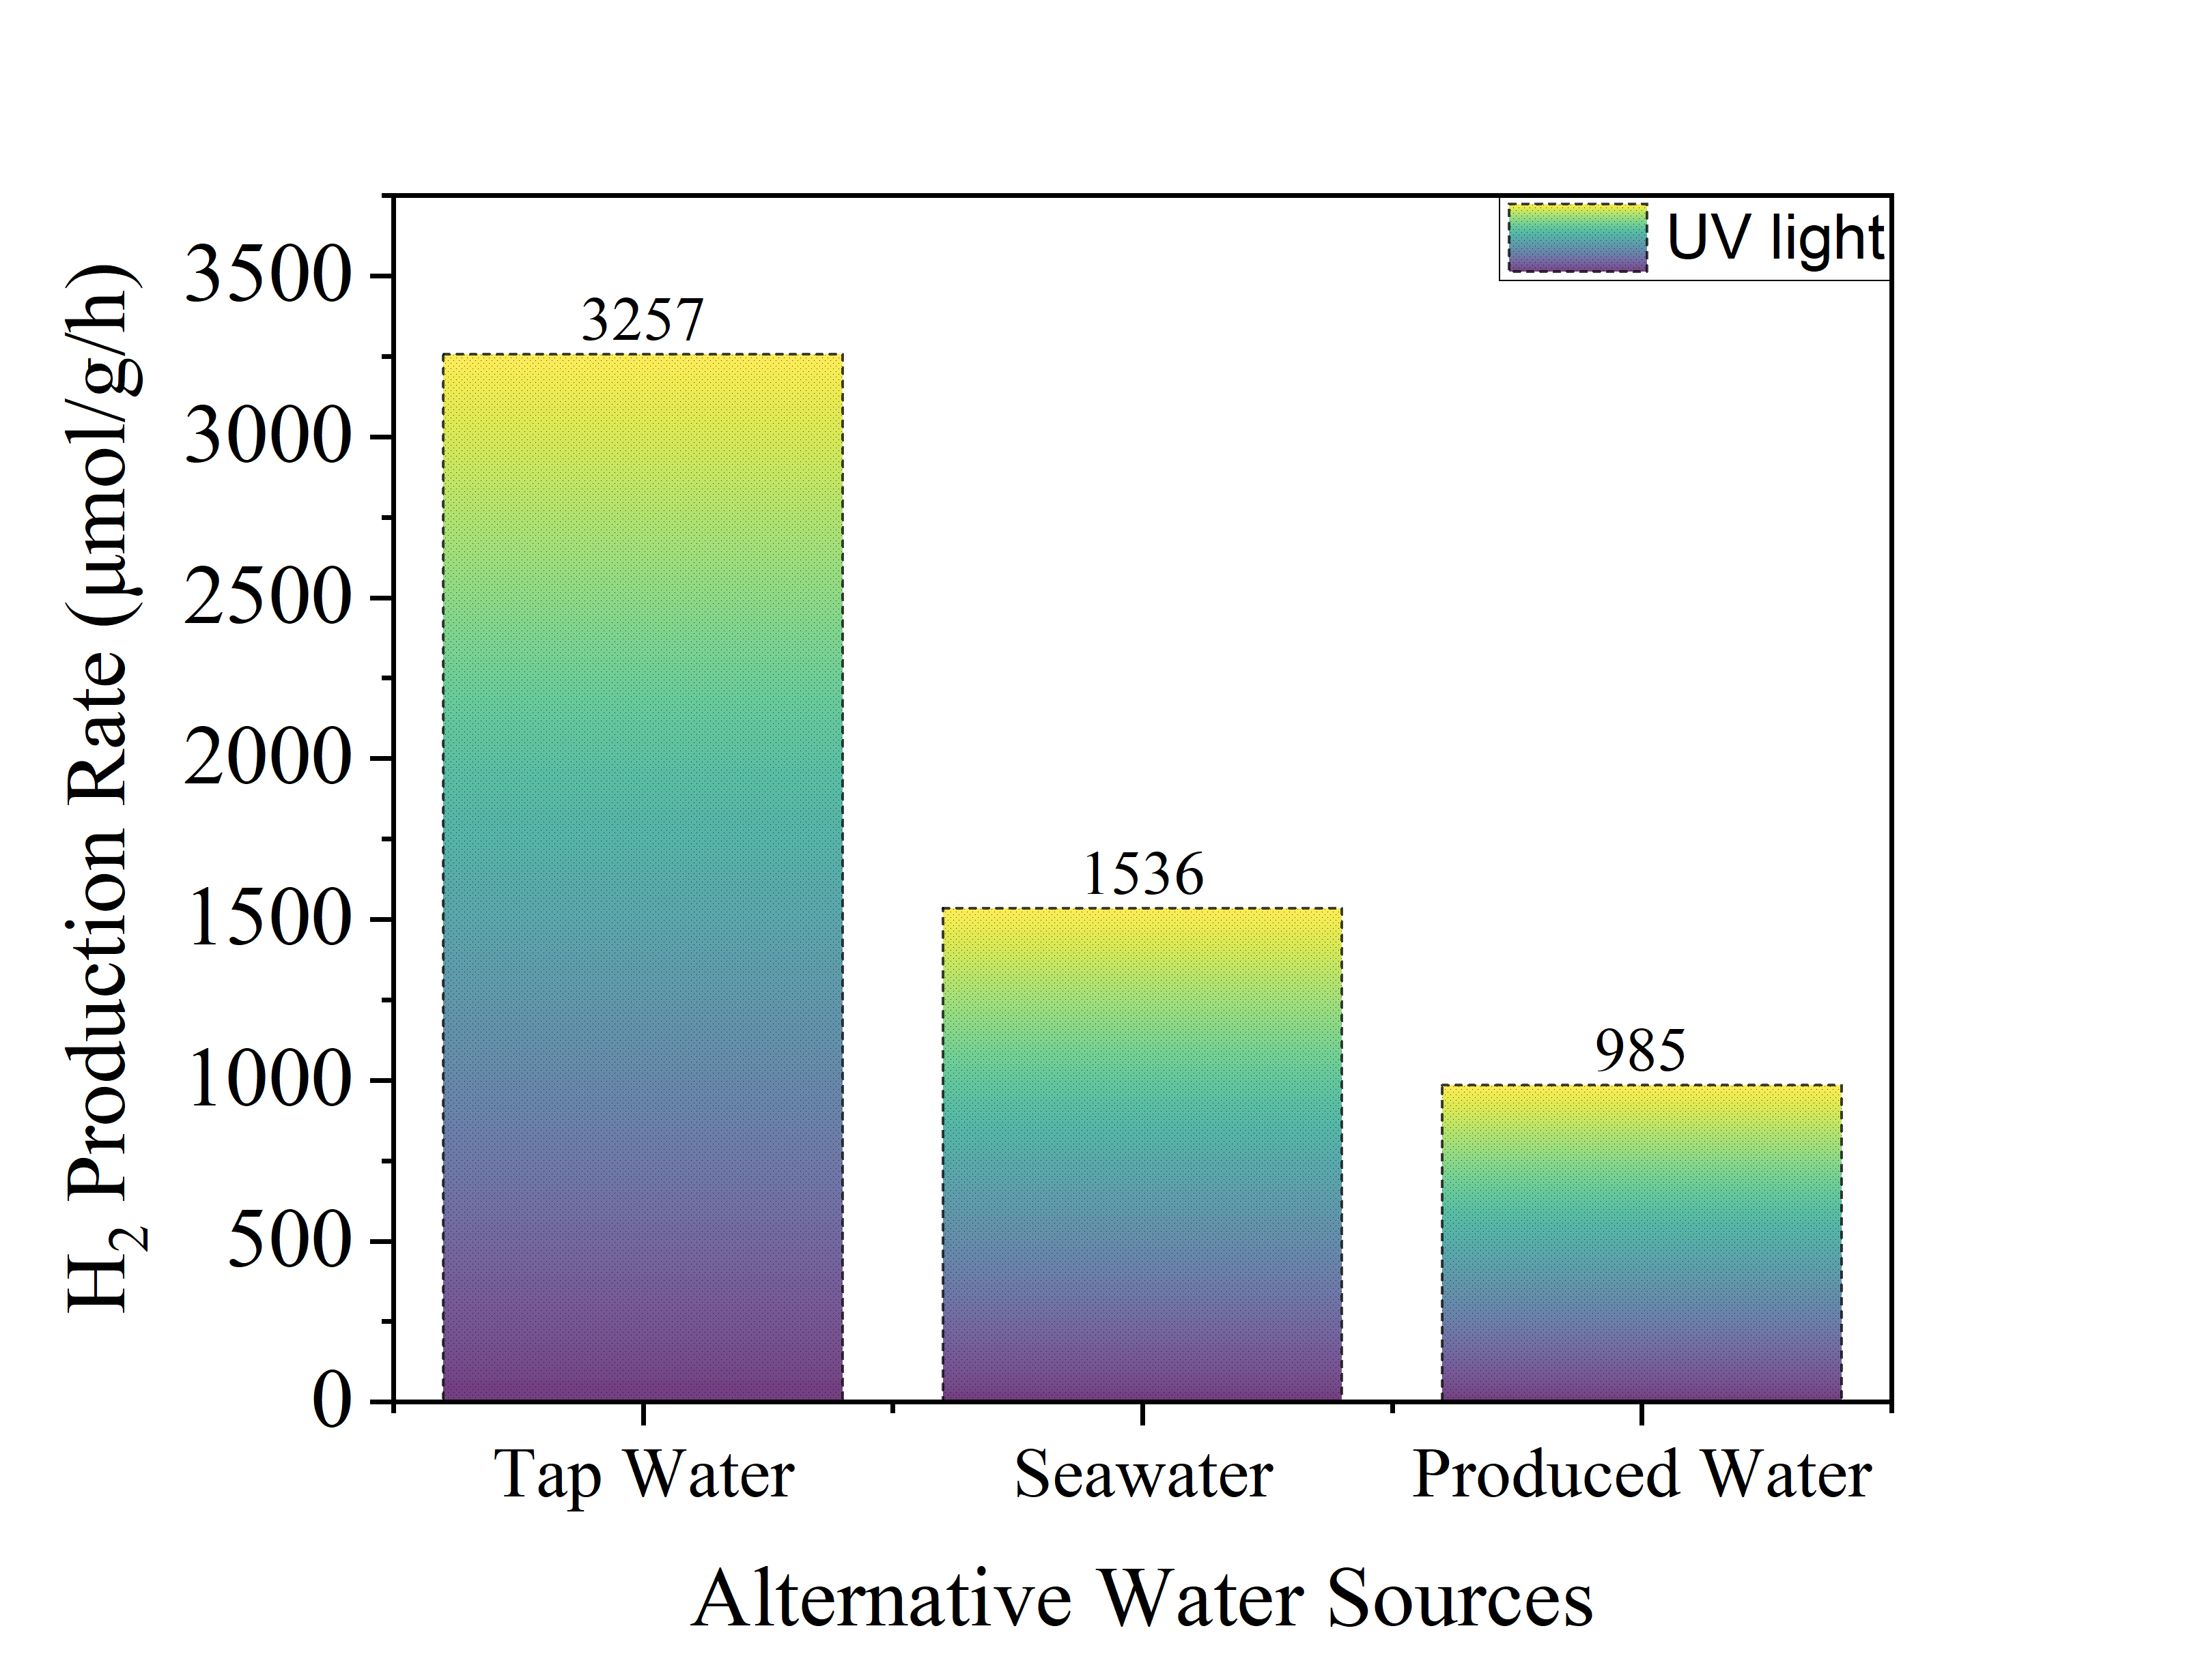
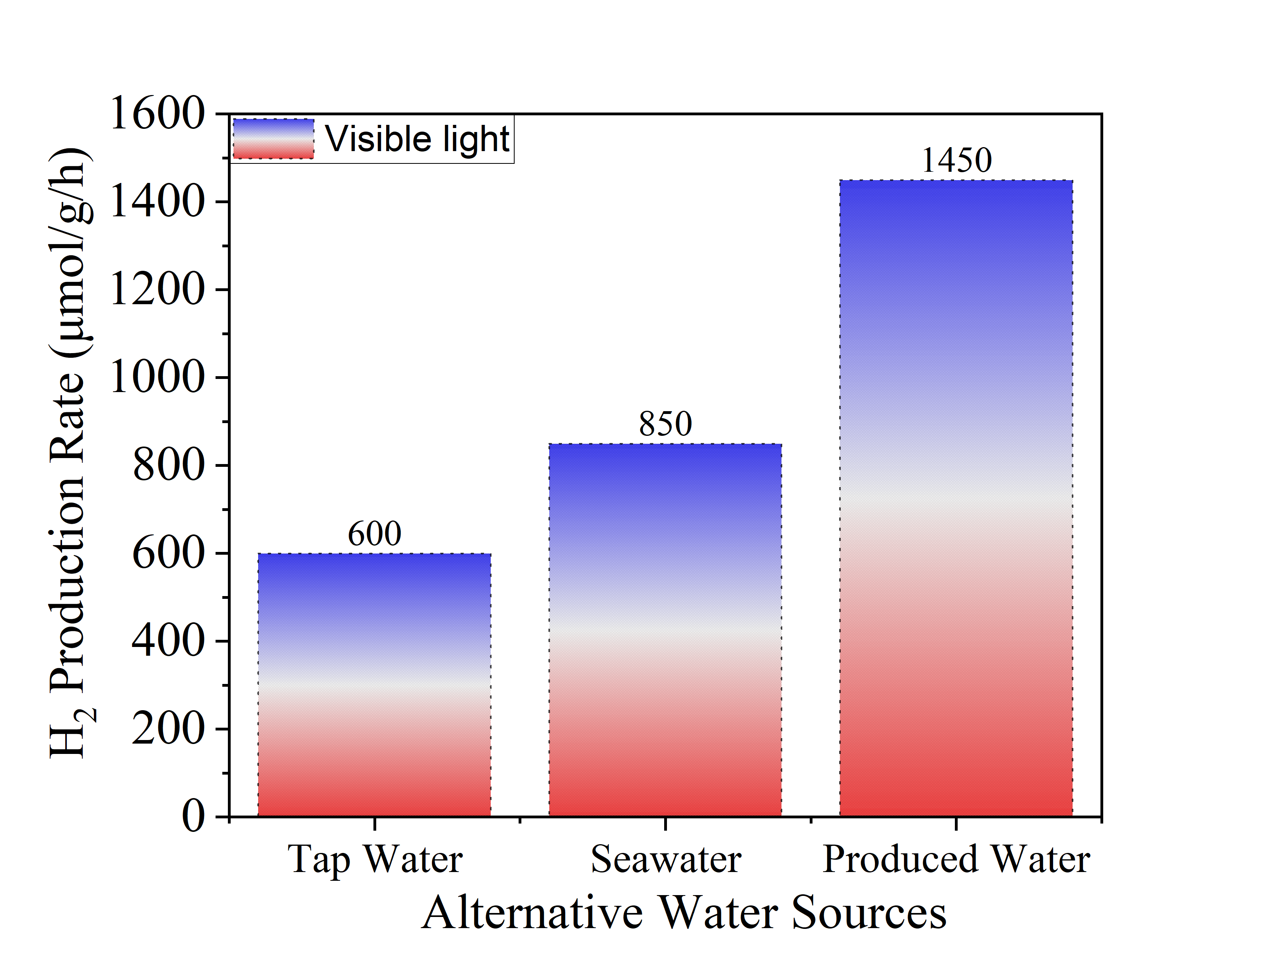
Hydrogen generation achieved using real water sources
Tap Water:
Consistent hydrogen production.
Brackish water and seawater:
H₂ is generated without pretreatment.
No additional cost for water pretreatment.
Produced water from the Permian Basin:
Used directly without any treatment.
Efficient hydrogen production achieved.
Simultaneous hydrogen production and ammonia reduction.
Wastewater:
Achieved concurrent hydrogen generation and organic removal.
Validated system performance across diverse, real water sources.
Operates under ambient conditions without external heating or pressure.
Figure 6: Hydrogen production rate from different alternative water sources under UV and visible light spectrum.
11
Notes:
Hydrogen Production from Various Water Sources
Tap Water:
Enables consistent and stable hydrogen production without the need for modifications.
Saline, Brackish Water, and Seawater:
Hydrogen is generated without any pretreatment,
Eliminates additional costs.
Produced Water from the Permian Basin:
Utilized directly without treatment.
Achieved efficient hydrogen production,
Enables simultaneous hydrogen generation and ammonia reduction.
Wastewater:
Demonstrated concurrent hydrogen production and organic pollutant removal,

Slide 13
Cost analysis
Aspect | Key Information
Production cost | $1.1-1.5/kg H₂ – close to DOE cost target
Energy source | Powered by free sunlight – no electricity cost
System design | Modular, scalable, and cost-effective setup
Deployment | Ideal for remote/off-grid
Feedstock | Utilize untreated alternative water – no pretreatment cost
Benefit | Offsets disposal cost and reduce waste
12
Notes:
Key Highlights of the Photocatalytic Hydrogen Production System
Production Cost: Estimated at $1.1–$1.5 per kg of H₂, aligning closely with the DOE cost target.
Energy Source: Powered by sunlight, eliminating electricity costs and enhancing sustainability.
System Design: Modular, scalable, and cost-effective, suitable for a wide range of applications and easy to deploy.
Deployment Potential: Ideal for remote or off-grid locations, reducing infrastructure dependence.
Feedstock: Uses untreated alternative water sources (e.g., saline, brackish, wastewater), eliminating pretreatment costs.
Environmental Benefit: Offsets water disposal costs while reducing environmental waste, supporting circular economy goals.

Slide 14
Market
Green Hydrogen Production
$4B market size | 55% Growth Rate
Driven by clean fuel policies and net-zero goals.
Produced Water Reuse and Treatment
~25 billion barrels/year by the U.S. oil and gas industry
Reduce environmental impacts.
Use Cases:
Hydrogen production directly from produced water in oilfields.
Renewable energy + wastewater treatment hybrid systems.
Industrial water reuse with energy recovery potential.
Clean hydrogen for local and off-grid applications.
13
Notes:
Market Opportunity and Use Cases
Green Hydrogen Production
Market Size: ~$4 billion
Growth Rate: ~55% annually
Key Drivers:
Global push for clean fuel alternatives
Net-zero carbon goals and climate policies
Produced Water Reuse & Treatment
The U.S. oil & gas industry generates ~25 billion barrels/year of produced water
Opportunity to reduce environmental impact and enhance resource recovery
Strategic Use Cases
On-site hydrogen production directly from produced water at oilfields
Hybrid systems combining renewable energy with wastewater treatment
Industrial water reuse integrated with energy recovery processes
Clean hydrogen supply for local and off-grid applications, reducing dependency on centralized infrastructure

Slide 15
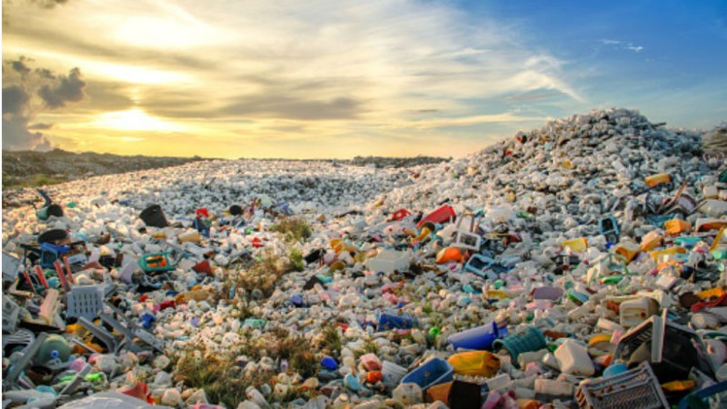

Another big challenge - plastic wastes
Globally, 448 million metric tons of plastics are generated annually
60% (275 million metric tons) of plastics pollutes the environment
18% (8 million metric tons) of plastics enters the ocean
The accumulation of plastic wastes in the environment has caused significant concerns about their health risks and ecological impacts.
This large-volume environmental contaminant, waste plastics, can be degraded and converted to hydrogen gas.
Source: Science News, 2021
Source: CNN, 2019
Figure 7: Plastic wastes
14
Notes:
In the world, 448 million tons of plastics are generated every year.
Only 40% is recycled
60% of plastics pollutes the environment and cause high health risk.

Slide 16
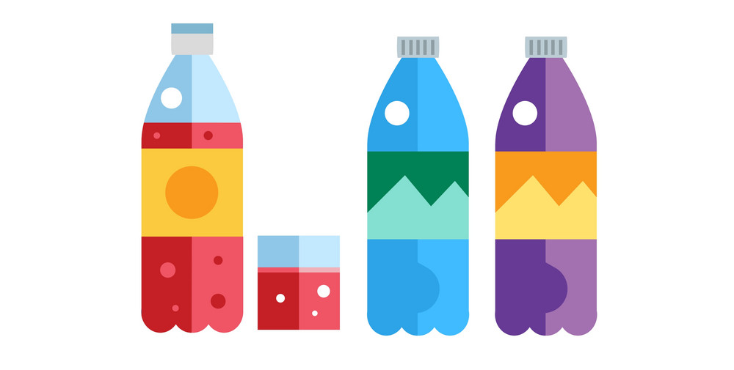
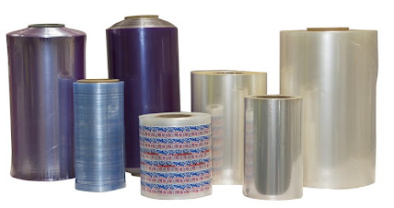
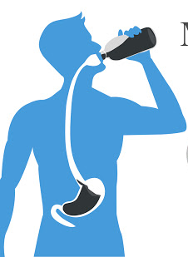


Health impact of microplastics
Polyethylene Terephthalate (PET)
Polyvinyl Chloride (PVC)
Can leach antimony in amounts exceed U.S. safety guidelines when exposed to high temperature.
Leaches toxic chemicals when in contact with water. The chemicals interfere with the body’s production of hormones.
High Density Polyethylene (HDPE)
Low Density Polyethylene (LDPE)
Leach estrogenic chemicals when exposed to heat, poor semen quality, early puberty and malformations of the reproductive tract.
LDPE is considered a low hazard plastic.
15
Notes:
The microplastic particles can accumulate in the human's body, such as kidney, ever brain. Different Plastics can cause different health problems.

Slide 17
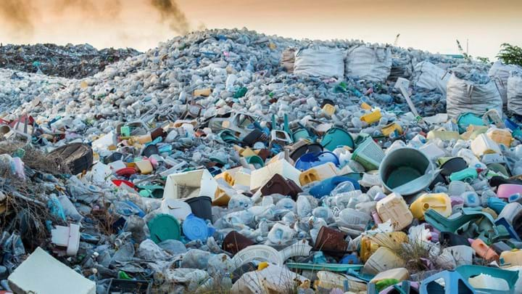
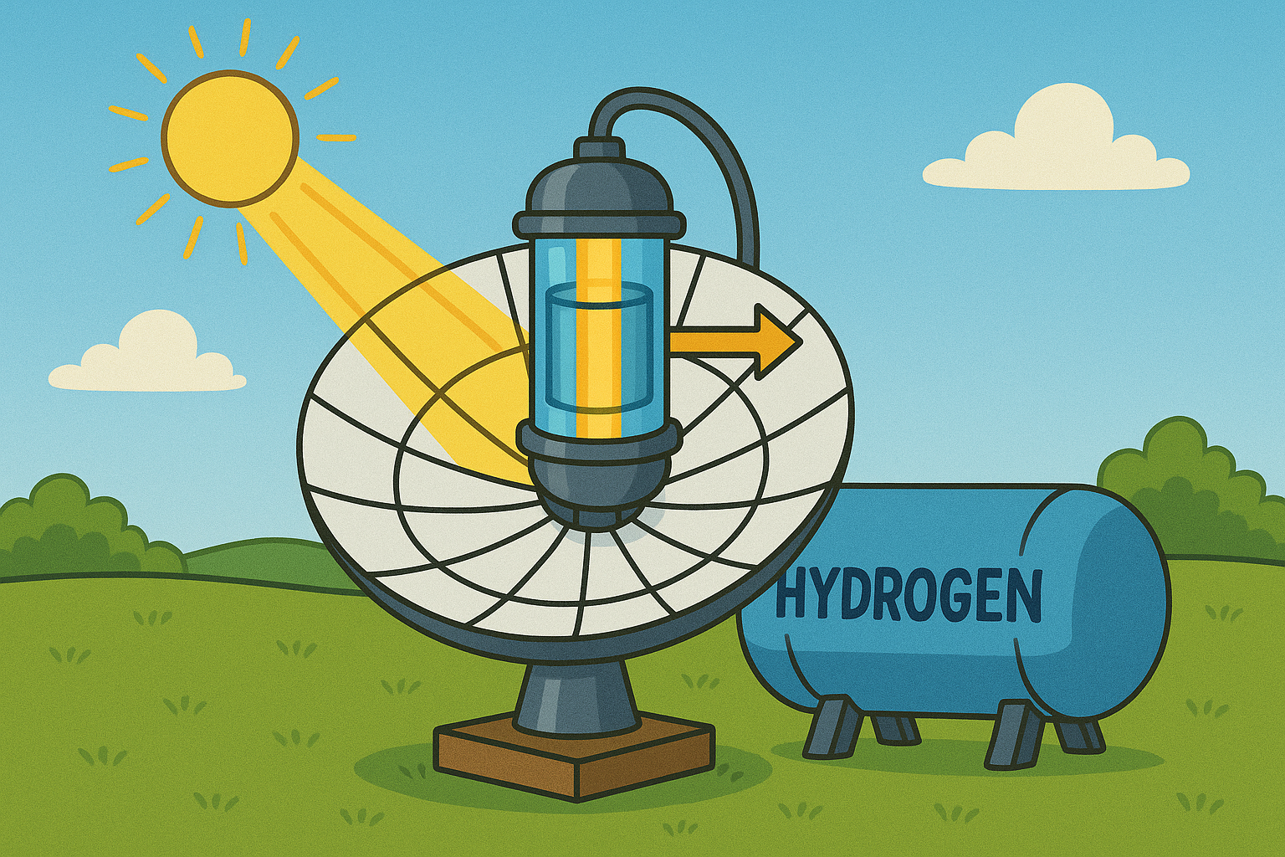
2. Photo reforming of plastic waste for H₂ production using nanocomposite photocatalysts (Waste to Energy)
Proposed solution:
Plastic Particles
Polyethylene terephthalate (PET)
Low-Density Polyethylene (LDPE)
Polystyrene (PS)
Clean and Green H₂
Pre-treatment
Alkaline hydrolysis
Catalyst
nano Au/TiO₂
nano Pt/TiO₂
nano Zn/TiO₂
16
Notes:
This large-volume waste plastics, can be degraded and converted to hydrogen gas by photo reforming method. One stone, two birds. We can degrade plastics and produce hydrogen at the same time.

Slide 18
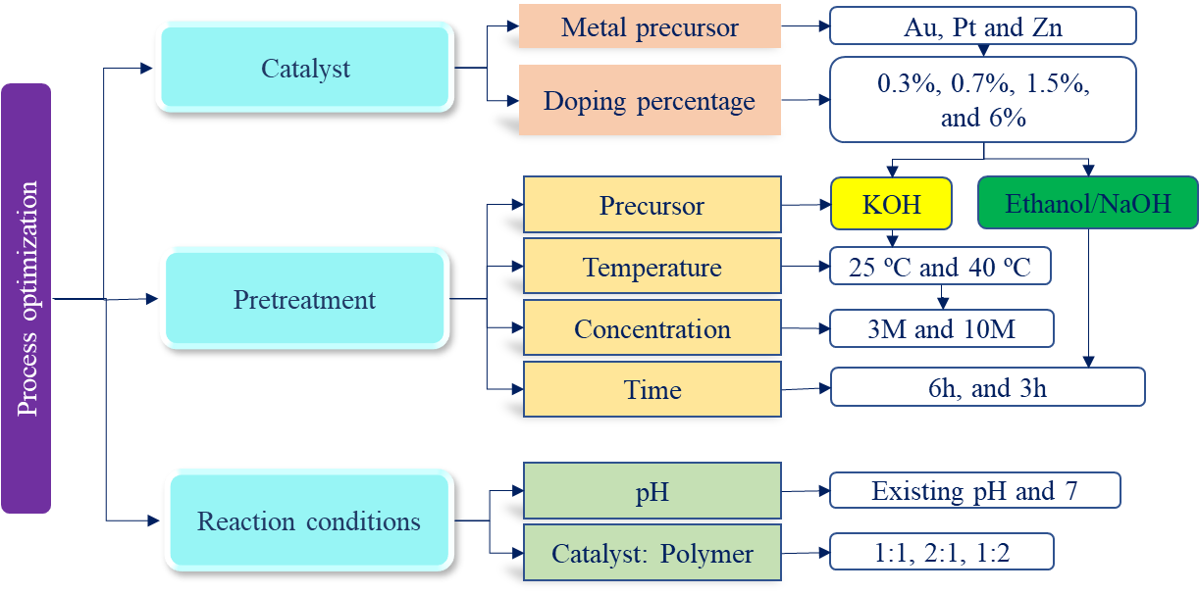
Optimization process of the photo-reforming
Figure 8: Optimization process of the photo-reforming hydrogen production system
17
Notes:
Figure 8 shows the overall hydrogen production optimization process. Three major factors, the catalysts, pretreatment, and reaction conditions, were optimized during the process. The catalysts were developed to boost hydrogen yield as the first step, and then the polymer pretreatment processes were developed to increase the monomer yield after hydrolysis. Reaction conditions such as pH and polymer-to-catalyst ratio were optimized to increase hydrogen yield.

Slide 19
R&D at NMSU for green H₂ production
Funded by the New Mexico Economic Development Department, NMSU collaborates with Global Impact Ventures (GIVE) and NM local companies to pilot and demonstrate a photocatalytic water splitting technology for H₂ production using solar energy and alternative water.
Simultaneous H₂ production and water treatment and recovery
6
18
Notes:
Funded by the New Mexico Economic Development Department, Our team is collaborating with Global Impact Ventures (GIVE) and local New Mexico companies to pilot and demonstrate a photocatalytic water-splitting technology for hydrogen (H₂) production. This project utilizes solar energy and alternative water sources, aiming to advance sustainable hydrogen generation in the state.
Powered by solar energy, the process generates water vapor as a byproduce. After condensation and cooling, this vapor can be collected as clean water, contributing to water recovery and reuse. TThis process integrates photocatalytic water splitting with water treatment and recovery, enabling dual benefits: the sustainable generation of hydrogen (H₂) fuel using solar energy, and the purification or reuse of alternative water sources.

Slide 20
R&D at NMSU for gGreen H₂ production
Patented Green H₂ production technologies developed by our team at NMSU
Photocatalytic water splitting for H₂ production using wastewater, brackish water, seawater, and produced water
Photoreforming plastic waste for H₂ production
Cost ~$1.1-1.5/kg H₂, meeting DOE target cost of $2/kg H₂ in 2026, and working towards $1/kg H₂ in 2030
7
19
Notes:
Patented Green Hydrogen Technologies Developed at NMSU
Innovative Photocatalytic Water Splitting Enables hydrogen production from non-traditional water sources including:
Wastewater
Brackish water
Seawater
Produced water (e.g., from oil & gas operations)
Photoreforming of Plastic Waste Converts plastic waste into clean hydrogen, addressing both energy and environmental challenges.
Cost-Effective Hydrogen Production
Current estimated cost: $1.1–$1.5/kg H₂
Aligned with the U.S. DOE target of $2/kg by 2025, and actively progressing toward $1/kg by 2030
electrolysis can result in zero greenhouse gas emissions, depending on the source of the electricity used.

Slide 21
Publications :
Edirisooriya, E.M.N.T., Senanayake, P.S., Xu, P., and Wang, H. * (2025). Recyclability and regeneration of Au/TiO₂ nanocomposite and Pt/TiO₂ atom-nano composite catalysts in photo-reforming plastics for hydrogen production. Journal of Environmental Chemical Engineering, 13 (3), 116467
Edirisooriya, E.M.N.T., Senanayake, P. S., Ahasan T., Xu, P., and Wang, H. * (2025). Comprehensive Insights into Photoreforming of Waste Plastics for Hydrogen Production. Catalysts, 15 (5), 453
Edirisooriya, E.M.N.T., Senanayake, P.S., Xu, P., and Wang, H. * (2025). Enhanced H₂ Production Efficiency in Photo-Reforming of PET Waste Plastic Using Dark-Deposited Atom/Nanocomposite Pt/TiO₂ Photocatalysts. Catalysts, 15 (4), 334
Ahasan T., Edirisooriya, E.M.N.T., Senanayake, P. S., Xu, P., and Wang, H. * (2025) Advanced TiO₂-Based Photocatalytic Systems for Water Splitting: Comprehensive Review from Fundamentals to Manufacturing. Molecules, 30 (5), 1127
Edirisooriya, E.M.N.T., Senanayake, P.S., Talipov M. R.; Xu, P., and Wang, H. * (2024). Optimization of green hydrogen production from plastic waste using TiO2-based nanocomposite & atom-nanocomposite photocatalysts with technoeconomic and carbon footprint assessment. Nanotechnology for Environmental Engineering, 00397-2.
Ahasan, T., Xu, P., Wang, H.* (2024). Dual-function photocatalysis in the visible spectrum: Ag-G-TiO₂ for simultaneous dye wastewater degradation and hydrogen production. Catalysts, 14, 530.
Edirisooriya, E.M.N.T., Senanayake, P.S., Xu, P., and Wang, H. * (2023) Hydrogen production and value-added chemical recovery from the photo-reforming process using waste plastics. Journal of Environmental Chemical Engineering, 11 (6), 111429.
Edirisooriya, E.M.N.T., Senanayake, P.S., Wang, H.B., Talipov, M.R., Xu, P., Wang, H*. (2023). Photo-reforming and degradation of waste plastics under UV and visible light for H₂ production using nanocomposite photocatalysts. Journal of Environmental Chemical Engineering, 11(2), 109580.
20

Slide 22
Conclusions
Photocatalytic water splitting and photo-reforming methods only use free sunlight, and alternative water or plastic waste as the feedstocks to produce green H₂ with a negative carbon footprint.
Various photocatalysts were synthesized, including Au/TiO₂, Pt/TiO₂, Zn/TiO₂ and Ag/G/TiO₂. The Pt/TiO₂ and Ag/G/TiO₂ atom-nanocomposites demonstrated the high efficiency for hydrogen production.
Efficient H₂ production can be achieved by optimizing pretreatment and reaction parameters.
The cost of H₂ production under optimum treatment conditions was $1.1-1.5/kg of H_{2.}
Photocatalysts can be recycled, regenerated, and reused.
Further development of single-atom deposition considering uniform distribution can minimizing metal usage and cost and improve catalytic efficiency.
21
Notes:
We already did a part of this work, and the lowest cost was about $1/kg of H₂

Slide 23
Thank you! Questions?
Huiyao Wang: huiyao@nmsu.edu

