Slide 1





brackish water in New Mexico
From the New Mexico Bureau of Geology at New Mexico Tech
Stacy Timmons
Associate Director, Hydrogeology Programs

Slide 2
Aquifer Mapping Program: What we do
Characterize the quantity, quality, and distribution of groundwater in aquifers using geology, geophysics, hydrology, and chemistry information
This program addresses state needs for groundwater and provides essential information used in planning, permitting, conserving, and protecting our most vital resource:
WATER

Slide 3
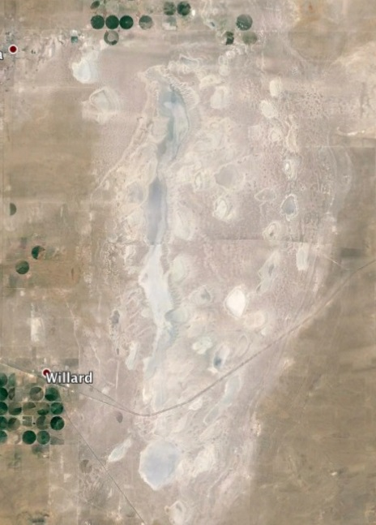
Brackish water In New Mexico
Found at a range of depths, shallow and deep.
We consider water to be “brackish” if the total dissolved solids (TDS) concentration ranges from 1000 to 10,000 ppm. (For reference, sea water is ~35,000 ppm TDS)
Brackish water starts as freshwater typically, but the fluids have spent more time in the subsurface interacting with rocks, thus increasing the TDS concentration.
The soluble minerals in rocks that make the water brackish have a wide range of chemistry - including sodium chloride (like table salt), or with other soluble minerals, like calcium sulfate.

Slide 4
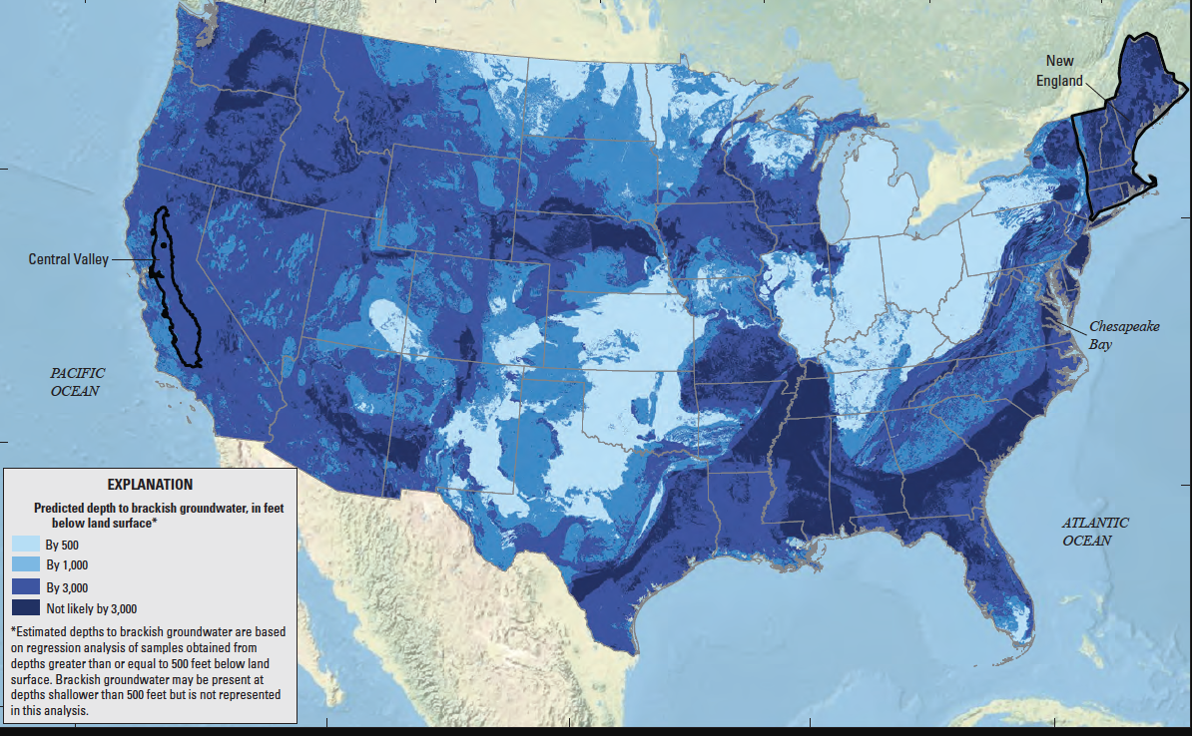
USGS Map of National Brackish Groundwater Assessment
from USGS professional paper 1833: Brackish Groundwater In The United States

Slide 5
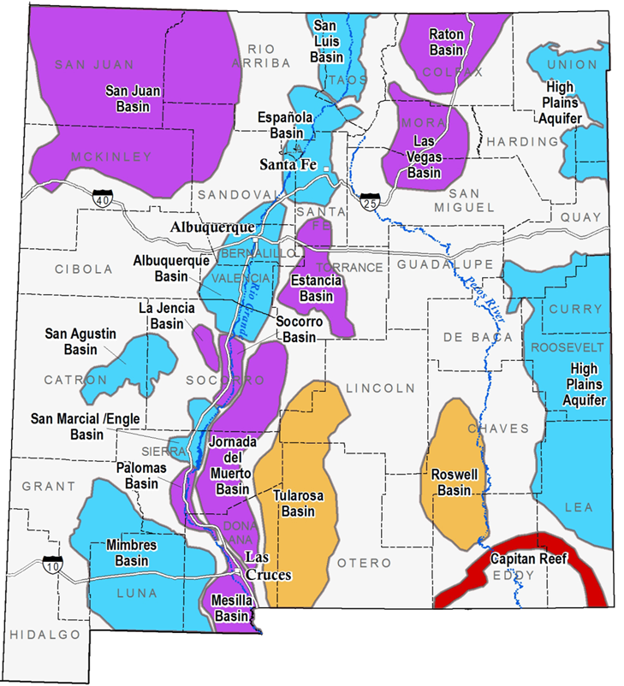
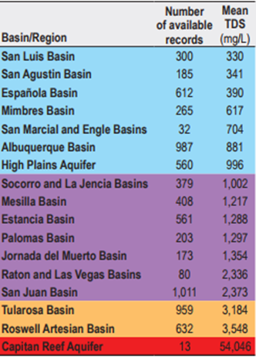
Statewide Brackish Water AssessmenT: NMBGMR Open FiLE REPORT 583
2014-2016: Funding from NMED
Digitized and compiled legacy water quality data – mostly drinking water wells from USGS, NMED and NMBGMR studies
Statewide Summary report: NMBGMR Open File Report 583
Tularosa Basin detailed study: NMBGMR Open File Report 582
maps.nmt.edu
More info at goo.gl/Tq1yFX
NMBGMR Open File Report 583

Slide 6
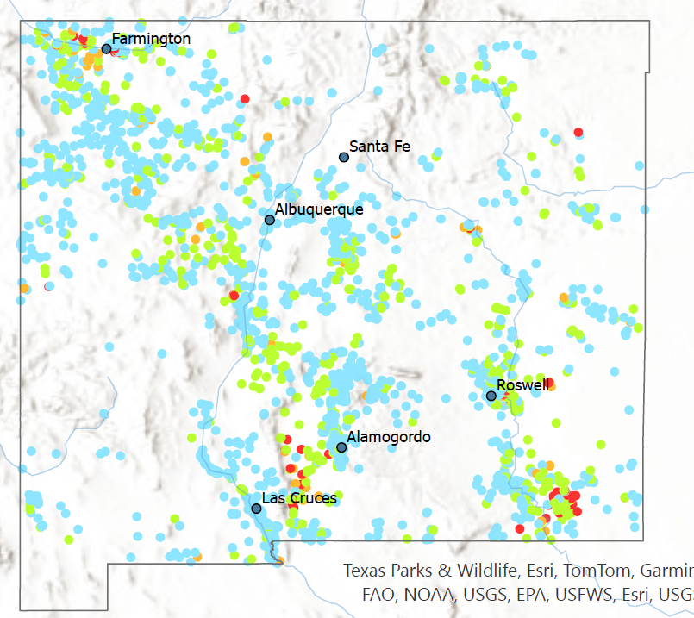
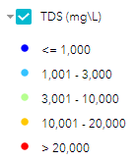
Brackish Water occurs across most of the state
About 8300 WATER wells have reported total dissolved solids (TDS) values digitally available; of those, about 2800 of these have brackish water >1000 ppm TDS.
Because most water wells are drilled for fresh water use, there is limited info on the extent and chemistry of brackish groundwater
The most significant brackish water basins likely include Albuquerque, San Juan, Roswell, Capitan Reef, Estancia, Mesilla and Tularosa.
Region specific studies are needed with exploratory wells focused on characterizing geology, water quality and aquifer properties
TDS (mg/L)

Slide 7
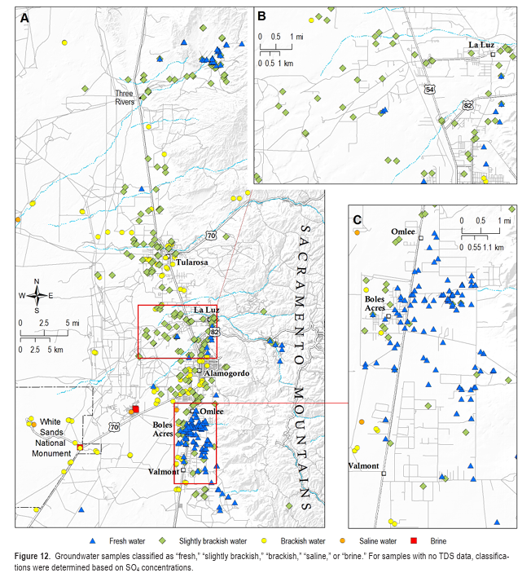
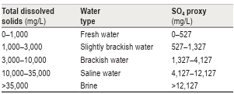
Tularosa Basin Brackish Water Assessment (NMBGMR Open File Report 582)
Many well owners are using brackish water, but there are challenges
Most groundwater in region is slightly brackish to brackish
In general, TDS concentrations increase towards the west and with depth as a result of fresh recharge mixing with saline water and brines.
Most existing wells are <400 ft deep
Future work needs to include exploratory/monitoring wells and geophysical surveys

Slide 8
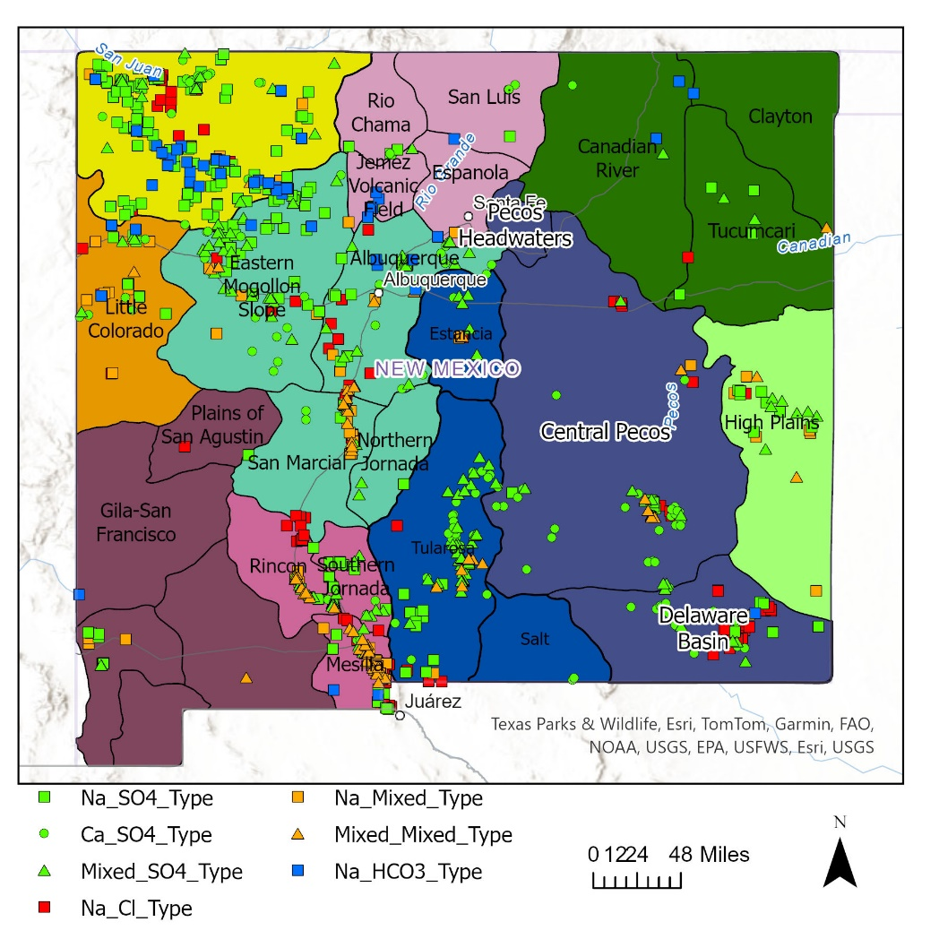
NEW! Brackish Groundwater Assessment
Compiling groundwater chemistry data and literature
Characterization brackish groundwater occurrences throughout the state
Depth
Geology
Hydrology – estimated hydrologic parameters (recharge, permeability, transmissivity, porosity…)
Geochemistry
Total dissolved solids
Water type
Contaminants of concern
Identify data gaps
Publication and data release target date: Spring 2026

Slide 9
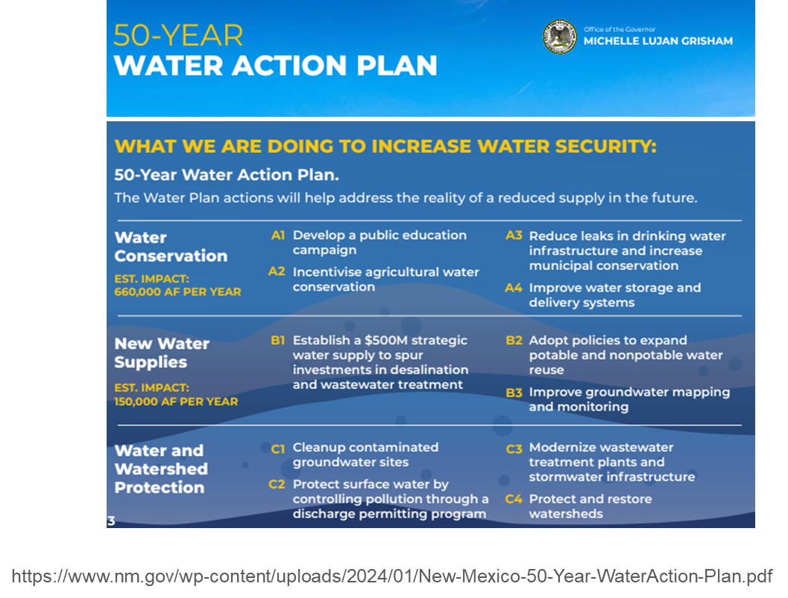
NM Bureau of Geology work From THE 50-YEAR WATER ACTION PLAN
Upon fulfillment of funding:
Characterize all major and minor aquifers in the state (fresh and brackish)
Characterize all major aquifers by 2032
Build a statewide groundwater monitoring network with 100 new dedicated wells by 2037

Slide 10
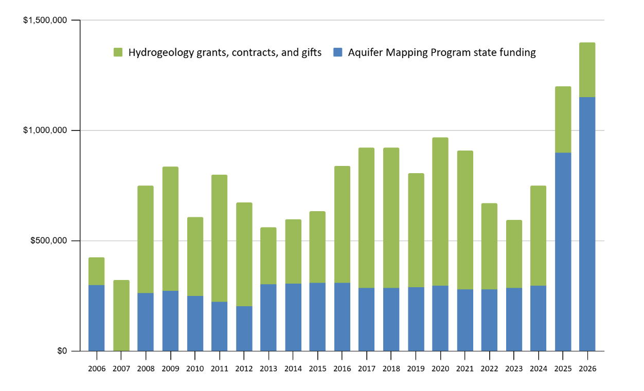
Current Aquifer Mapping budget and Since 2006
Plus! $7.5M non-recurring for FY2026

Slide 11
OUR VISION for Aquifer Characterization and Monitoring
Complete regional aquifer characterization
Build long-term groundwater monitoring
Compile existing data, reports and models
Address data gaps (water chemistry, water levels, geophysical studies, etc.)
Build improved conceptual and functional models
Full characterization of groundwater basins, including brackish and freshwater resources
Drill wells to fill data gaps; utilize high quality existing wells
Collect abundant data on each drilled well (geophysics, chemistry, age data)
Set wells for long-term monitoring with telemetry for aquifer levels, possibly water quality
Continued operation and maintenance; reporting updates
11

Slide 12
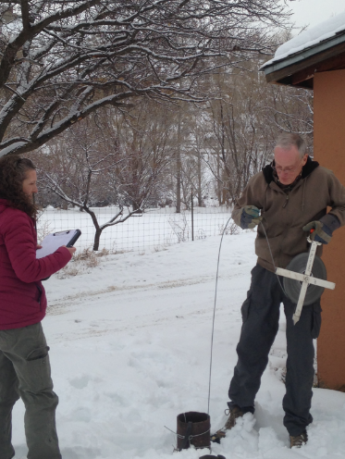
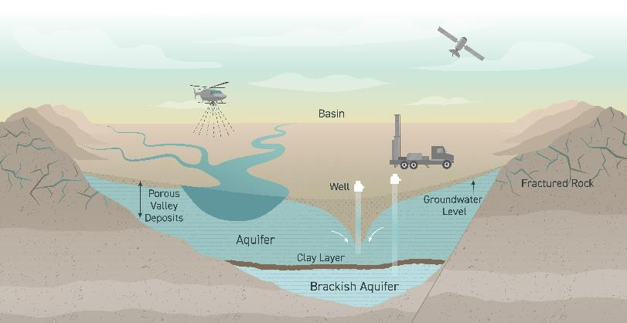
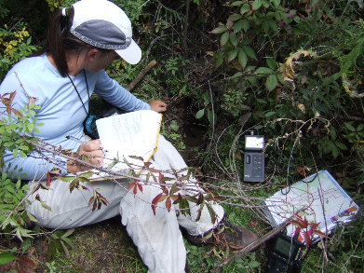
new data collection
Collect geophysics (i.e. airborne electromagnetic surveys (AEM))
Measure groundwater depths / changes
Geochemical sampling
Geologic mapping
Drill wells (exploratory, monitoring)

Slide 13
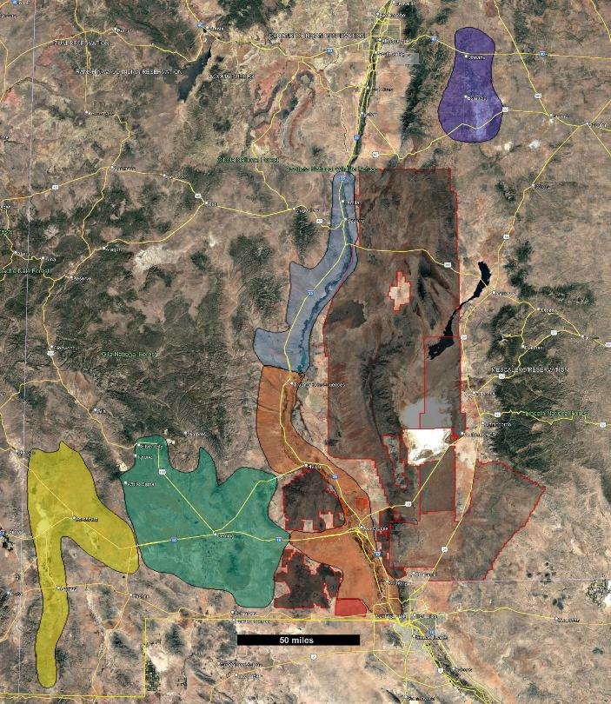
Planned Project areas this year
Alb.
Goal to conduct basin-scale geophysical surveys to locate fresh & brackish water down to 1000-1500 feet.
Projects will use airborne electromagnetic (AEM) paired with existing data, mapping and surveys
Current efforts include building resistivity models to select the best technology, evaluating vendors & tools
Applying any / all well-log data to improve accuracy in detecting fresh- and brackish-water zones
A
Estancia
B
Mimbres
A
C
LRG
D
MRG
E
Animas Valley
D
WSMR
HAFB
E
B
Ft. Bliss
C
Las Cruces
Sta. Teresa
13

Slide 14
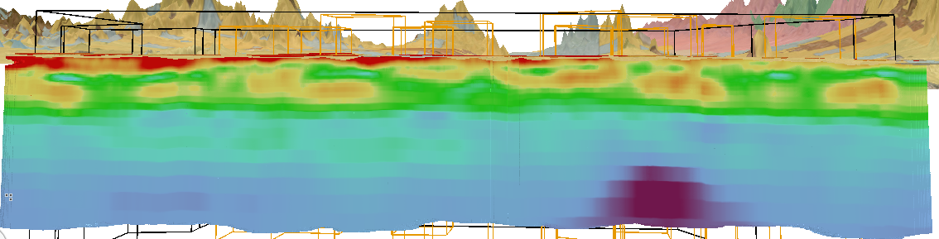
EXAMPLE: Santa Teresa study by NM ISC
Preliminary Results of Santa Teresa AEM study
ISC 2024-25 study to locate brackish-water in west Mesilla Basin with limited well data
Preliminary findings used to guide well placement / next steps
Reveals hydrogeologic features in alluvial basins, including potential brackish / geothermal anomalies
Data helps optimize upcoming NMBGMR airborne electromagnetic surveys
Resistivity map at 700 ft depth
Resistivity cross section: Preliminary Results
Sand/Gravel
Silt/Clay
Water Table
Fresh/Brackish contact?
Low-resistivity feature

Slide 15
Planning for alternative water supplies
Discussions to have:
Where are the communities currently needing additional water supplies?
How much additional water is needed?
Are there water alternatives available that can meet this need that are realistic from economic, engineering and environmental perspective?

Slide 16
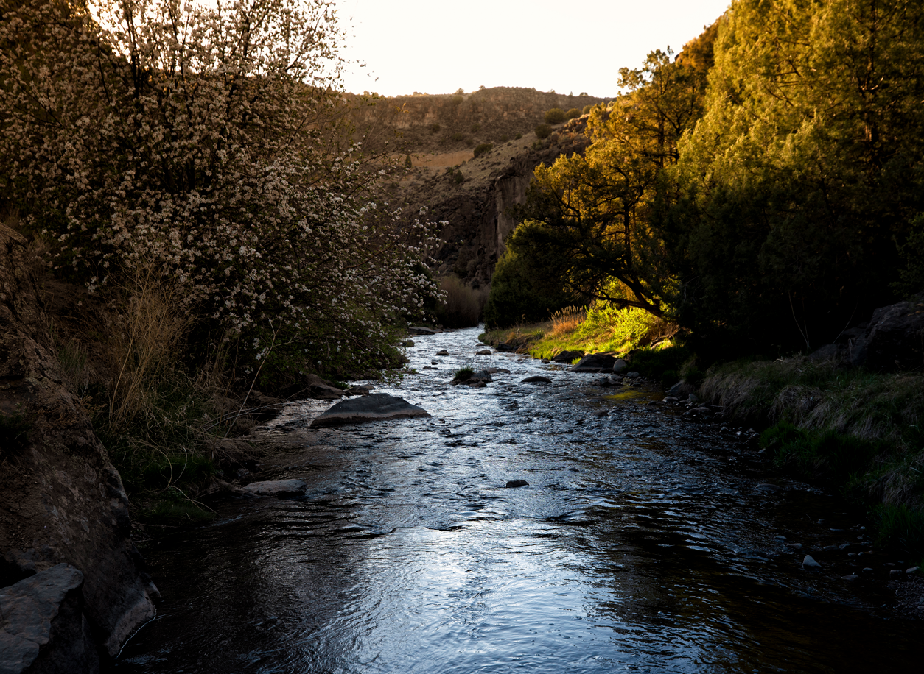
Stacy.Timmons@nmt.edu

