Slide 1
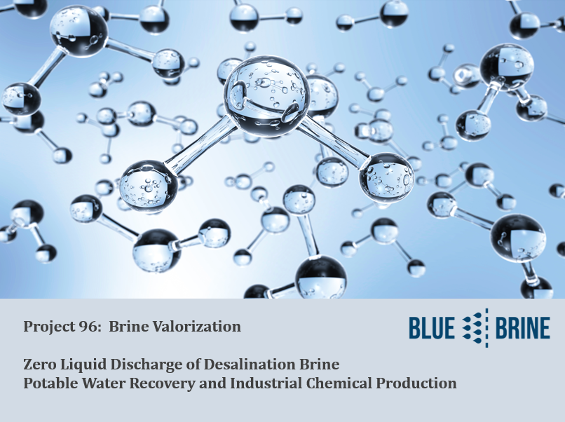

Slide 2

Blue brine project 96: Two fundamental questions
What if the waste brine happened to be worth MORE than the pure water being produced?
What if we could convert the efficiency of ANY desalination plant from 40-50% recovery to >96% recovery?

Slide 3

Recovery/Efficiency of a Typical Desalination Plant
Only 40-50% of water entering a desalination plant becomes potable water. The rest is returned as a waste concentrate.
50-60% (approx.)
Concentrate return to source
100%
Water Fed to Desalination Plant
40-50% (approx.)
Water Recovered as Potable

Slide 4
Seawater Constituents (Pacific)

Slide 5
What is the process:
Transfer the brine to the Blue Brine facility
Reorganize the ions and molecules into useful chemicals
Fractionate out the chemicals for commercial offtake
Return the potable water

Slide 6
Recovery/Efficiency by adding blue Brine Technology
The Blue Brine facility converts the brine into useful industrial chemicals and returns potable water to the desalination plant.
50-60% (approx.) Brine
40-50% (approx.)
Pure Water
40-45% (approx.)
Pure Water Return
Industrial Products:
-Magnesium (Mg)
-Gypsum (CaSO4)
-Caustic Soda (NaOH)
-Hydrochloric Acid (HCl)

Slide 7
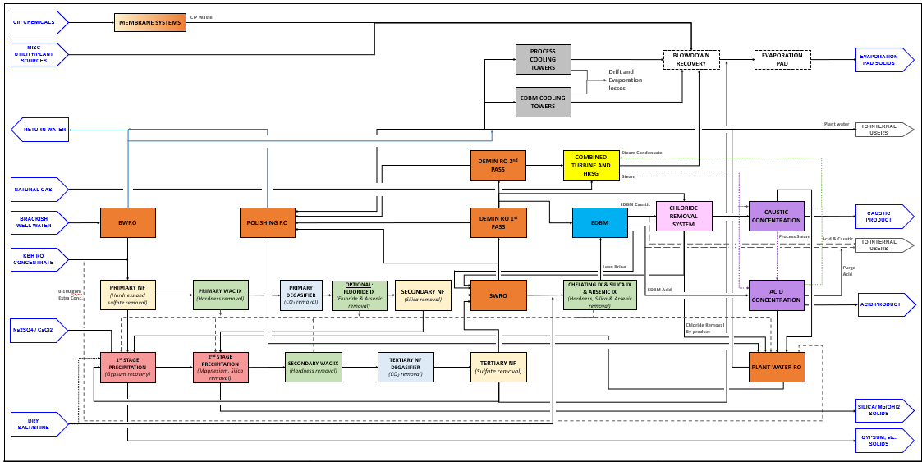
Simple concept: numerous integrated processes
Engineering Challenges: ZLD, NSF Compliance, Process Design, Scaling from Pilots

Slide 8
Process stages
Gypsum precipitation using nanofiltration, hydrocyclones and dewatering.
Magnesium Hydroxide precipitation using nanofiltration and vibratory shear membrane concentration.
Salt concentration using SWRO’s
Ion exchange and chelating to remove divalent & trivalent ions
Electrodialysis for production of HCl and NaOH
Distillation of HCl and NaOH
Storage & Offtaking

Slide 9
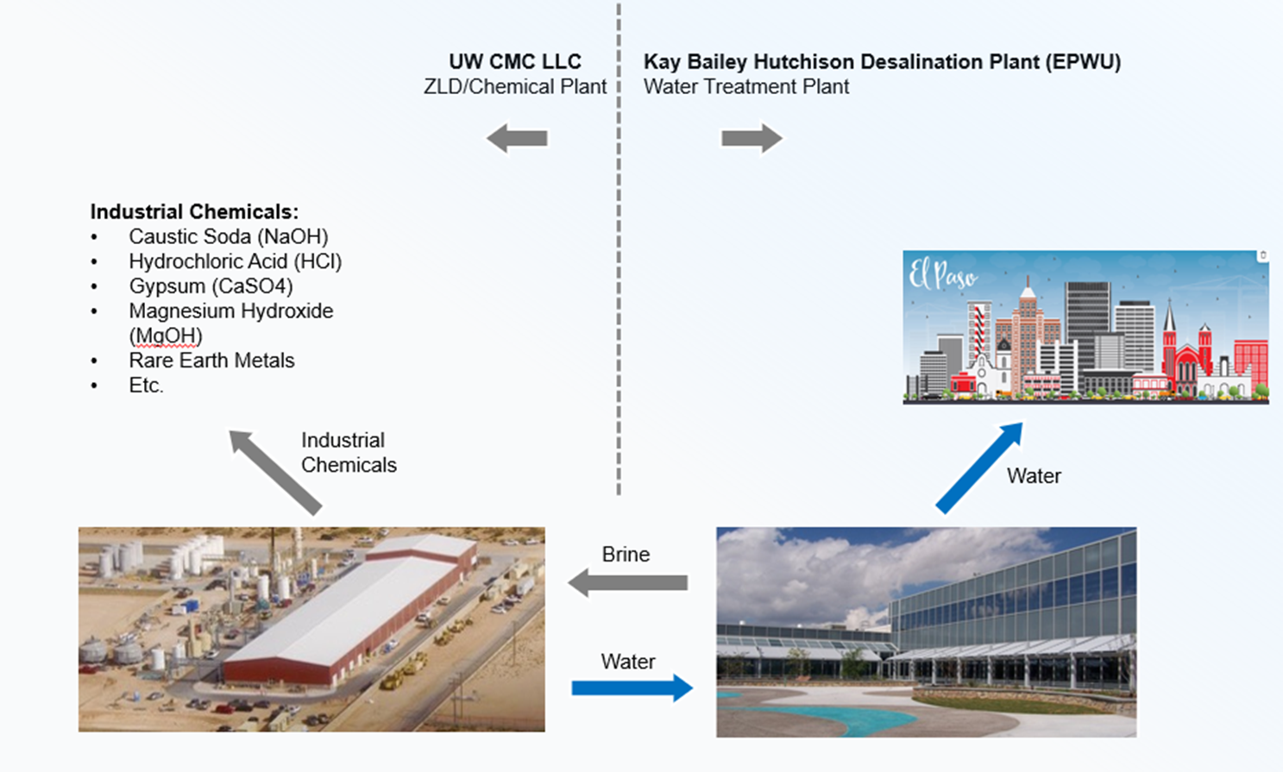
el paso, Texas project….. 10,000 m3/day

Slide 10
Project efforts to date
Project touched by over 200 engineers
Core team of 20 Engineers and Technicians
3 Years of Design, Engineering, Piloting and Testing
$USD 75 Million invested to date. $85M remaining
Construction completion December 2026
Confidential & Proprietary

Slide 11
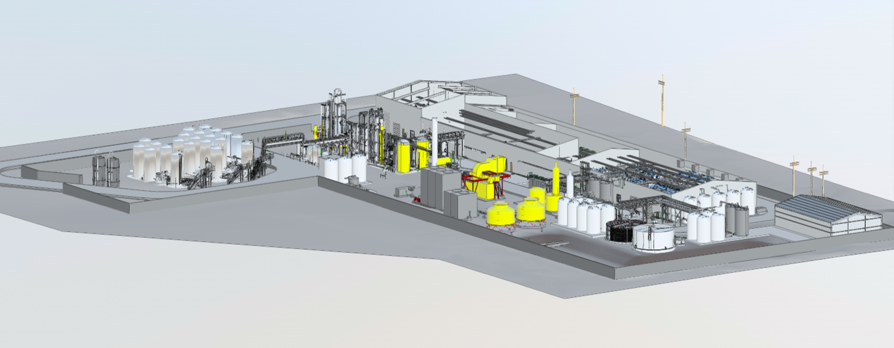
7 Hectare site: end to end treatment & Distribution

Slide 12
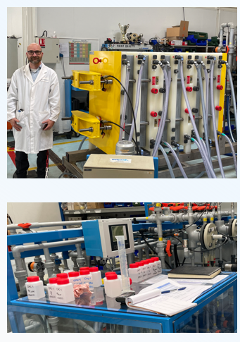
Electrodialysis bipolar membrane piloting & Testing

Slide 13
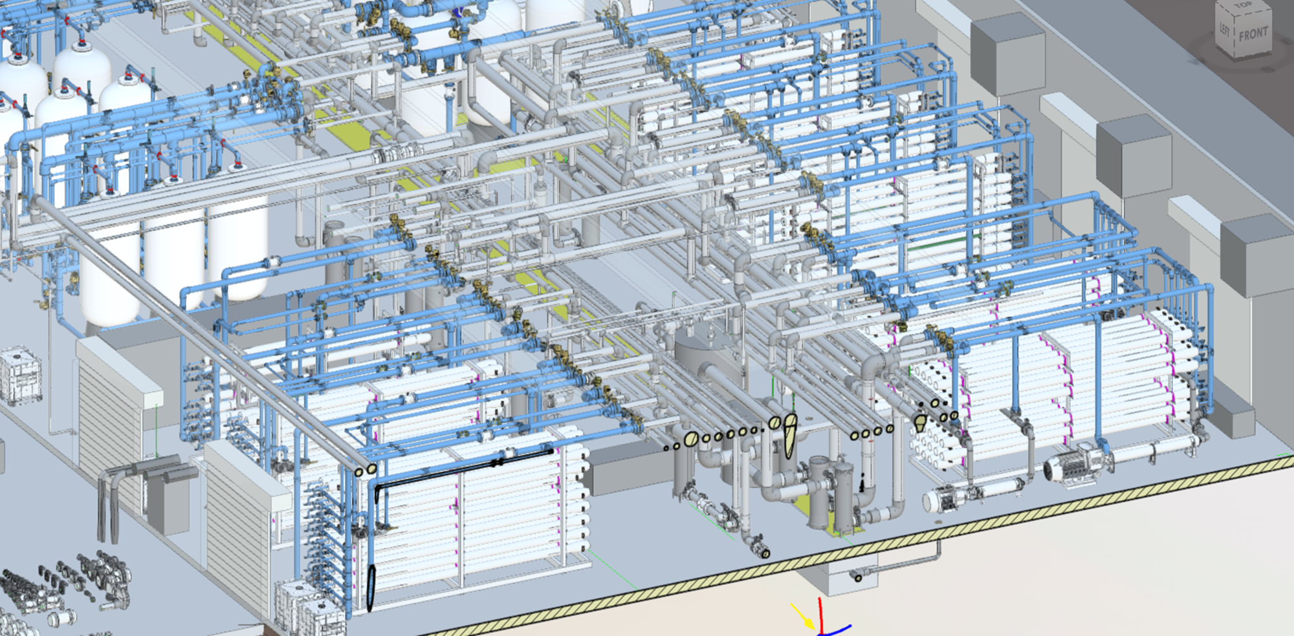
22 Membrane skids: Nano, BWRO, SWRO

Slide 14
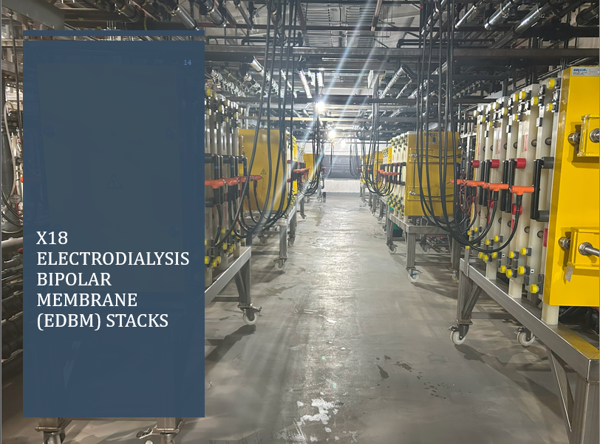

Slide 15



Key Takeaways
Surface and sub-surface discharge of brine represents a lost opportunity.
The production of industrial chemicals from salt brines is technically and commercially feasible.
Production of industrial chemicals from salt brines is profitable
Salt brines can be selectively engineered to obtain specific elements or chemical compounds.
Seawater Desalination Plants can almost double their capacity with this technology.

