Slide 1
Treatment and Beneficial Uses of Produced Water
Zachary Stoll Ph.D., Assistant Director
New Mexico Produced Water Research Consortium
Session Speakers
Jianjia Yu, Ph.D., New Mexico Tech
Yanyan Zhang, Ph.D., New Mexico State University
Adrianne Lopez, Texas Pacific Water Resources and Punhasa Senanayake, New Mexico State University
Huiyao Wang, Ph.D., New Mexico State University
Disclaimer: The New Mexico Produced Water Research Consortium at New Mexico State University is conducting independent, science-based research to evaluate potential environmental and health effects related to the reuse of treated produced water for fit-for-purpose applications. This work is designed to generate objective data under controlled conditions, without promoting or opposing any specific reuse practices. Our goal is to provide clear, reliable information that supports informed decision-making around the safe and responsible use of produced water in New Mexico and beyond.
This presentation includes preliminary research data from the New Mexico Produced Water Research Consortium at New Mexico State University. The information presented is subject to change and has not yet undergone formal quality assurance or quality control (QA/QC) review. Distribution or sharing of this material without prior authorization from New Mexico State University is not permitted.
Notes:
Hope everyone had a gtreat lunch and thanks to Sam for the excellent keynote.
We’re going to pivot from Ag to

Slide 2
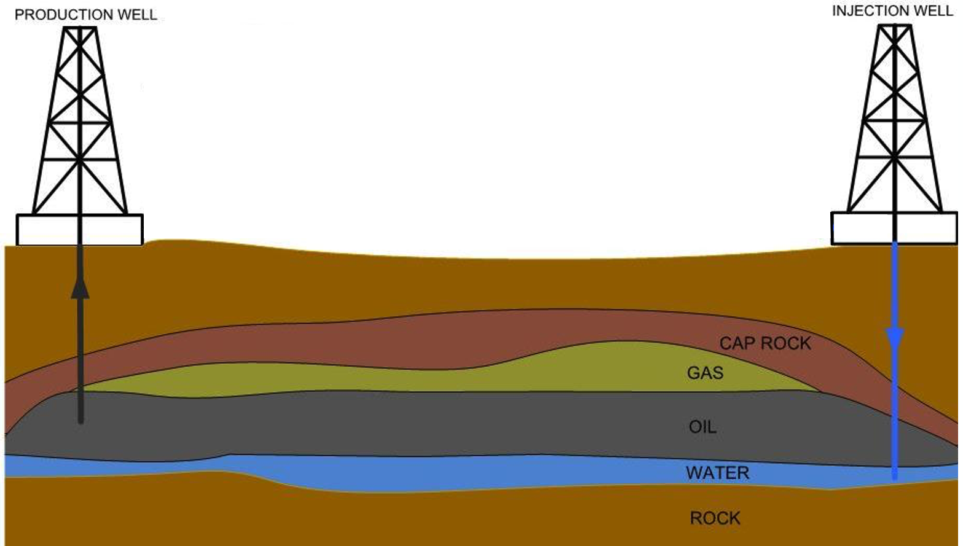
What is Produced Water?
Produced Water is:
Naturally occurring formation water co-mingled with oil and gas.
Typically, high in salts, metals, and organic compounds.
A byproduct from oil and gas extraction.
Oil-Water Separator
Oil to Refining
Produced Water
to Injection
Recycled
Modified from https://www.lenzing-technik.com/en/news/detail/news/produced-water-management/

Slide 3
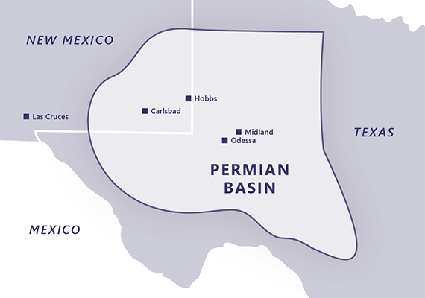
The Role of Produced Water in New Mexico’s
New Mexico is the 2nd largest oil producer in the United States and is among the top natural gas-producing states.
How much produced water is generated in NM?
220 MGD
50 MGD
9 MGD
18 MGD
8 MGD
https://www.okenergytoday.com/2025/04/discussion-grows-about-permian-basin-and-end-of-peak-production/
Notes:
1.9 billion bbls/year = 5.4 million bbls/day = 220 MGD
= ~ 50 MGD after recycle & treatment
What could we do with 50 MGD more freshwater in this region? There are many considerations and challenges to overcome but, this is the purpose for this event, and this session, which is to showcase how far the research and science has come over the last few years.
Before handing it over to our speakers, I did want to cover some brief terminology because if you start googling PW you will see inconsistencies in how certain terms are used, and its leading to a lot of confusion of what researchers are actually trying to do.

Slide 4
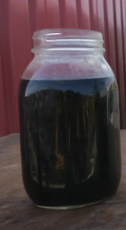
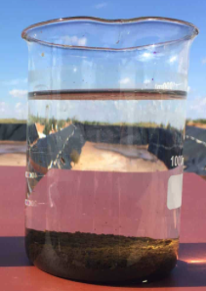
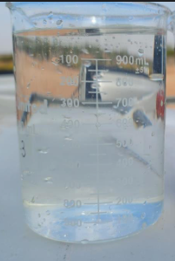
Terminology
Raw PW
Clean Brine
Desal. PW
Pol. PW
Water
Type
TM
TM
TM
Appearance
Salinity
Extremely High
(~120,000 mg/L TDS)
Extremely High
(~120,000 mg/L TDS)
Low
(< 500 mg/L TDS)
Low
(< 500 mg/L TDS)
Reuse
Inside O&G
(Fracking)
Reuse
Outside O&G*
Reuse
Outside O&G
Uses
None
Notes:
So the first term I want everyone to be aware of is what “raw PW” is.
This is the water that comes directly out of the ground that is co-mingled with the oil and gas and has undergone separation
As with any untreated wastewater, it contains a lot of nasties including salts, metals, and organics that need to be removed prior thinking about reuse.
The next is “clean brine”, which is the resulting water from a partial treatment of the raw PW. This water is treated to a standard specification for re-use inside the O&G field mostly for fracking but there are other uses.
This water still contains very high levels of salt and contains elevated levels of oils, hydrocarbons, and metals.
While it is true that you could call this “treated PW”, and many news articles and media outlets will do this then claim this is the water that entities are wanting to water crops with or put into the environment, this is 100% incorrect.
This clean brine is only for use within the O&G field.
What researchers, engineers, and sciencitsts in the field call “treated PW” is the desalinated produced water.
This water has undergone an immense amount of treatment to remove all of the oil, hydrocarbons, over 99% of the salts, and get the water to a level that is much more amenable for reuse applications outside the o&G field.
There is an astericks here because there are still trace compounds present in this water that can be toxic.
So Futher treatment is required, and this is accomplished by adding yet more treatment on the back end, to generate what we call a “polished” produced water.
These are processes like your water softener and a brita filter that are engineered to remove these residual compounds.

