Slide 1


High-purity Water Recovery from Produced Water via Membrane Distillation
2nd Annual State of the Science Symposium
Jianjia Yu
Assistant Professor of Chemical Engineering Research Engineer/Section Head
Petroleum Recovery Research Center (PRRC)
New Mexico Institute of Mining and Technology, Socorro, NM 87801
August 26, 2025

Slide 2
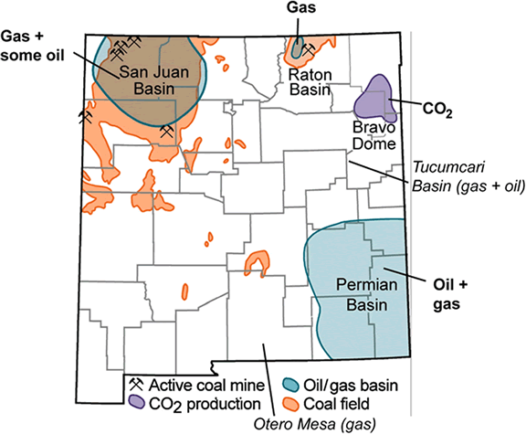

Where is the PRRC?
Located in Socorro;
Central location ~3-4 hour drive to all producing areas in the state.

Slide 3
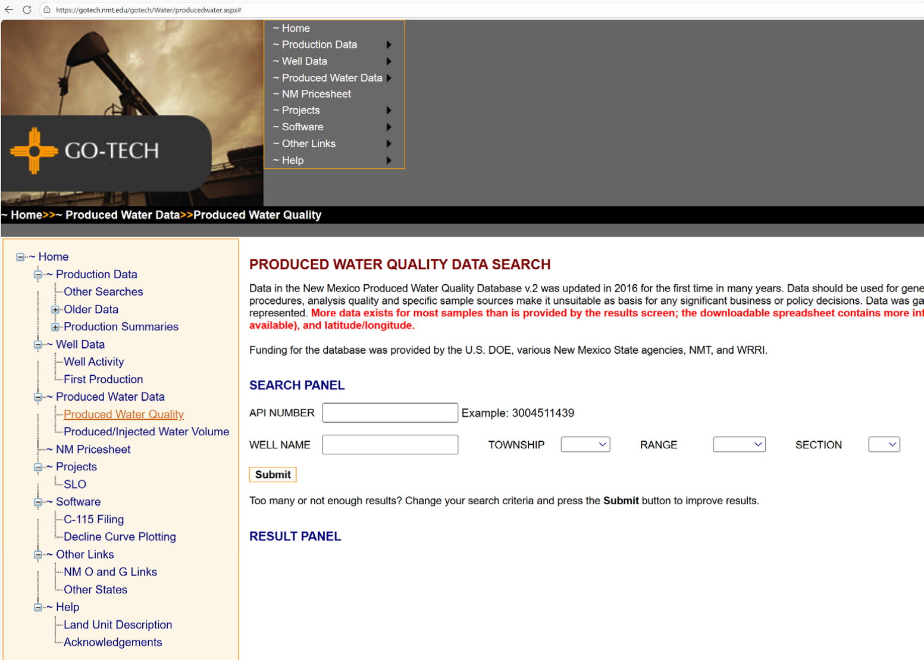
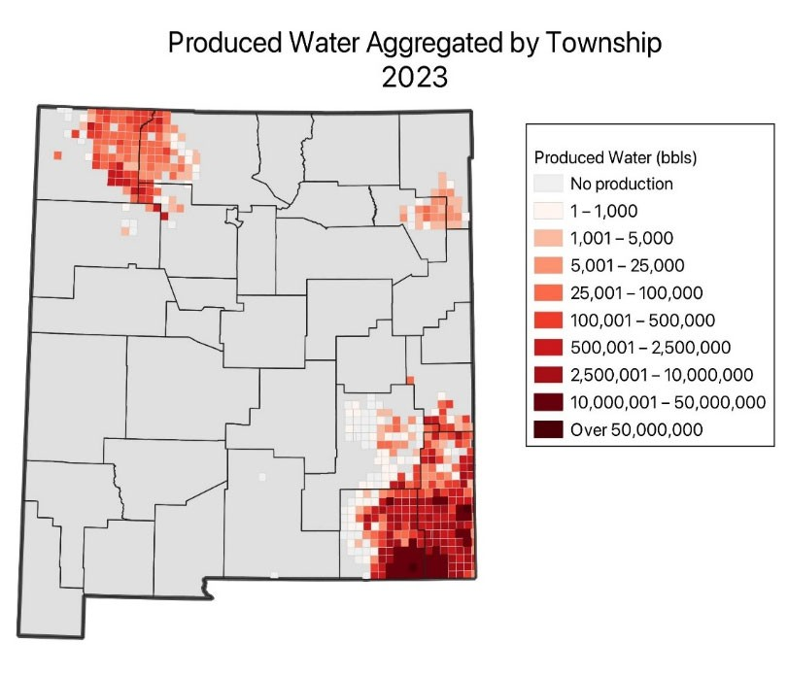
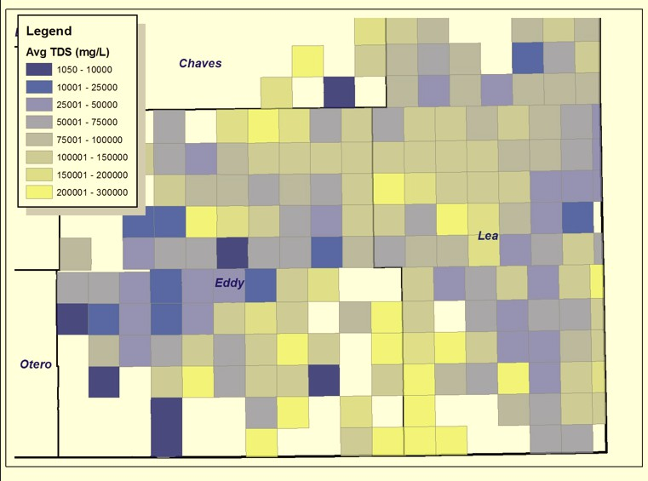
GO-TECH
New Mexico Water and Infrastructure Data System (NM WAIDS), Led by Martha Cather.
GO-TECH Web Site (production data, well info, produced water data, etc).
>10 million page views each year!
Water quality data available for
~9,400 wells and volume data for over 75,000 wells on GO-TECH.
(From Martha Cather, 2025)

Slide 4
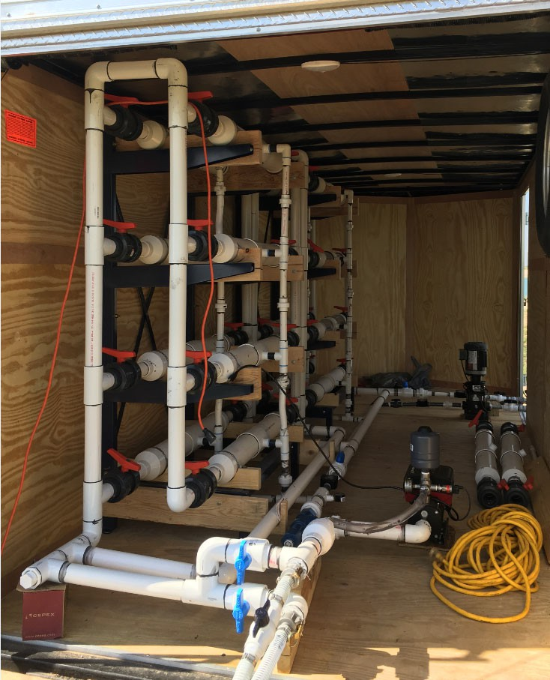
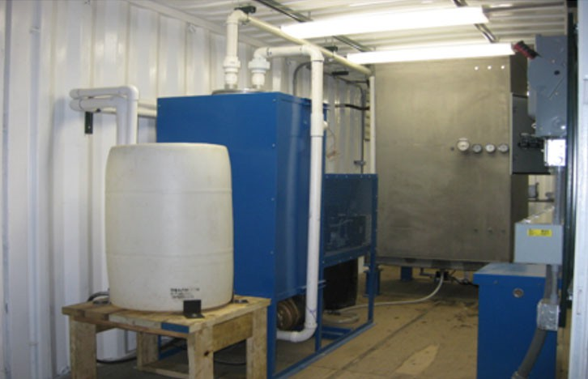
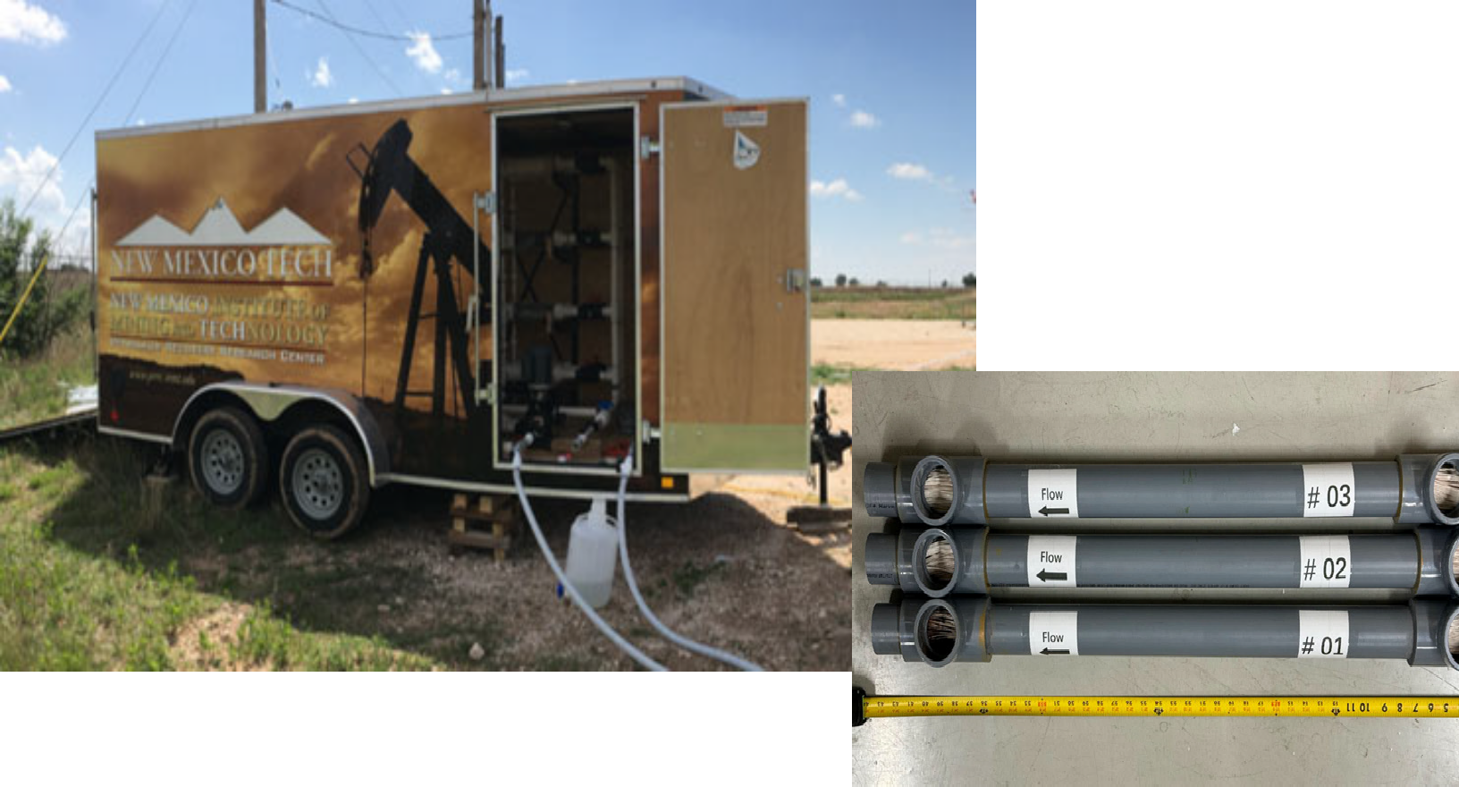
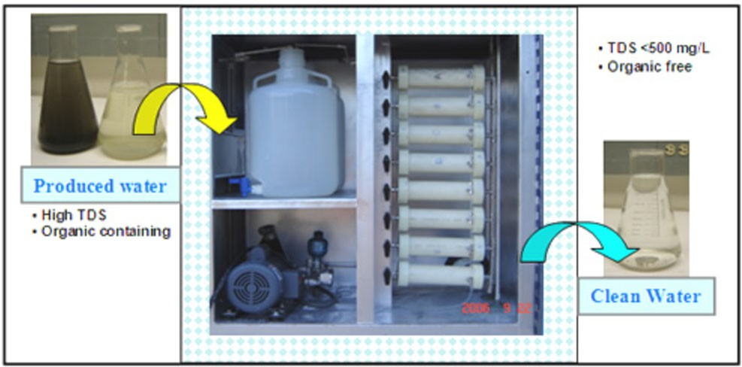
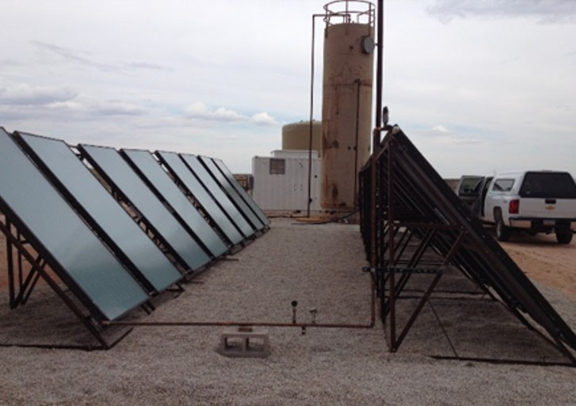





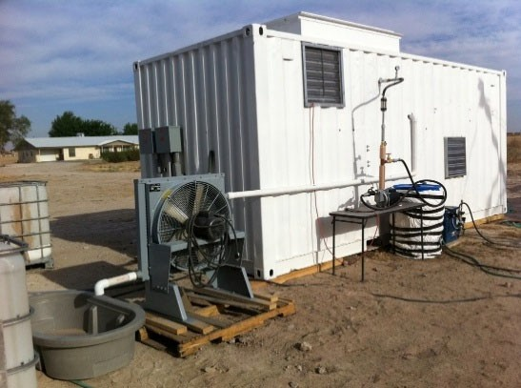
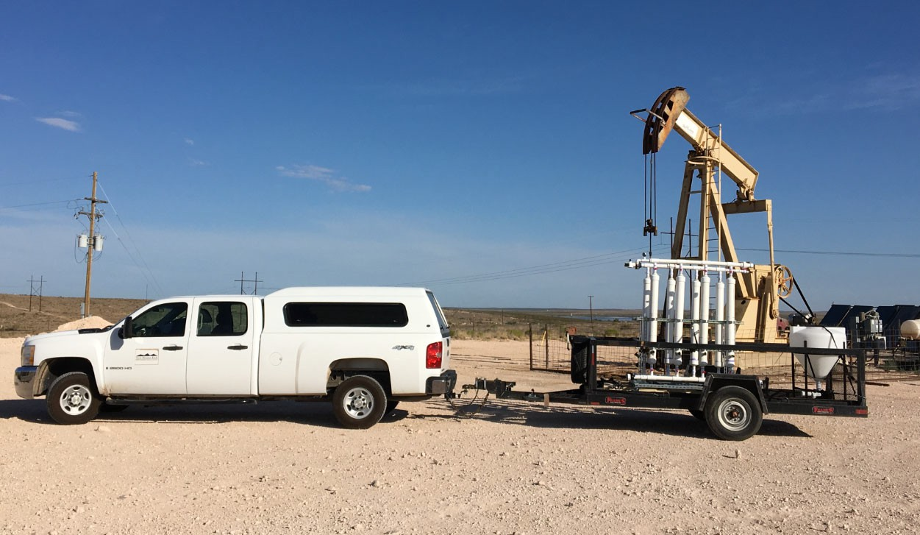
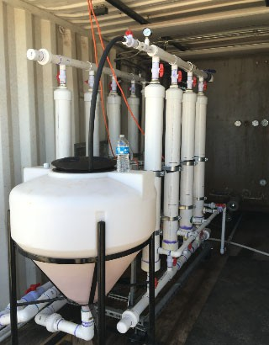
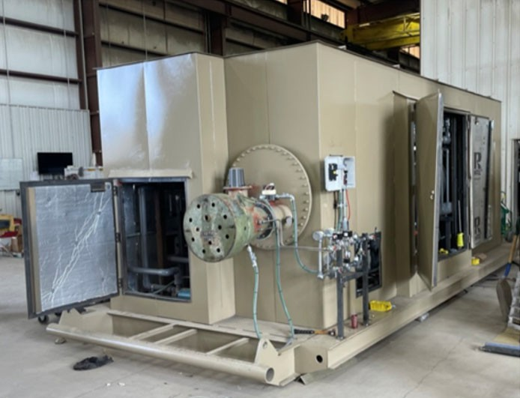
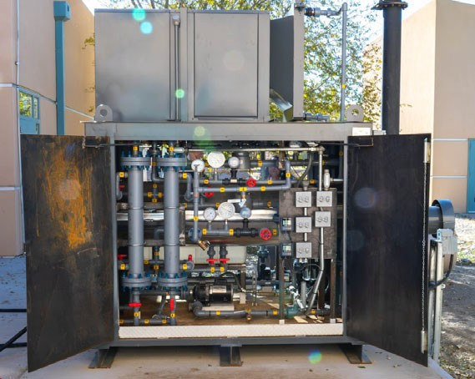
Produced Water Treatment at PRRC/NMT
(1998 - current)
1998
2009
2013
2016
2018
2021
2023

Slide 5

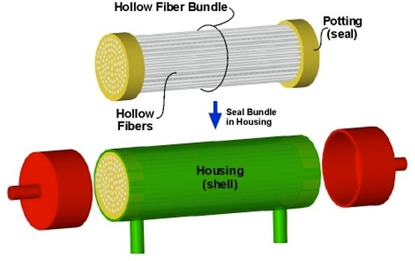
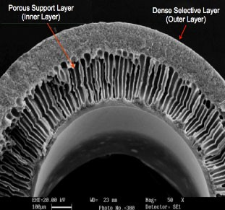
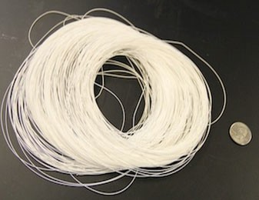
Objective: to develop novel, portable, and scalable robust hollow fiber membrane-based separation processes that convert produced water into a sustainable water resource.
Compared to flat sheet membrane:
higher productivity per unit volume (high packing density and large surface area)
For a 0.04 m³ membrane device:
HF membrane: 575 m² (90 mm in diameter);
Spiral wound fiat-sheet membrane: 30 m²;
Tubular configuration: 5 m².
Hollow fiber membranes
self-supporting
small footprint, easy to scalable
Organics removal
Desalination/ Resource Recovery
Ultrafiltration
Microfiltration
Membrane adsorption
Hybrid processes
Nanofiltration
Reverse/Forward osmosis
Membrane distillation
Hybrid processes
Hollow fiber membrane module*
* https://www.permselect.com/membranes

Slide 6
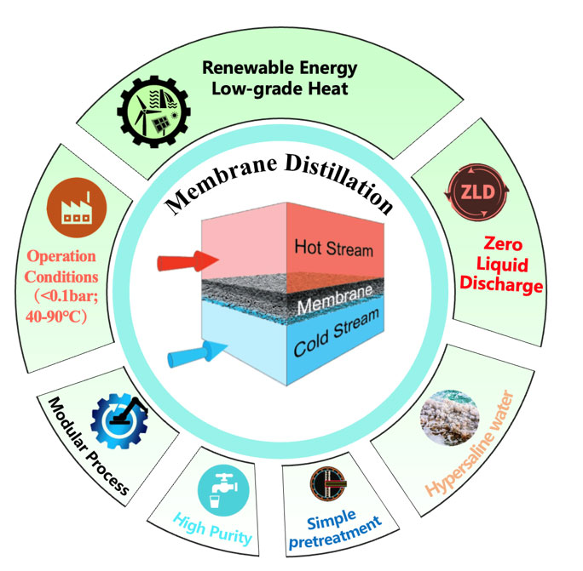
Direct Contact Membrane Distillation (DCMD)
Very few full-scale MD tests have been reported in the world.
Main challenges: (1) lack of commercially available membranes for particular use in DCMD; (2) energy consumption.

Slide 7
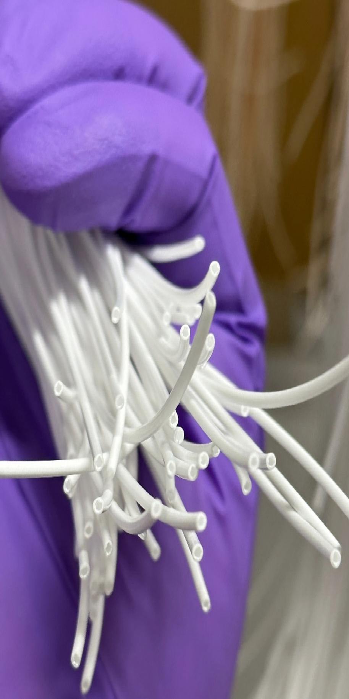
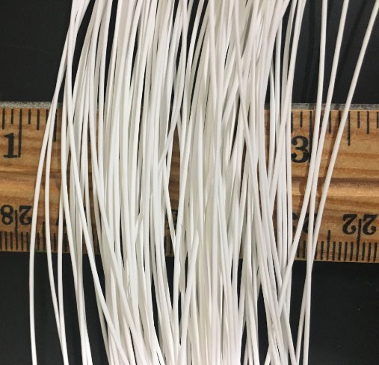
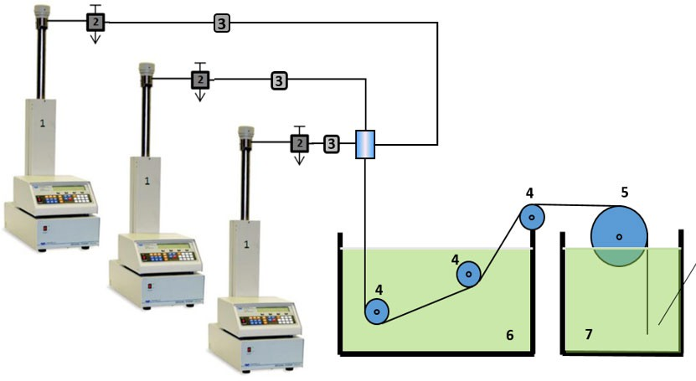

Hollow fiber membranes
Properties of the fabricated Janus hollow fiber membrane.
OD/ID/WT
Bulk Porosity Mean pore size
Effective surface Bubble point pore size LEP
(μm) | (ε, %) | porosity (ε_{e}, m⁻¹) | (d_{a}, μm) | (d_{m}, μm) | (bar)
1088/767/135 | 80.6±0.4 | 6471.3 | 0.27 | 0.40 | 1.95

Slide 8
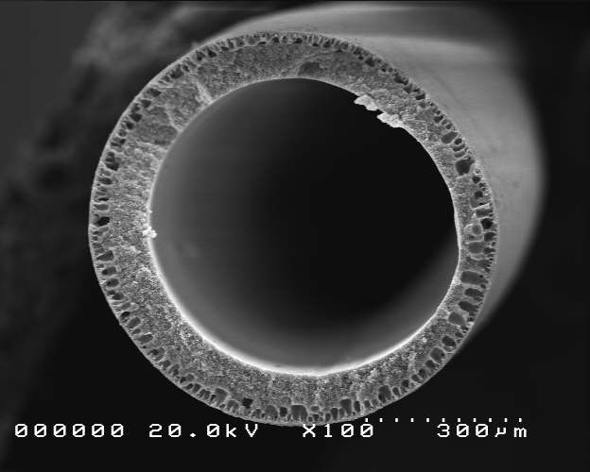
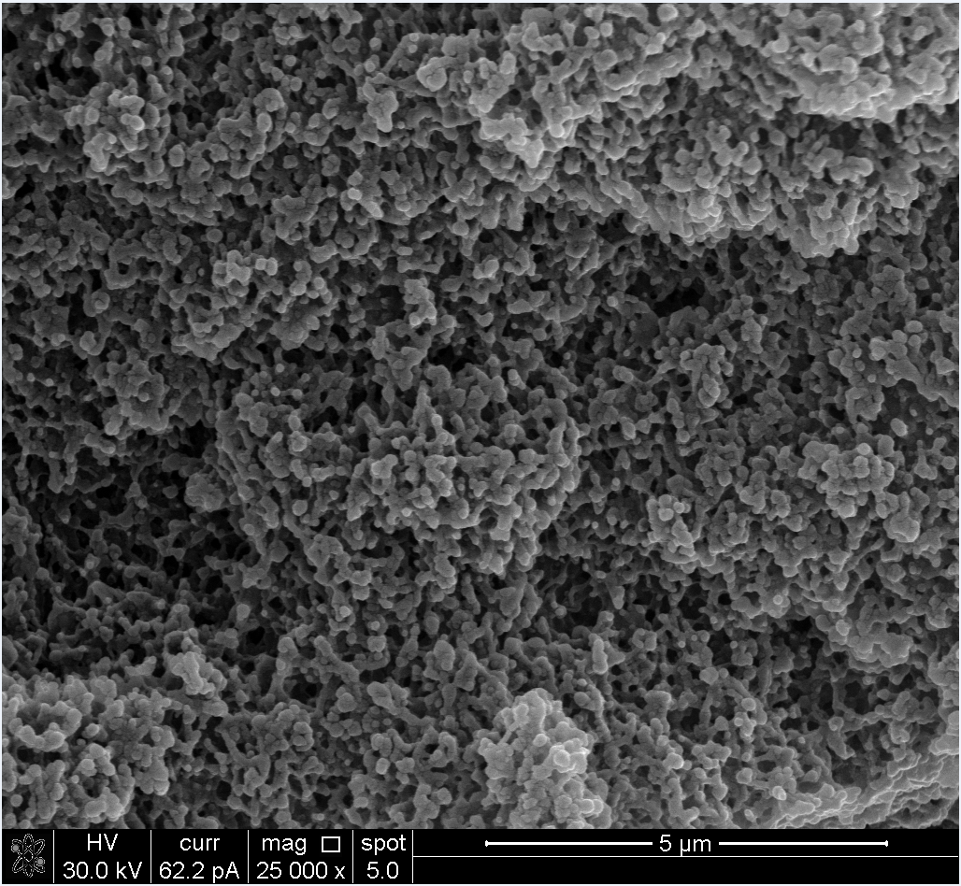
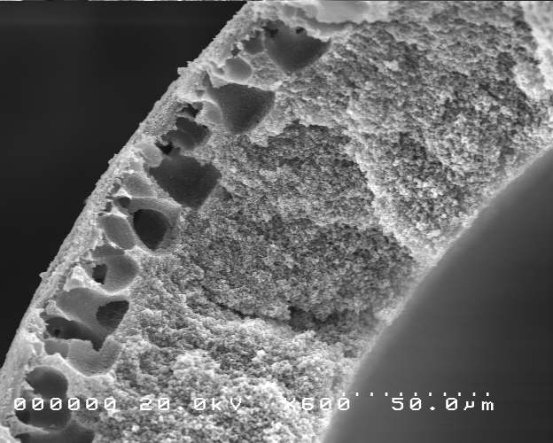

Slide 9
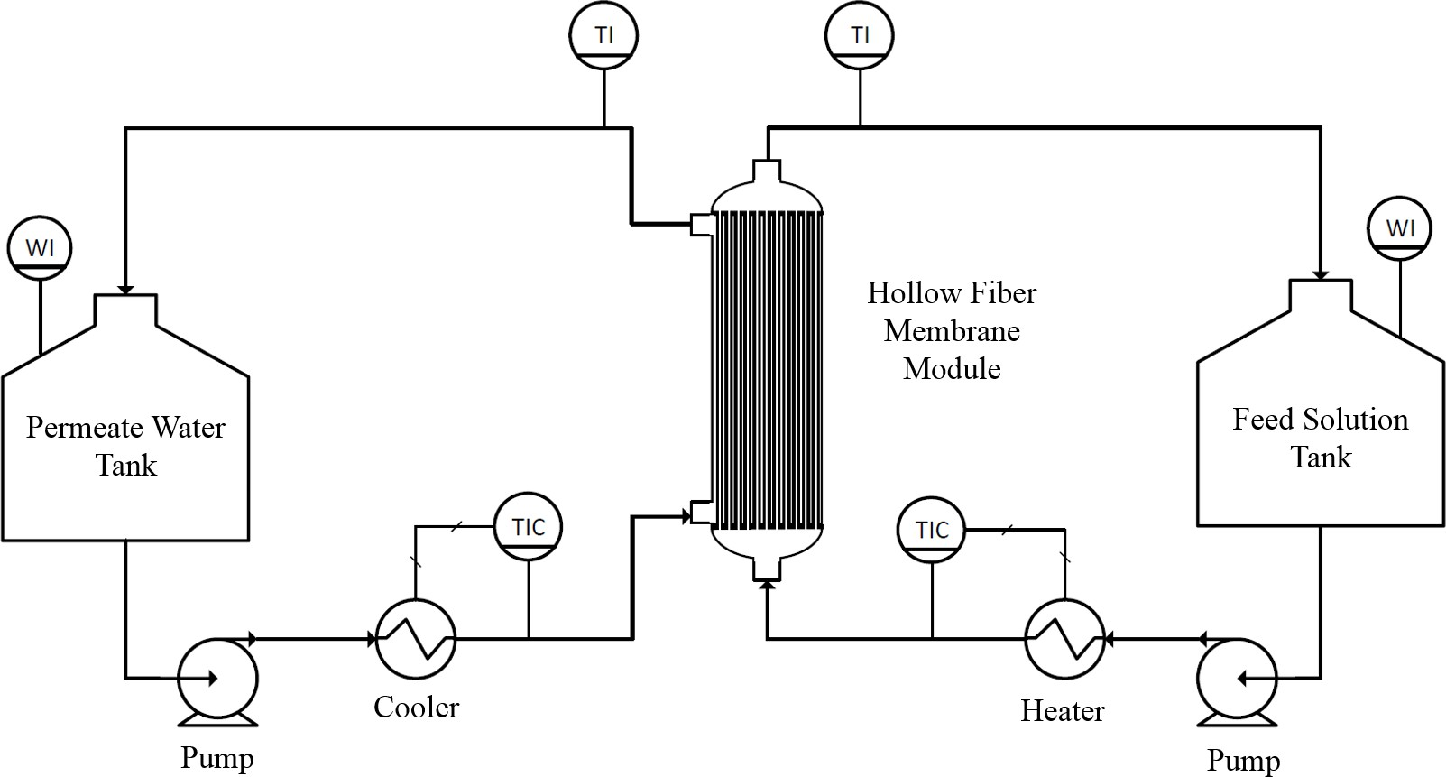
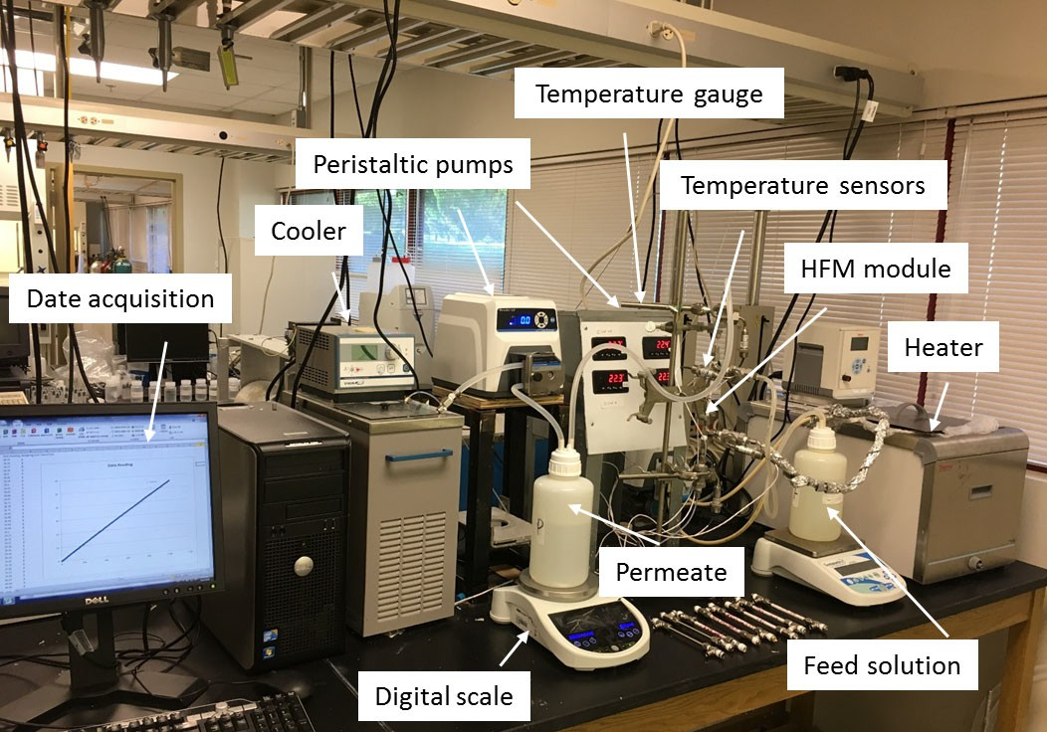
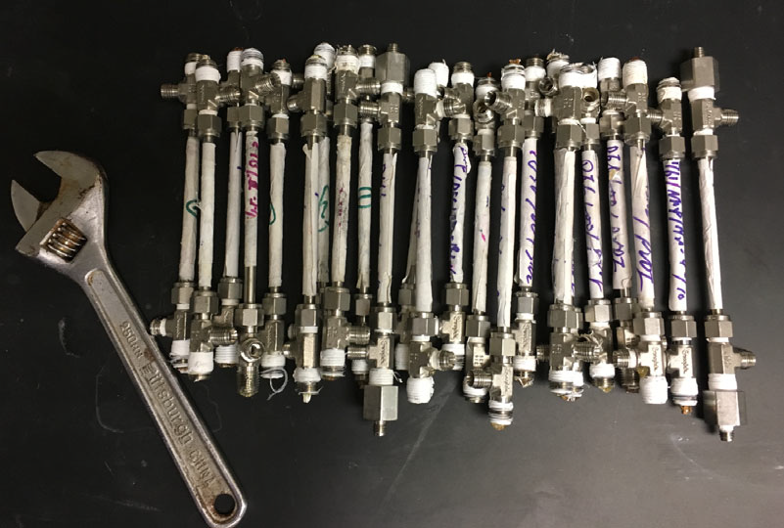
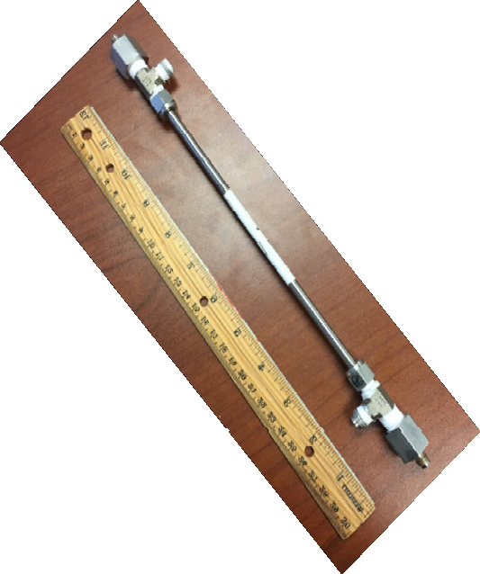
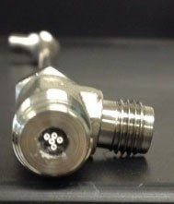
DCMD Process for PW Desalination
Membrane modules assembled for the DCMD experiments.
Apparatus of hollow fiber membrane-based DCMD process for high-salinity brines desalination.

Slide 10
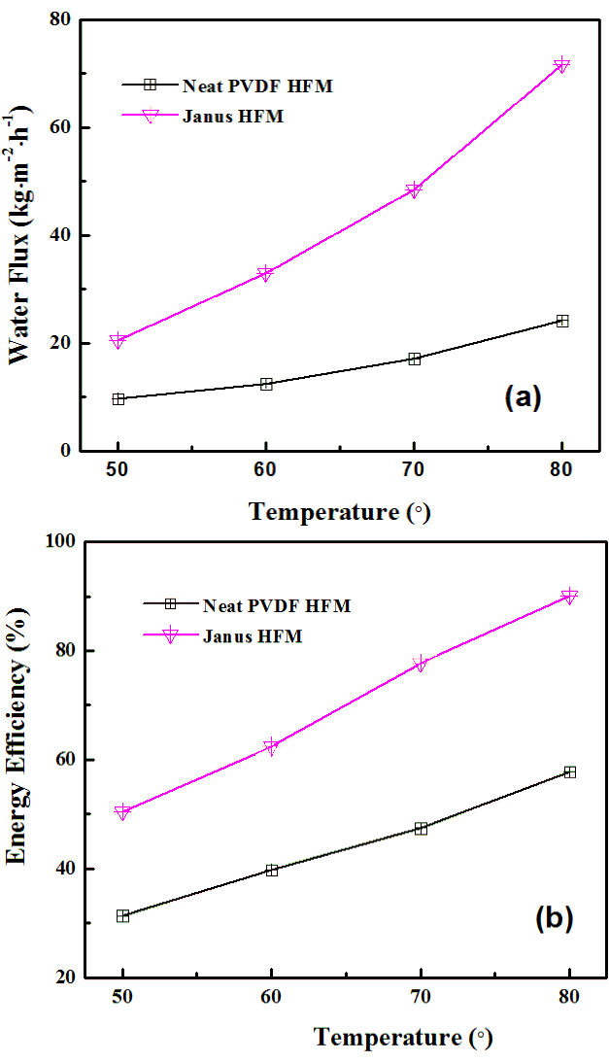
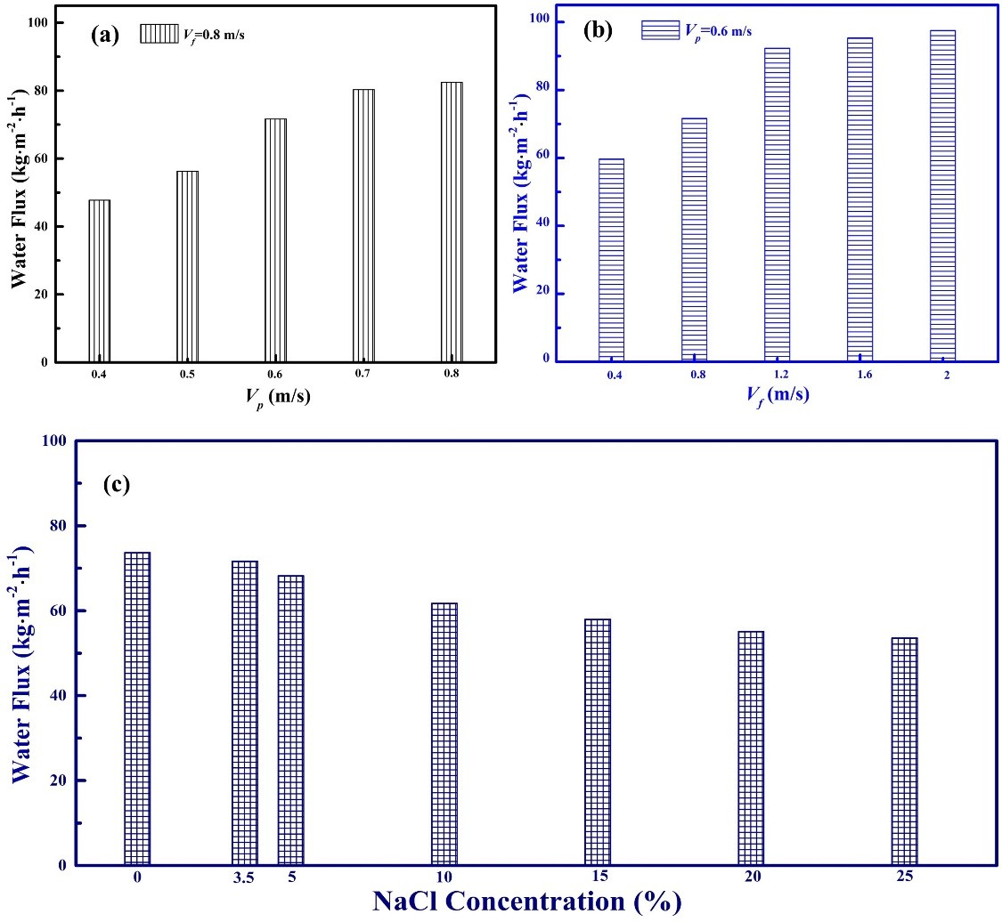
Desalination Performance Evaluation
Salt rejection: >99.9%

Slide 11
Long-term desalination performance evaluation
50
40
SW: TDS=35,000 mg/L
35
Water Flux (kg/m²h)
40
Conductivity (μS/cm)
30
30
25
Operating conditions:
T-feed: 60°C;
T-permeate: 20°C;
ν-feed: 0.8 m/s
ν -permeate: 0.6 m/s
No significant scaling and wetting during a continuous 200 hours of DCMD operation.
20
20
15
Typical drinking water: 50 - 500 µS/cm (25 °C).
10
10
5
0
0
0
20
40
60
80 100 120 140 160 180 200
Time (hr)

Slide 12
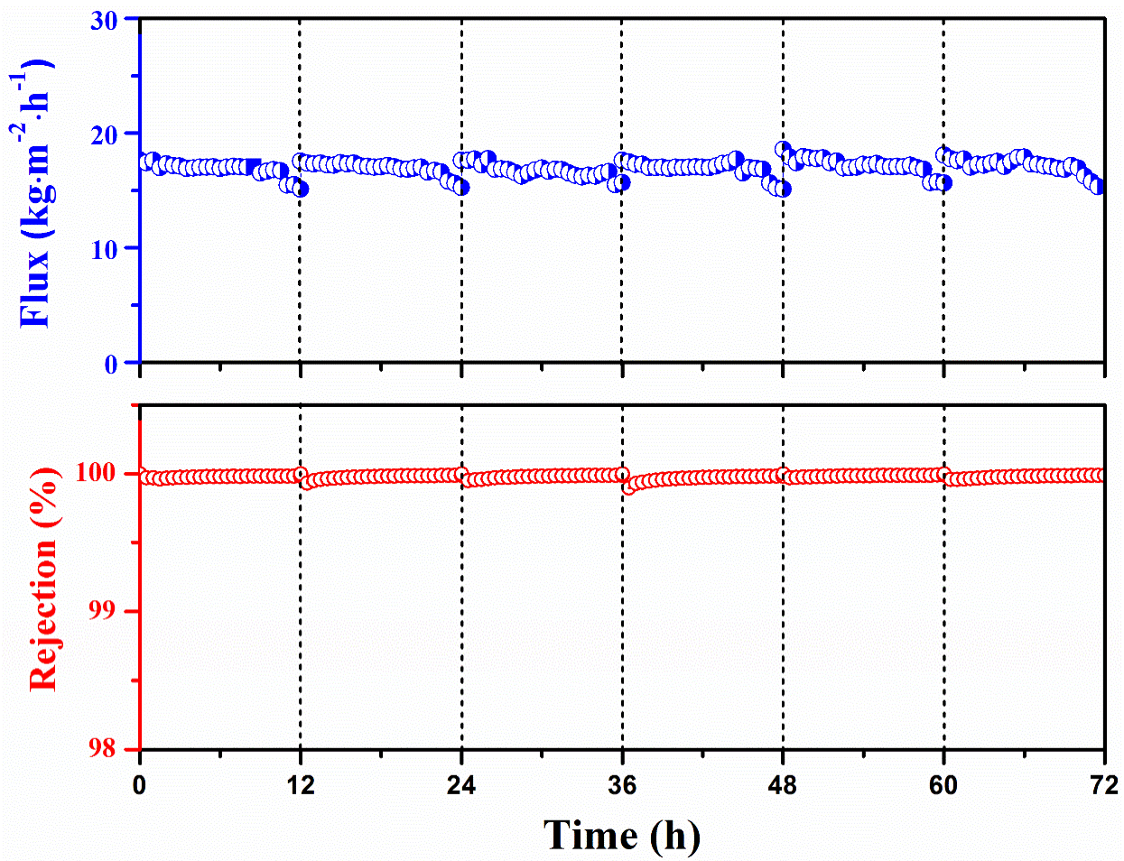
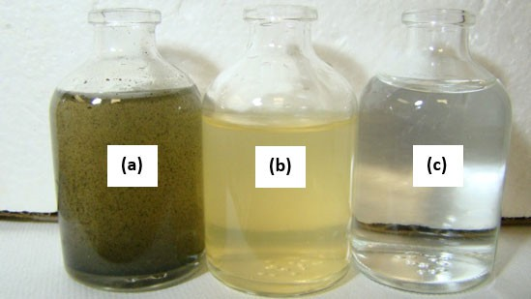
PW: TDS=155,000 mg/L NPOC=57.6 mg/L
Operating conditions:
T-Feed: 60°C;
T-Permeate: 20°C;
ν-feed: 0.4 m/s
ν -permeate: 0.4 m/s
Due to the complicate composition of PW, membrane regeneration was preformed for 30 mins every 12 hours.
No membrane wetting, the salt rejection remains higher than 99.99%.
Water samples: (a) actual oilfield produced water; (b) pre-treated with a 50 µm filter;
(c) product water.

Slide 13
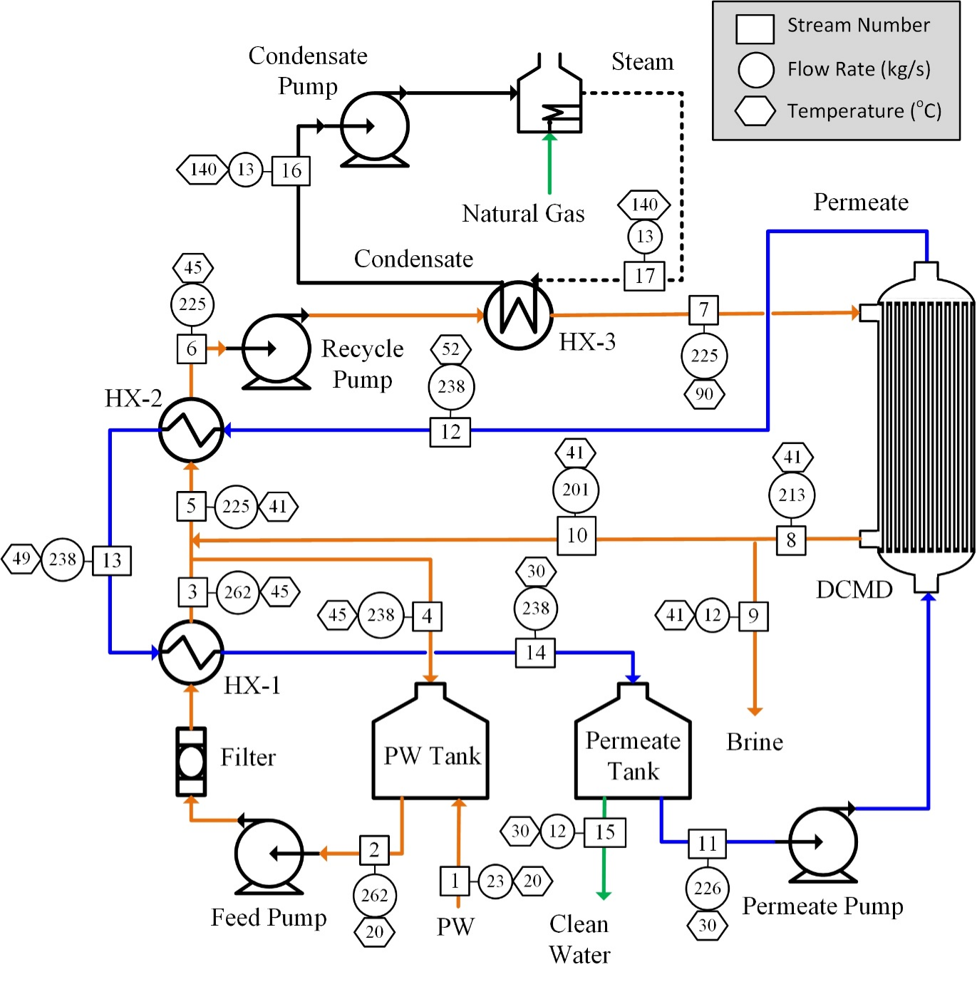
Tech-economic analysis
- Assumptions:
Plant capacity: 500,000 GPD;
Plant lifetime: 30 Years;
Plant availability: 90%; 100,000 mg/L
PW - initial TDS:;
PW – concentrated brine: 200,000 mg/L;
PW - recovered: <500 ppm;
Water recovery: 50%;
Membrane cost: $20/m²;
Membrane replacement: 20%/year;
Pretreatment: $80/m³/day;
Electricity cost: $0.069/kwh;
Steam price: $0.008/kg

Slide 14
O&M cost
Capital cost
1.0
$0.87
The cost does not include the
0.8
transportation/intake of PW to the DCMD system.
Cost ($/bbl.)
The cost does not include the transportation/disposal of the brine concentrate.
0.6
0.4
The recovery factor is 50%.
0.2
$0.10
0.0
Base case
With heat integration

Slide 15

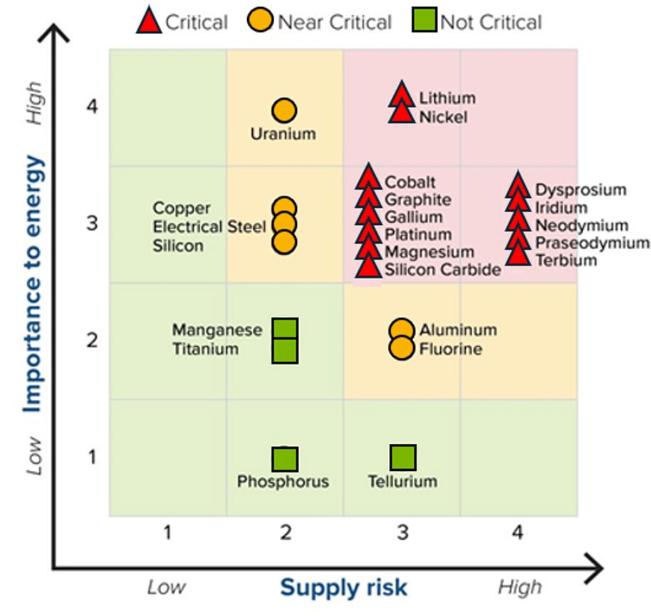
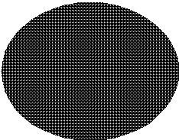
DOE list of the most important critical materials with respect to energy and supply chain risk.

Slide 16





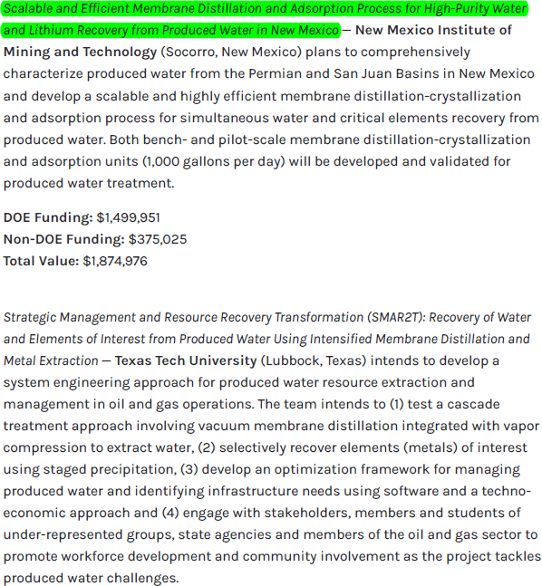
https://www.energy.gov/fecm/articles/doe-invests-additional-8-million- increase-domestic-supplies-water-and-critical

Slide 17







Acknowledgement

