Slide 1

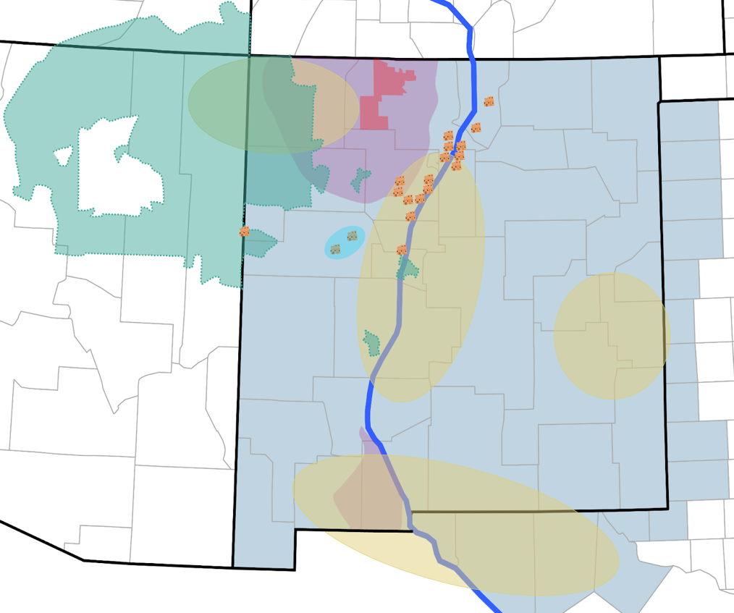


ENERGIZED WATERSHED ENGINE
  www.energizedwatershed.org
Regional Coalition to Scale & Commercialize Water and Energy Security Technologies
Problem:
      Most water stressed state in America
Resources:
      2nd largest oil producing state
      Large brackish water resources
      Solar, wind, and geothermal resources
      State government support
Strong R&D, industry, and workforce partners
Robust community engagement
Coalition of 50+ is growing
22 industry partners
5 venture capital
2 national labs
3 workforce development providers
6 state and local government entities
5 academic institutions
UT
Rio Grande
CO
Farmington
Navajo Nation
Jicarilla Apache Nation
San Juan
Aquifer
NM
Sante Fe
AZ
Albuquerque
Laguna Pueblo
City
Clovis
Community College
Utilities
NM
Socorro
TX
Testbed
Startups
Node-subregion
Future node-subregion
Mesilla Aquifer
Las Cruces
County in Region of Service Area
El Paso
Pueblos
TX
Core Partners
Rio Grande

Slide 2


WHAT ARE NSF ENGINES?
Among the largest investments in place-based research and development in the history of the US
  Up to $160 million over 10-years
Three core functions:
  Use-inspired Research & Development (R&D)
  Translation of innovation for societal benefit
  Workforce Development
Regional
Engagement
Workforce
Development
Use-Inspired
R&D
Strategic Investment & Sustainable Capital
Translation of Innovation to Practice
I N N O V A T I O N F E E D B A C K L O O P

Slide 3

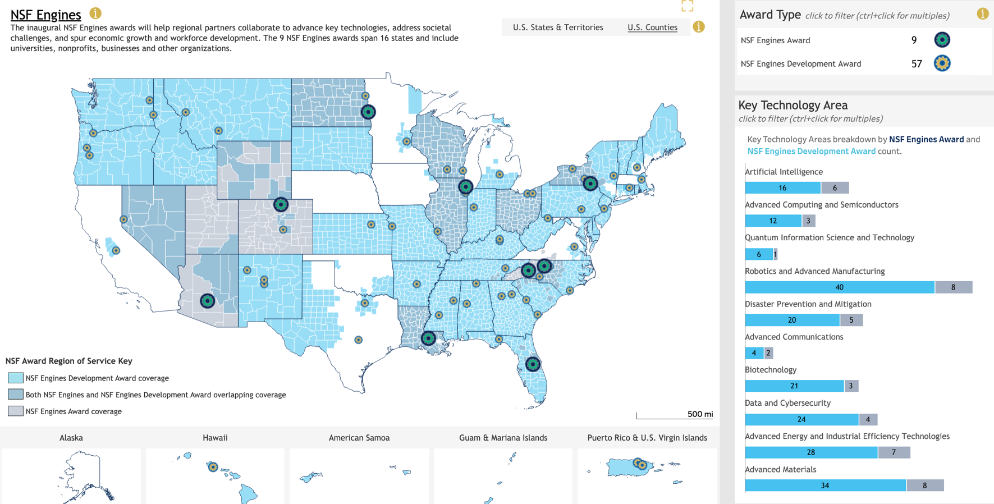
Source: https://www.nsf.gov/funding/initiatives/regional-innovation-engines/portfolio

Slide 4
Timelines
May 2022 Competition
Launch
August 2022 Proposals Encouraged
May 2023
First Dev Awards
June 2023
Engine Semi-Finalists
January 2024 Engine Awards
New Dev Awards
February 2024 Funds Arrive for New Awards
February 2026 Development Awards End
ROUND 1
CURRENT
April 2024
New Competition
Launch
August 2024 New Preproposals
October 2024
Encourage Full
Proposals
February 2024
Full proposals Due
Summer 2025 Semi-Finalists
Fall 2025 New Awards
March 2026 Funds Arrive for New awards
ROUND 2
CURRENT

Slide 5
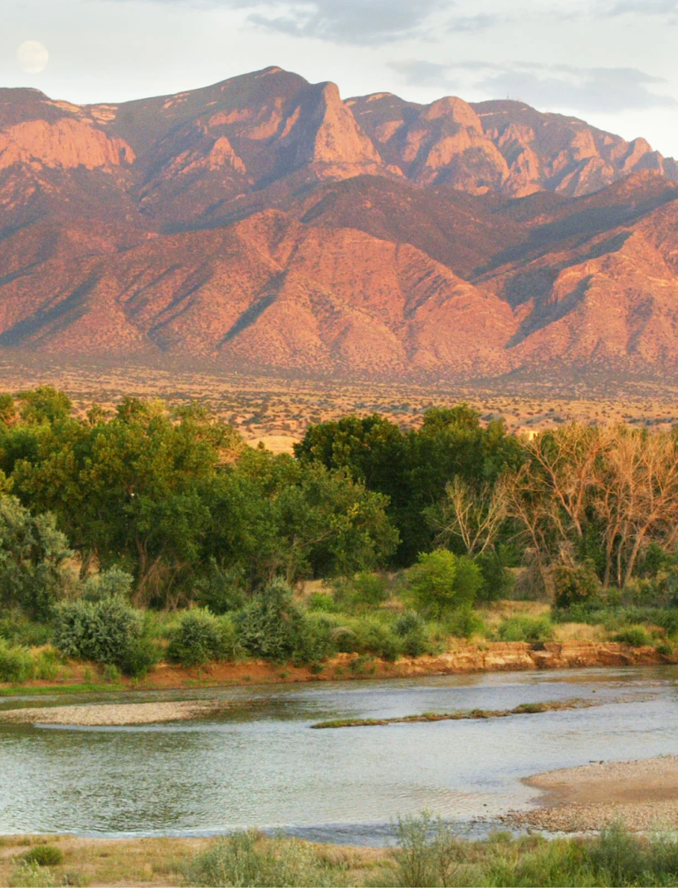
A D V A N C I N G A M E R I C A ‘ S
W A T E R A C C E S S & S E C U R I T Y
Why Us: We are the preeminent coalition of industry, National Labs, Tribal leaders, workforce developers, educators, investors, and government partners needed to create and commercialize water security technologies.
Why Now: Increased manufacturing, economic development, and population requires secure water
Water Security is:
National Security
Economic Security
Farming Security
Energy Security
Critical Materials & Minerals Security
Our Innovation and Tech Transfer Drives Water Security
3

Slide 6
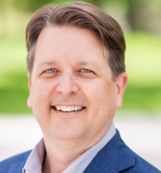
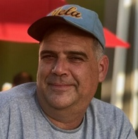
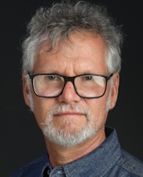
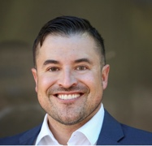

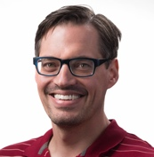
ENERGIZED WATERSHED PANEL
GOAL: By 2035, the Energized Watershed Engine is a national and global commercial hub for water security and energy technologies — accelerating market-ready innovations through deep collaboration among industry partners, regional R&D institutions, Tribes, community members across the region, and investors.
GOVENOR’S 50-YEAR WATER ACITON PLAN
Water conservation
A1 Public education campaign
A2 Agricultural water conservation
A3 Municipal conservation
A4 Water storage and delivery
New Water Supplies
B1 Desalination and water treatment
B2 Expand potable and non-potable water reuse
B3 Groundwater mapping and monitoring
Water and Watershed Protection
C1 Clean-up contaminated groundwater sites
C2 Control discharge through permitting
C3 Modernize wastewater treatment plants
C4 Protect and restore watersheds
Panel Members
David Hanson
Stephen Gomez
Alex Mayer
Ken Armijo
Source: www.nm.gov/wp-content/uploads/2024/01/New-Mexico-50-Year-WaterAction-Plan.pdf
Sundaram Arumugam
Kurt Solander

Slide 7
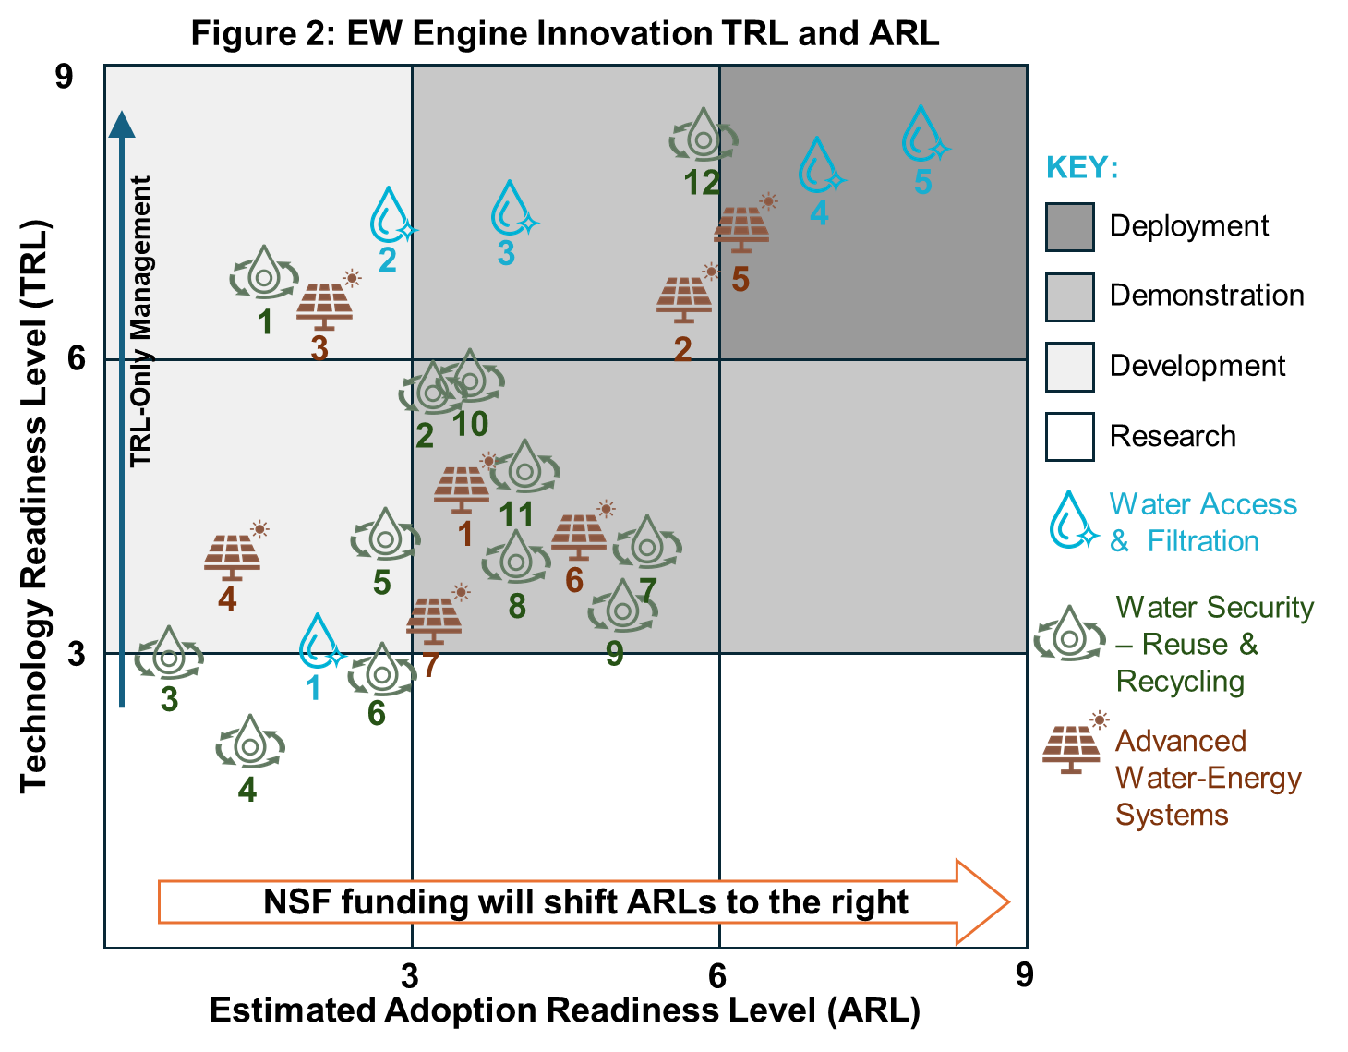
WATERSHED SCALE SOLUTIONS
10-Year Outcomes
100+ technologies commercialized
30+ scalable companies launched
$150M+ in revenue generated
50,000+ students trained
5,000 internships
50,000 new direct, indirect, induced jobs
Widespread deployment of sustainable water-energy systems
$25M–$30M in invested capital
New public-private capital models operating in region
Sovereign-led industries producing & exporting water-energy innovations
Regional models of inclusive IP ownership and governance

